Slide 1
L1 – Introduction to Chemistry
Learning Objectives:
Describe the structure of an atom.
Understand information provided by the periodic table.
Understand chemical formulae and what they represent.
Use information from the periodic table to:
Write chemical formulae
Determine the number of fundamental particles of an atom or ion
Be able to name compounds and identify them as ionic or covalent.
Be able to use the terms atom, element, molecule and compound.
Write balanced chemical equations.

Slide 2
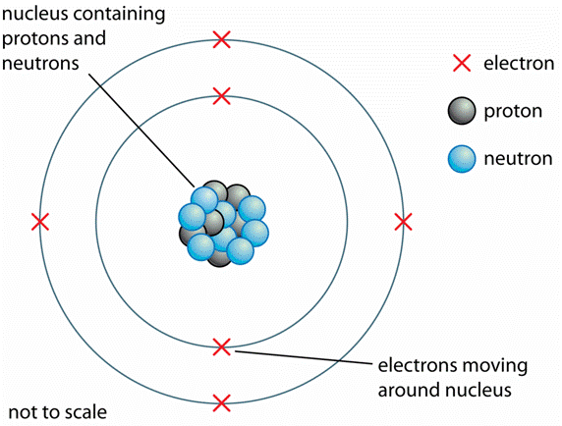
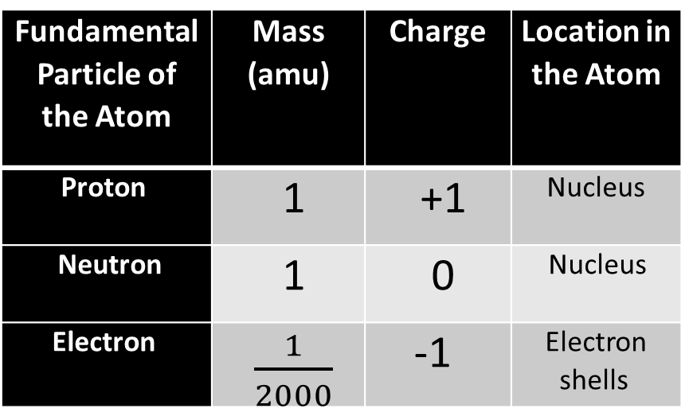
Structure of the Atom
Fundamental Particle of the Atom | Mass (amu) | Charge | Location in the Atom
Proton | 1 | +1 | Nucleus
Neutron | 1 | 0 | Nucleus
Electron | $\frac{1}{2000}$ | -1 | Electron shells
amu = atomic mass unit

Slide 3
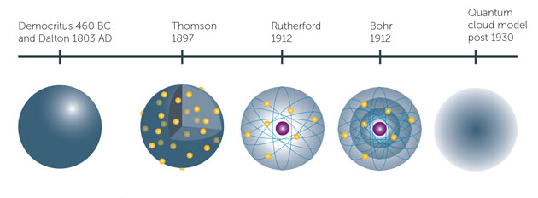
Evolution of the Structure of the Atom

Slide 4
L1 – Introduction to Chemistry
Learning Objectives:
Describe the structure of an atom.
Understand information provided by the periodic table.
Understand chemical formulae and what they represent.
Use information from the periodic table to:
Write chemical formulae
Determine the number of fundamental particles of an atom or ion
Be able to name compounds and identify them as ionic or covalent.
Be able to use the terms atom, element, molecule and compound.
Write balanced chemical equations.

Slide 5
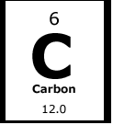
Elements
Atomic Number (Z)
(Number of protons)
Symbol
Name
Mass (A)
(protons + neutrons)

Slide 6
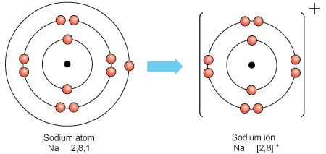
Atoms vs. Ions
An atom is neutral.
But an ion is a charged particle.
It will have a different number of electrons.

Slide 7
Fundamental Particles
 | # of Protons | # of Neutrons | # of Electrons
Na atom | 11 | 12 | 11
Na⁺ ion | 11 | 12 | 10
F atom | 9 | 10 | 9
F⁻ ion | 9 | 10 | 10
Protons = Atomic Number = Z
Neutrons = Mass Number – Atomic Number = A – Z
Electrons = Atomic Number – Charge = Z – Q
Remember that subtracting a negative number is actually addition!

Slide 8
L1 – Introduction to Chemistry
Learning Objectives:
Describe the structure of an atom.
Understand information provided by the periodic table.
Understand chemical formulae and what they represent.
Use information from the periodic table to:
Write chemical formulae
Determine the number of fundamental particles of an atom or ion
Be able to name compounds and identify them as ionic or covalent.
Be able to use the terms atom, element, molecule and compound.
Write balanced chemical equations.

Slide 9
Groups
Outer electrons
Charges

Slide 10
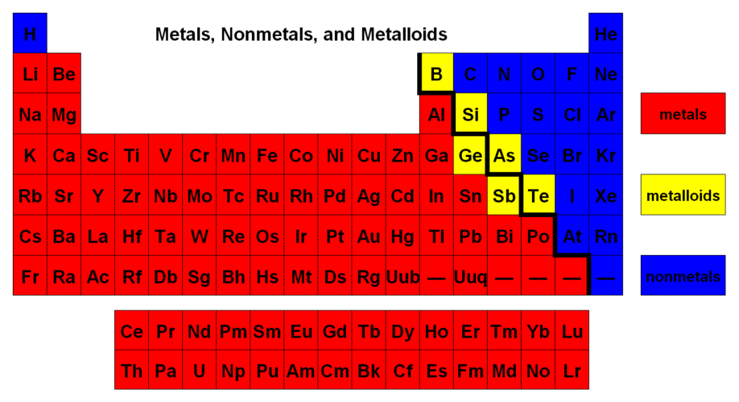

Slide 11
L1 – Introduction to Chemistry
Learning Objectives:
Describe the structure of an atom.
Understand information provided by the periodic table.
Understand chemical formulae and what they represent.
Use information from the periodic table to:
Write chemical formulae
Determine the number of fundamental particles of an atom or ion
Be able to name compounds and identify them as ionic or covalent.
Be able to use the terms atom, element, molecule and compound.
Write balanced chemical equations.

Slide 12
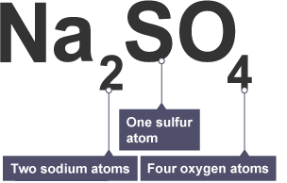
What is a chemical formula?

Slide 13
Determining Chemical Formula (Ionic)
When determining chemical formulae of ionic compounds the charges on the ions need to balance out.
Ions are charged, but ionic compounds are neutral.
Li?F?
Li⁺ ion (group 1) F⁻ ion (group 7)
(+1) + (-1) = 0
Li₁F₁ = LiF

Slide 14
Determining Chemical Formula (Ionic)
When determining chemical formulae of ionic compounds the charges on the ions need to balance out.
Ions are charged, but ionic compounds are neutral.
Li?O?
Li⁺ ion (group 1) O²⁻ ion (group 6)
(+1) + (-2) = -1 (unbalanced) → 2(+1) + (-2) = +2 – 2 = 0
Li₂O

Slide 15
Determining Chemical Formula (Ionic)
Na Cl
Mg Cl
Be N

Slide 16
Determining Chemical Formula (Ionic)
NaCl
MgCl₂
Be₃N₂

Slide 17
Determining Chemical Formula (with Compound Ions)
Na CO₃
Mg PO₄
NH₄ NO₃
Compound Ions
Carbonate = CO₃²⁻
Nitrate = NO₃⁻
Phosphate = PO₄⁻³
Sulphate = SO₄⁻²
Hydroxide = OH⁻
Ammonium = NH₄⁺

Slide 18
Determining Chemical Formula (with Compound Ions)
Na₂CO₃
Mg₃(PO₄)₂
NH₄NO₃
Compound Ions
Carbonate = CO₃²⁻
Nitrate = NO₃⁻
Phosphate = PO₄⁻³
Sulphate = SO₄⁻²
Hydroxide = OH⁻
Ammonium = NH₄⁺

Slide 19
Determining Chemical Formula (Covalent)
Nitrogen and hydrogen
Oxygen
Nitrogen

Slide 20
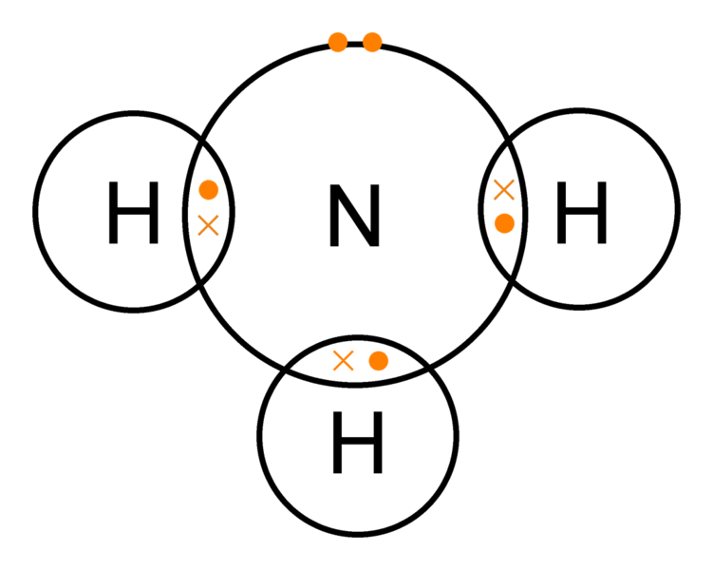
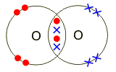
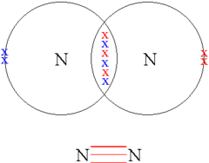
Determining Chemical Formula (Covalent)
Nitrogen and hydrogen
NH₃
Oxygen
O₂
Nitrogen
N₂

Slide 21
L1 – Introduction to Chemistry
Learning Objectives:
Describe the structure of an atom.
Understand information provided by the periodic table.
Understand chemical formulae and what they represent.
Use information from the periodic table to:
Write chemical formulae
Determine the number of fundamental particles of an atom or ion
Be able to name compounds and identify them as ionic or covalent.
Be able to use the terms atom, element, molecule and compound.
Write balanced chemical equations.

Slide 22
Naming Simple Molecules Metal + Non-Metal (Ionic)
First word: Write out the full name of the first element (metal) of the chemical formula.
Second word: Write out the root of the second element (non-metal) and add –ide to the end.
Numbers do NOT matter!
Example: MgO = magnesium oxide
CaF₂ = calcium fluoride

Slide 23
Can you figure out the roots?
Element
Hydrogen
Sulphur
Chlorine
Nitrogen
Phosphorous
Root
Hydr-
Sulph-
Chlor-
Nitr-
Phosph-

Slide 24
Name that Compound!
Chemical Formula
NaCl
CuO
KBr
CaCl₂
ZnS
Name
Sodium Chloride
Copper Oxide
Potassium Bromide
Calcium Chloride
Zinc Sulphide

Slide 25
Naming Simple Molecules Metal + Non-Metal + Oxygen (Ionic)
First word: Write out the full name of the first element (metal) of the chemical formula.
Second word: Write out the root of the second element (non-metal) and add –ate to the end.
Do not worry about number of oxygens here!
Example: MgSO₄ = magnesium sulphate
ZnNO₃ = zinc nitrate

Slide 26
Common Non-Metal + Oxygen Endings (Compound Ions)
Sulphate
Nitrate
Phosphate
Carbonate
Hydroxide
-SO₄
-NO₃
-PO₄
-CO₃
-OH

Slide 27
Name that Compound!
Chemical Formula
MgCO₃
ZnSO₄
Na₂SO₄
LiNO₃
Ca₃(PO₄)₂
Name
Magnesium Carbonate
Zinc Sulphate
Sodium Sulphate
Lithium Nitrate
Calcium Phosphate

Slide 28
Naming Simple Molecules Non-Metal + Non-Metal (Covalent)
1. First word: Prefix (unless its 1) + Write out the full name of the first element of the chemical formula.
2. Second word:
a. Look at the number of atoms and write the correct prefix.
b. Write out the root of the second element and add –ide to the end.
Example: CO₂ = carbon dioxide N₄Cl₈ = Tetranitrogen octachloride

Slide 29
Can you figure out the prefix?
Number
One
Two
Three
Four
Five
Six
Seven
Eight
Nine
Ten
Prefix
Mono-
Di-
Tri-
Tetra-
Penta-
Hex-
Hept-
Oct-
Non-
Dec-

Slide 30
Name that Compound!
Chemical Formula
NO
SO₂
CO
CCl₄
Name
Nitrogen Monoxide
Sulphur Dioxide
Carbon Monoxide
Carbon Tetrachloride

Slide 31
Name the following compounds
LiCl
CaF₂
KBr
BaO
MgCO₃
ZnSO₄
ZnSO₃
WCl₃
AlPO₄
NaNO₃
Lithium Chloride
Calcium Fluoride
Potassium Bromide
Barium Oxide
Magnesium Carbonate
Zinc Sulphate
Zinc Sulphite
Tungsten Chloride
Aluminium Phosphate
Sodium Nitrate
Notes:
Students should try to name these on their own to check their understanding

Slide 32
Name the following compounds
CO
SF₆
SO₂
SiCl₄
P₄O₁₀
NH₃
PBr₅
PCl₃
SiO₂
XeF₆
Carbon Monoxide
Sulphur Hexafluoride
Sulphur Dioxide
Silicon Tetrachloride
Tetraphosphorus Decaoxide
Nitrogen Trihyride
Phosphorous Pentabromide
Phosphorous Trichloride
Silicon Dioxide
Xenon Hexafluoride
Notes:
Students should try to name these on their own to check their understanding

Slide 33
What is the formula?
Silicon tetrafluoride
Nitrogen dioxide
Disulphur dichloride
Arsenic trihydride
Radon difluoride

Slide 34
L1 – Introduction to Chemistry
Learning Objectives:
Describe the structure of an atom.
Understand information provided by the periodic table.
Understand chemical formulae and what they represent.
Use information from the periodic table to:
Write chemical formulae
Determine the number of fundamental particles of an atom or ion
Be able to name compounds and identify them as ionic or covalent.
Be able to use the terms atom, element, molecule and compound.
Write balanced chemical equations.

Slide 35
Definitions
Atom = smallest unique particle of an element
Element = one type of atom with a specific proton number
Molecule = two or more atoms (of any kind) chemically bonded together
Compound = a substance made of two or more atoms of different elements chemically bonded together

Slide 36
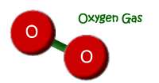
Examples of Use
This is a molecule of elemental oxygen.

Slide 37
Examples of Use
This is a molecule of the compound methane.

Slide 38
L1 – Introduction to Chemistry
Learning Objectives:
Describe the structure of an atom.
Understand information provided by the periodic table.
Understand chemical formulae and what they represent.
Use information from the periodic table to:
Write chemical formulae
Determine the number of fundamental particles of an atom or ion
Be able to name compounds and identify them as ionic or covalent.
Be able to use the terms atom, element, molecule and compound.
Write balanced chemical equations.

Slide 39
Balanced Equations
In a chemical reaction, atoms are not created or destroyed, only rearranged.
This is the law of conservation of mass.
This is why an equation has to be balanced.
Methane + Oxygen → Carbon Dioxide + Water
_ CH₄ + _ O₂ → _ CO₂ + _ H₂O

Slide 40
L1 – Introduction to Chemistry
Learning Objectives:
Describe the structure of an atom.
Understand information provided by the periodic table.
Understand chemical formulae and what they represent.
Use information from the periodic table to:
Write chemical formulae
Determine the number of fundamental particles of an atom or ion
Be able to name compounds and identify them as ionic or covalent.
Be able to use the terms atom, element, molecule and compound.
Write balanced chemical equations.

Slide 41
Homework
Revise material from today’s lesson.
Read Unit 1, Section 1-1 and 1-2 (pg. 12-16) in the textbook.
Write revision notes.
Learn the names and symbols of the first 36 elements.
There will be a quiz at the beginning of every lesson.
Looking ahead: Read Section 1-3, 1-4, 1-5 (pg. 17-24).

