Slide 1
Topic 2 – Amount of Substance
L1: The Mole and the Ideal Gas Equation
Learning Objectives:
Understand the concept of the mole as a unit of amount of substance.
Use the Avogadro’s constant to calculate number of particles.
Convert between mass and moles, using Mr.
Carry out calculations using concentration, volume, and amount of substance.
Use the ideal gas equation for calculations.

Slide 2
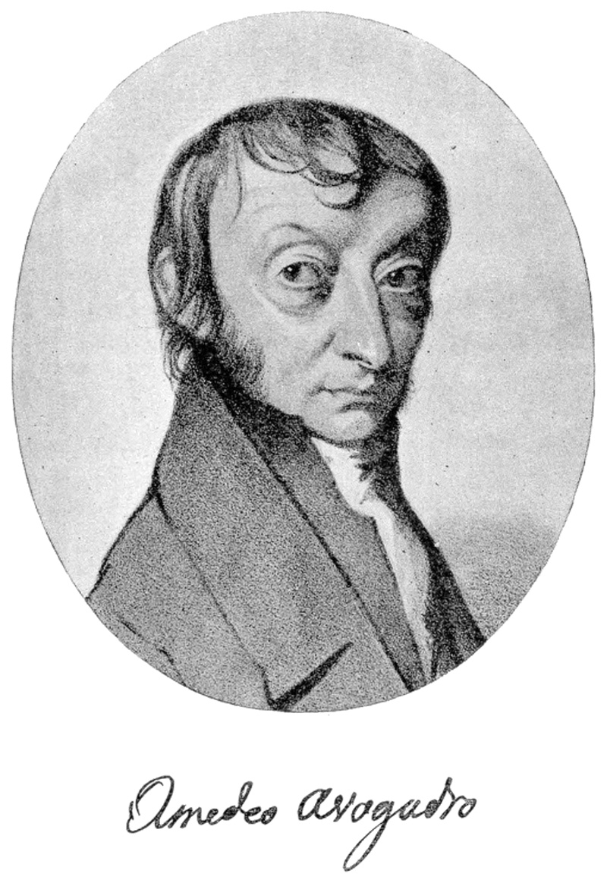

The Mole and Avogadro’s Constant
Note: You will be given the value for constants in an exam.
The mole (n) is a unit for measuring amount of substance.
Avogadro’s constant = 6.02 x 10²³
1 mole = 6.02 x 10²³ particles
This applies to all particles; atoms, ions, or molecules.

Slide 3
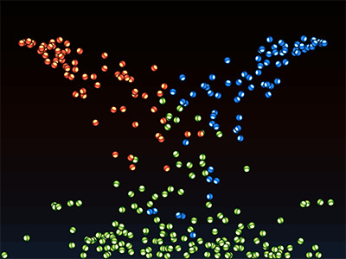
Calculating Number of Particles
Number of particles = number of moles x Avogadro’s constant

Slide 4
Let’s calculate!
Complete Q1-2 on pg. 39
1. How many molecules are in 0.360 moles of H2O?
(0.360)(6.02 x 10²³) = 2.17 x 10²³ molecules
2. How many ions are in 0.0550 moles of magnesium ions?
(0.0550)(6.02 x 10²³) = 3.31 x 10²² molecules
Use standard form and correct number of significant figures.

Slide 5

Topic 2 – Amount of Substance
L1: The Mole and the Ideal Gas Equation
Learning Objectives:
Understand the concept of the mole as a unit of amount of substance.
Use the Avogadro’s constant to calculate number of particles.
Convert between mass and moles, using Mr.
Carry out calculations using concentration, volume, and amount of substance.
Use the ideal gas equation for calculations.

Slide 6
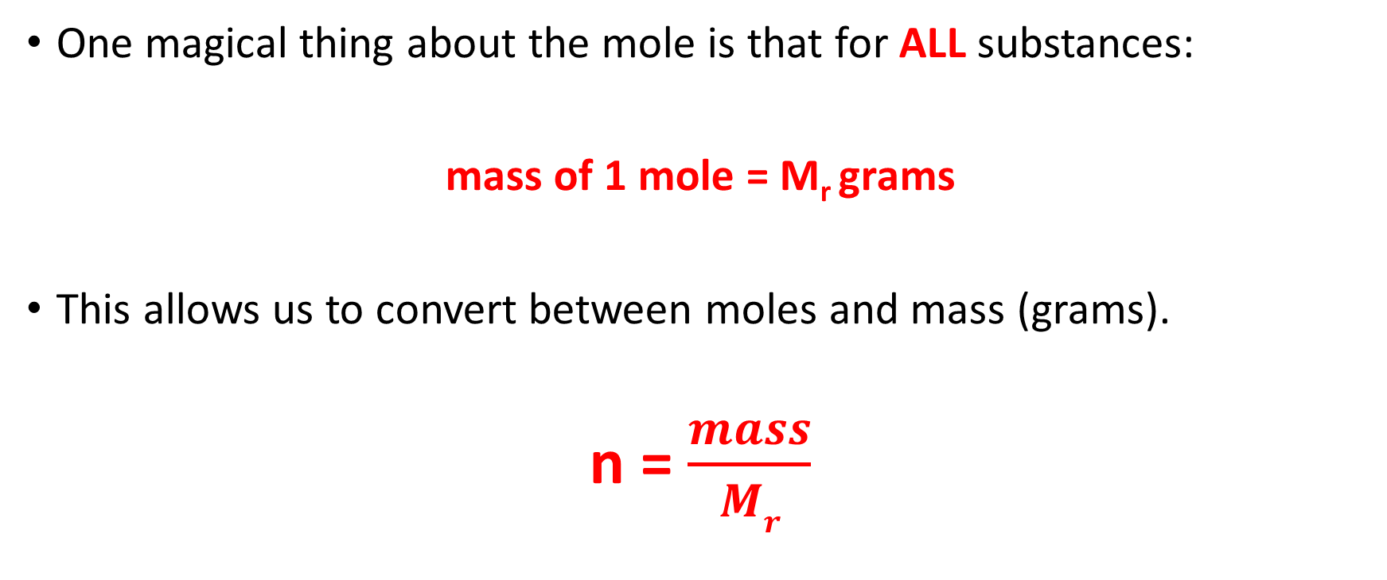
Using the mole and Mr
One magical thing about the mole is that for ALL substances:
mass of 1 mole = M_{r} grams
This allows us to convert between moles and mass (grams).
n = $\frac{mass}{Mr}$

Slide 7
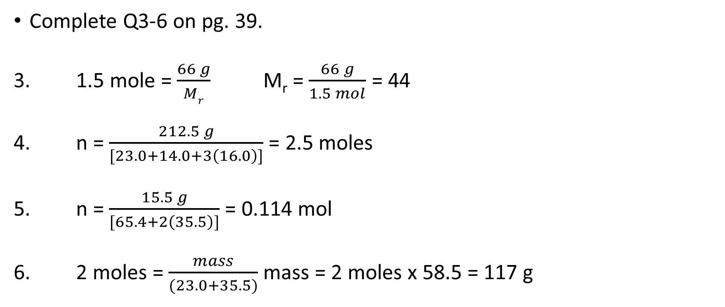
Let’s calculate
Complete Q3-6 on pg. 39.
3. 1.5 mole = $\frac{66 g}{Mr}$ M_{r} = $\frac{66 g}{1.5 mol}$ = 44
4. n = $\frac{212.5 g}{[23.0+14.0+3\left(16.0\right)]}$ = 2.5 moles
5. n = $\frac{15.5 g}{[65.4+2\left(35.5\right)]}$ = 0.114 mol
6. 2 moles = $\frac{mass}{(23.0+35.5)}$ mass = 2 moles x 58.5 = 117 g

Slide 8
Topic 2 – Amount of Substance
L1: The Mole and the Ideal Gas Equation
Learning Objectives:
Understand the concept of the mole as a unit of amount of substance.
Use the Avogadro’s constant to calculate number of particles.
Convert between mass and moles, using Mr.
Carry out calculations using concentration, volume, and amount of substance.
Use the ideal gas equation for calculations.

Slide 9
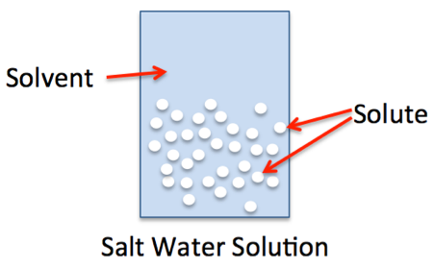
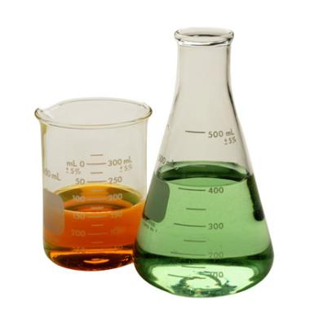
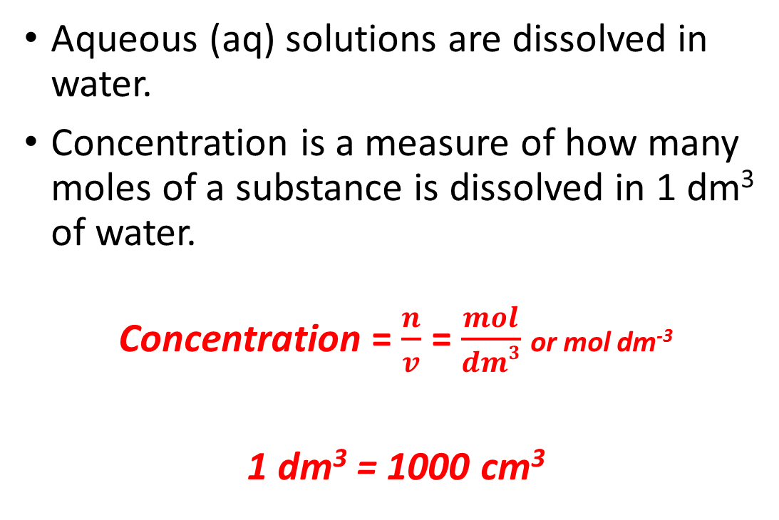
Moles and Concentration
Aqueous (aq) solutions are dissolved in water.
Concentration is a measure of how many moles of a substance is dissolved in 1 dm³ of water.
Concentration = $\frac{n}{v}$ = $\frac{mol}{dm3}$ or mol dm⁻³
1 dm³ = 1000 cm³

Slide 10
Let’s Calculate!
Complete Q1, 6, 7, 9, and 11 on pg. 41.

Slide 11
Topic 2 – Amount of Substance
L1: The Mole and the Ideal Gas Equation
Learning Objectives:
Understand the concept of the mole as a unit of amount of substance.
Use the Avogadro’s constant to calculate number of particles.
Convert between mass and moles, using Mr.
Carry out calculations using concentration, volume, and amount of substance.
Use the ideal gas equation for calculations.

Slide 12
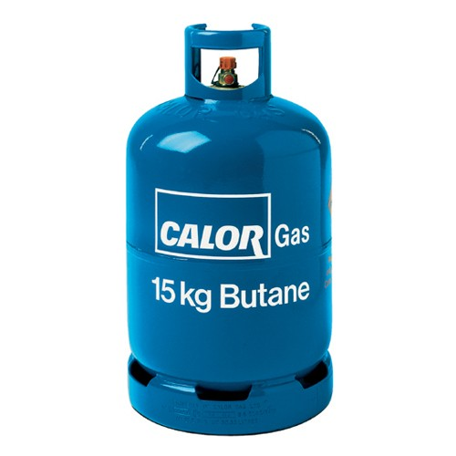
Gases
You can also use moles to carry out calculations on gases.
What other measurements do you think we might need to use?

Slide 13
The Ideal Gas Equation
moles
Gas Constant
8.31 JK⁻¹ mol⁻¹
pV = nRT
The ideal gas law is used to relate pressure, volume, moles, and temperature.
BE CAREFUL WITH UNITS!
Volume
m³
Pressure Pascals (Pa)
Temperature Kelvins (K)

Slide 14
Let’s Calculate!
Complete Q1, 2, 4, 7 on pg. 43.

Slide 15
Topic 2 – Amount of Substance
L1: The Mole and the Ideal Gas Equation
Learning Objectives:
Understand the concept of the mole as a unit of amount of substance.
Use the Avogadro’s constant to calculate number of particles.
Convert between mass and moles, using Mr.
Carry out calculations using concentration, volume, and amount of substance.
Use the ideal gas equation for calculations.

Slide 16
Homework
Revise Section 2.1-2.2 (pg. 38-43), make revision notes, and complete any questions we did not do in class for extra practice.
Looking ahead:
Read Sections 2.3,2.4, and 2.6.
Pay close attention to the worked examples.

