Slide 1
L2: Equations and Calculations
Learning Objectives:
Explain the difference between empirical and molecular formula.
Calculate molecular formula given empirical formula and M_{r}.
Calculate empirical formula give data about mass.
Write balanced equations and ionic equations.
Use balanced equations to calculate:
Masses
Volumes of gases
Concentrations and volumes for solutions

Slide 2
Empirical Formula vs Molecular Formula
Molecular formula = actual number of atoms of each element in a compound
Empirical formula = the simplest whole number ratio of atoms of each element in a compound
Molecular Formula
C₆H₁₂O₆
Empirical Formula
CH₂O

Slide 3
L2: Equations and Calculations
Learning Objectives:
Explain the difference between empirical and molecular formula.
Calculate molecular formula given empirical formula and M_{r}.
Calculate empirical formula give data about mass.
Write balanced equations and ionic equations.
Use balanced equations to calculate:
Masses
Volumes of gases
Concentrations and volumes for solutions

Slide 4
Calculating Molecular Formula Using Empirical Formula and M_{r}
Find the empirical mass (add up the A_{r} for the empirical formula).
Divide the molecular mass, M_{r} , by the empirical mass.
Multiply the empirical mass by the multiple found in step 2.
Empirical Formula: CH₂O Mr = 180
Empirical Mass = 12.0 + 2(1.0) + 16.0 = 30
180 / 30 = 6 → molecular formula contains 6x the atoms
Molecular Formula: C₆H₁₂O₆

Slide 5
Let’s Calculate!
Complete Q1 and 4 on pg. 55.
Check answers in the back of the book.

Slide 6
L2: Equations and Calculations
Learning Objectives:
Explain the difference between empirical and molecular formula.
Calculate molecular formula given empirical formula and M_{r}.
Calculate empirical formula give data about mass.
Write balanced equations and ionic equations.
Use balanced equations to calculate:
Masses
Volumes of gases
Concentrations and volumes for solutions

Slide 7
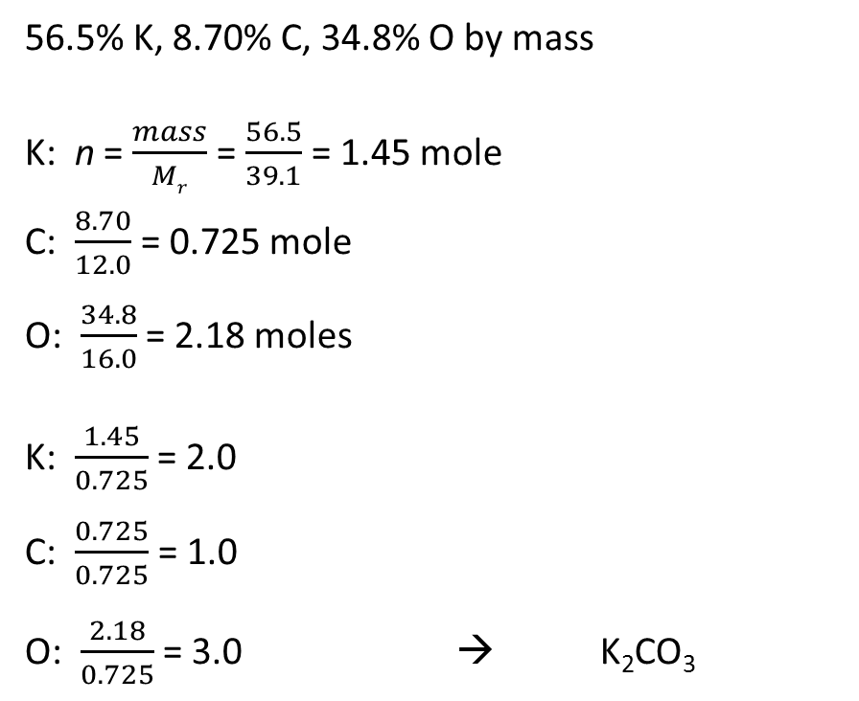
Calculating Empirical Formula from Mass
If percentages given, assume the percentages are masses in grams.
Work out how many moles, n, there are of each element.
Divide the n for each element by the smallest number to work out the ratios.
Apply the ratio to the formula.
56.5% K, 8.70% C, 34.8% O by mass
K: n = $\frac{mass}{Mr}$ = $\frac{56.5}{39.1}$ = 1.45 mole
C: $\frac{8.70}{12.0}$ = 0.725 mole
O: $\frac{34.8}{16.0}$ = 2.18 moles
K: $\frac{1.45}{0.725}$ = 2.0
C: $\frac{0.725}{0.725}$ = 1.0
O: $\frac{2.18}{0.725}$ = 3.0 → K₂CO₃

Slide 8
Let’s calculate!
Complete Q1, 3, and 5 on pg. 57.

Slide 9
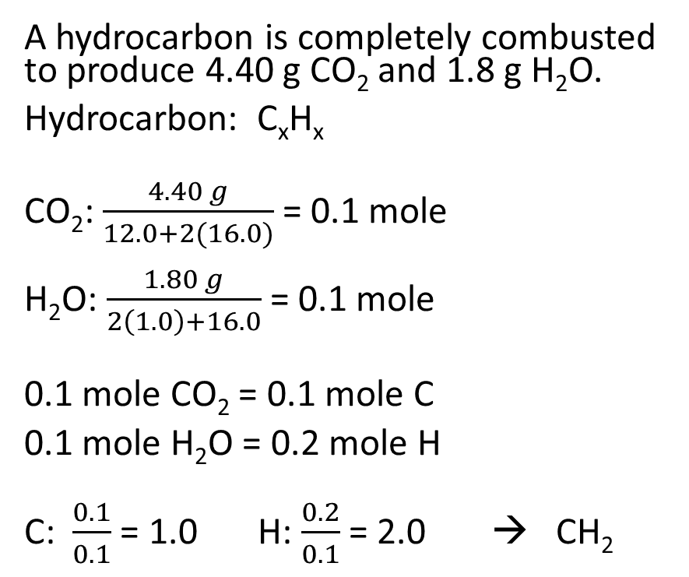
Calculating Empirical Formula from Masses in a Reaction
A hydrocarbon is completely combusted to produce 4.40 g CO₂ and 1.8 g H₂O.
Hydrocarbon: C_{x}H_{x}
CO₂: $\frac{4.40 g}{12.0+2(16.0)}$ = 0.1 mole
H₂O: $\frac{1.80 g}{2\left(1.0\right)+16.0}$ = 0.1 mole
0.1 mole CO₂ = 0.1 mole C
0.1 mole H₂O = 0.2 mole H
C: $\frac{0.1}{0.1}$ = 1.0 H: $\frac{0.2}{0.1}$ = 2.0 → CH₂
Calculate the number of moles of given compounds.
Calculate the number of moles of each element in your empirical formula.
Divide number of moles by the smallest to find the ratio.
Apply the ratio to the formula.

Slide 10
Let’s Calculate!
Complete Q7, 8, 9 on pg. 57.

Slide 11
L2: Equations and Calculations
Learning Objectives:
Explain the difference between empirical and molecular formula.
Calculate molecular formula given empirical formula and M_{r}.
Calculate empirical formula give data about mass.
Write balanced equations and ionic equations.
Use balanced equations to calculate:
Masses
Volumes of gases
Concentrations and volumes for solutions

Slide 12
Balancing Equations
Balanced chemical equations have to have the same number of atoms on each side of the reaction.
Don’t forget to use state symbols: (g), (l), (s), and (aq)
__CH_{4 (g)} + __O_{2 (g)} → __CO_{2 (g)} + __H₂O _{(g)}

Slide 13
Let’s Balance!
Complete Q1 on pg. 45.

Slide 14
Ionic Equations
HNO₃ _{(aq)} + NaOH _{(aq)} → NaNO_{3 (aq)} + H₂O _{(l)}
H⁺ + NO₃⁻ + Na⁺ + OH⁻ → Na⁺ + NO₃⁻ + H₂O
H⁺ + OH⁻ → H₂O
Na₃PO_{4 (aq)} + CaCl_{2 (aq)} → NaCl _{(aq)} + Ca₃(PO₄)_{2 (s)}
2Na₃PO_{4 (aq)} + 3CaCl_{2 (aq)} → 6NaCl _{(aq)} + Ca₃(PO₄)_{2 (s)}
6Na⁺ + 2PO₄³⁻ + 3Ca²⁺ + 6Cl⁻ → 6Na⁺ + 6Cl⁻ + Ca₃(PO₄)₂
2PO₄³⁻ + 3Ca²⁺ → Ca₃(PO₄)₂
Ionic equations can be written for reactions involving ions.
In ionic equations only the reacting particles and their products are included.
Spectator ions, ions that remain in solution unchanged, are removed.
Writing Ionic Equations:
Balance the equation.
Rewrite all dissolved ions (aq) separately.
Cross out any ions that appear unchanged on both sides.
Rewrite the equation without the spectator ions.

Slide 15
Let’s try it!
Complete Q2 on pg. 45.

Slide 16
L2: Equations and Calculations
Learning Objectives:
Explain the difference between empirical and molecular formula.
Calculate molecular formula given empirical formula and M_{r}.
Calculate empirical formula give data about mass.
Write balanced equations and ionic equations.
Use balanced equations to calculate:
Masses
Volumes of gases
Concentrations and volumes for solutions

Slide 17
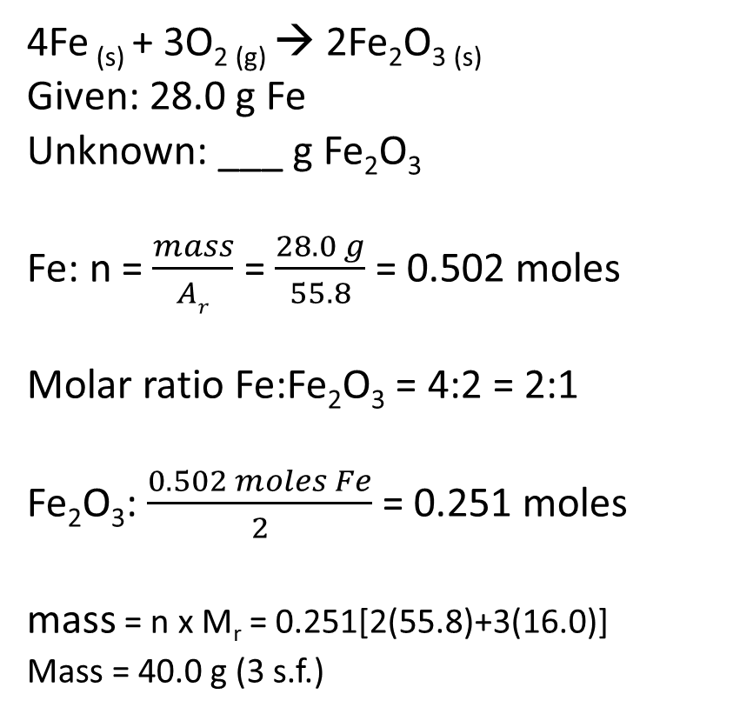
Using equations to calculate masses
4Fe _{(s)} + 3O_{2 (g)} → 2Fe₂O_{3 (s)}
Given: 28.0 g Fe
Unknown: ___ g Fe₂O₃
Fe: n = $\frac{mass}{Ar}$ = $\frac{28.0 g}{55.8}$ = 0.502 moles
Molar ratio Fe:Fe₂O₃ = 4:2 = 2:1
Fe₂O₃: $\frac{0.502 moles Fe}{2}$ = 0.251 moles
mass = n x M_{r} = 0.251[2(55.8)+3(16.0)]
Mass = 40.0 g (3 s.f.)
Write out the balanced equation for the reaction.
Calculate the number of moles using given information.
Calculate the number of moles for the unknown quantities using the molar ratios from the balanced equation.
Calculate the mass of the unknown quantity using M_{r}.

Slide 18
Let’s calculate!
Complete Q1-3 on pg. 47.

Slide 19
L2: Equations and Calculations
Learning Objectives:
Explain the difference between empirical and molecular formula.
Calculate molecular formula given empirical formula and M_{r}.
Calculate empirical formula give data about mass.
Write balanced equations and ionic equations.
Use balanced equations to calculate:
Masses
Volumes of gases
Concentrations and volumes for solutions

Slide 20
Using equations to calculate volumes of gas
This is the same as the previous, except once you calculated the number of moles you use the ideal gas equation.

Slide 21
Let’s calculate!
Complete Q2, 3, and 5 on pg. 48.

Slide 22
L2: Equations and Calculations
Learning Objectives:
Explain the difference between empirical and molecular formula.
Calculate molecular formula given empirical formula and M_{r}.
Calculate empirical formula give data about mass.
Write balanced equations and ionic equations.
Use balanced equations to calculate:
Masses
Volumes of gases
Concentrations and volumes for solutions

Slide 23
Calculating Concentrations and Volumes
This is the same as the previous, except once you calculated the number of moles you convert between moles and concentration or volume.
Concentration (mol dm⁻³) = $\frac{moles}{volume (dm3)}$

Slide 24
Let’s Calculate!
Complete Q1 and 3 on pg. 52.
Complete Q1 and 3 on pg. 53.

Slide 25
L2: Equations and Calculations
Learning Objectives:
Explain the difference between empirical and molecular formula.
Calculate molecular formula given empirical formula and M_{r}.
Calculate empirical formula give data about mass.
Write balanced equations and ionic equations.
Use balanced equations to calculate:
Masses
Volumes of gases
Concentrations and volumes for solutions

Slide 26
Homework
Revise Section 2.3, 2.4.
Complete practice questions not done in class and check your work.
Looking Ahead:
Read Section 2.5 (pg. 49-53).
Pay close attention to practical information.
Required Practical 1: Titrations

