Slide 1
Starter
Complete the quiz.
Review your notes until everyone has finished.

Slide 2
L2 – Mass
Learning Objectives:
Explain the existence of isotopes.
Define the term relative atomic mass, A_{r}, and relative molecular mass, M_{r}, in terms of ¹²C.
Calculate A_{r} from isotopic abundance.

Slide 3
Using your textbook glossary define the following terms
Isotope
Relative atomic mass
Relative isotopic mass
Relative isotopic abundance

Slide 4
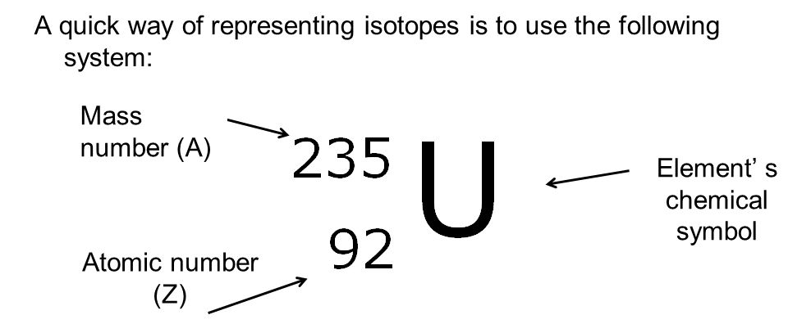
Representing Isotopes

Slide 5
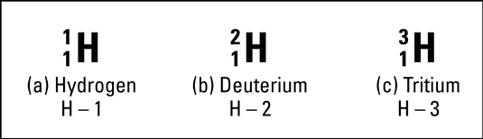
Representing Isotopes
To name an isotope just add a dash and the mass at the end of the name.
Example: carbon-12 is an isotope of carbon with a mass of 12.

Slide 6
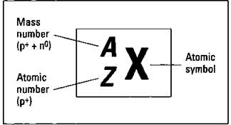
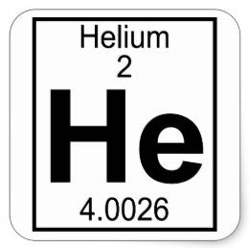
Relative Atomic Mass, A_{r}
The mass of one atom (mass number), A, is always a whole number (protons + neutrons, you can’t have part of a proton or neutron).
The relative atomic mass, A_{r}, is the average mass of an atom compared to an atom of carbon-12, which is given a mass of exactly 12.
It is an average of all the existing isotopes so is NOT a whole number.

Slide 7
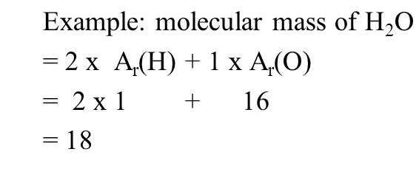
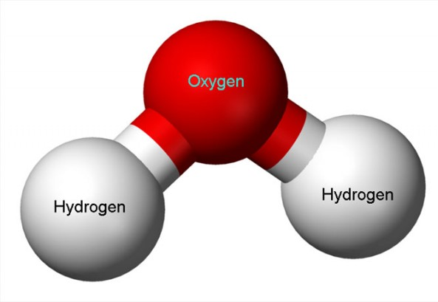
Relative Molecular Mass, M_{r}
The relative molecular mass, M_{r}, is simply the relative atomic masses of all the atoms in the molecule added together.

Slide 8
Practice
Answer application questions 1-3 on pg. 18.

Slide 9

L2 – Mass
Learning Objectives:
Explain the existence of isotopes.
Define the term relative atomic mass, A_{r}, and relative molecular mass, M_{r}, in terms of ¹²C.
Calculate A_{r} from isotopic abundance.

Slide 10
Calculating relative atomic mass, A_{r}
A_{r} is an average of all the existing isotopes.
However, isotopes do NOT exist in equal amounts.
So, calculating A_{r} takes into account the relative abundance of each isotope.

Slide 11
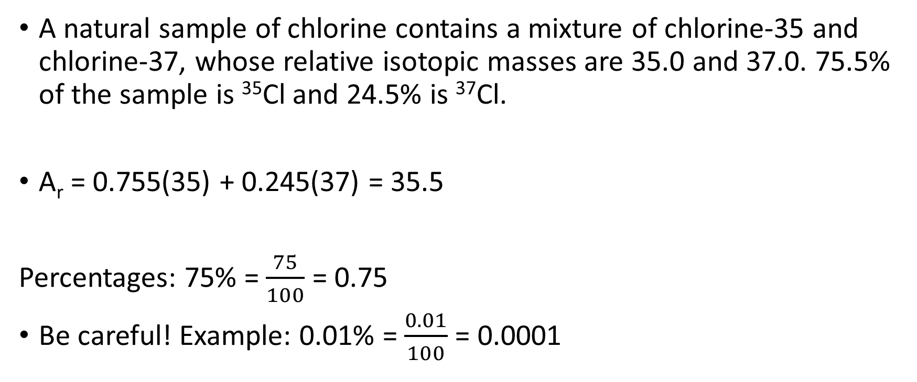
Example: Calculating A_{r}
A natural sample of chlorine contains a mixture of chlorine-35 and chlorine-37, whose relative isotopic masses are 35.0 and 37.0. 75.5% of the sample is ³⁵Cl and 24.5% is ³⁷Cl.
A_{r} = 0.755(35) + 0.245(37) = 35.5
Percentages: 75% = $\frac{75}{100}$ = 0.75
Be careful! Example: 0.01% = $\frac{0.01}{100}$ = 0.0001

Slide 12
Practice
Complete the worksheet.

Slide 13
L2 – Mass
Learning Objectives:
Explain the existence of isotopes.
Define the term relative atomic mass, A_{r}, and relative molecular mass, M_{r}, in terms of ¹²C.
Calculate A_{r} from isotopic abundance.

Slide 14
Homework
Revise material from today’s lesson, complete any unfinished classwork.
Read Unit 1, Section 1-3 (pg. 17-18) in the textbook.
Write revision notes.
There will be a quiz at the beginning of every lesson.
Looking ahead: Read Section 1-4, 1-5 (pg. 19-24).

