Slide 1
Starter
Complete the quiz and hand in.

Slide 2
L3 – Mass Spectrometry
Learning Objectives:
Recall how a TOF mass spectrometer works including the following steps:
Ionisation
Acceleration
Ion drift
Detection
Interpret simple mass spectra of elements.

Slide 3
Using your textbook glossary define the following terms
Mass spectrometry
Mass spectrum
Ionisation

Slide 4
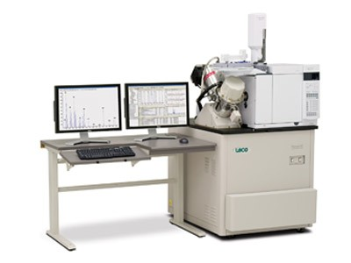
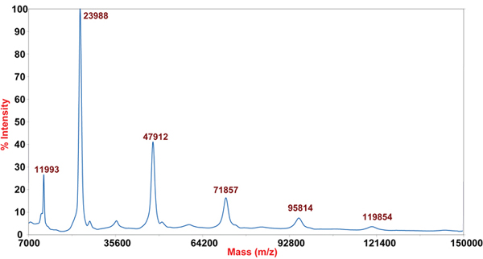
Mass Spectrometry
Spectrometers are instruments that make scientific measurements and produce spectra (read outs with a range of results).
Mass spectrometers give information about the mass of substances in a sample.

Slide 5
Time of Flight (TOF) Mass Spectrometers (MS)
TOF-MS
Ionisation
Acceleration
Ion Drift
Detection
Ionisation
Ion

Slide 6
Time of Flight (TOF) Mass Spectrometers (MS)
TOF-MS
Ionisation
Electron Impact
The sample is bombarded by high energy electrons.
The sample atom or molecule loses an e⁻ and gains a +1 charge.
Ionisation
Ion

Slide 7
Time of Flight (TOF) Mass Spectrometers (MS)
TOF-MS
Acceleration
An electric field accelerates the ions. The electric field gives the same amount of kinetic energy to all particles.
BUT: Lighter particles accelerate more and heavier particles accelerate less.
Ionisation
Ion

Slide 8
Time of Flight (TOF) Mass Spectrometers (MS)
TOF-MS
Ion Drift
When they leave the electric field they drift at constant (but different!) speeds until they hit the detector.
Ionisation
Ion

Slide 9
Time of Flight (TOF) Mass Spectrometers (MS)
TOF-MS
Detection
Ions will hit the detector at different times, the time for each particle is measured.
When the + ions hit the detector plate, electrons move onto the + ions to form neutral atoms.
The size of the current generated is also measured.
Ionisation
Ion

Slide 10
L3 – Mass Spectrometry
Learning Objectives:
Recall how a TOF mass spectrometer works including the following steps:
Ionisation
Acceleration
Ion drift
Detection
Interpret simple mass spectra of elements.

Slide 11
Purpose of TOF-MS
Gives accurate information about:
Relative isotopic mass
Relative isotopic abundance
Can be used to:
Identify elements
Calculate isotopic abundance
Calculate relative atomic mass, A_{r}
Calculate relative molecular mass, M_{r}

Slide 12
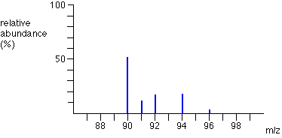
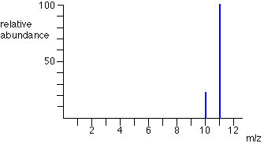
Interpreting Mass Spectra: Identifying Elements
MS can be used to identify elements.
m/z = mass to charge ratio
Since the charge is usually +1 we assume this is the mass of the particle.
There is a specific pattern produced due to the different isotopes of the element.
zirconium
boron

Slide 13
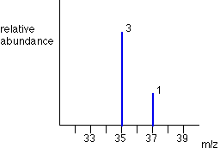
Interpreting Mass Spectra: Isotopic Abundance
The height of the peak relates to the abundance. A comparison of the peaks allows you to calculate isotopic abundance.
A pure sample of chlorine was tested.
The mass spectra shows that the abundance of chlorine-35 is 3x greater than chlorine-37.
Chlorine-35 abundance = 75%
Chlorine-37 abundance = 25%

Slide 14
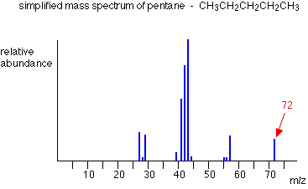
Interpreting Mass Spectra: Relative Molecular Mass M_{r}
Molecules can also be analysed by TOF-MS.
The peak with the highest m/z value is the molecular ion, M⁺, which forms when the entire molecule forms into an ion by losing one electron.
This gives you the relative molecular mass, M_{r}.
The other peaks are formed by the fragmentation of the molecule to form smaller ions, creating a unique pattern.

Slide 15
L3 – Mass Spectrometry
Learning Objectives:
Recall how a TOF mass spectrometer works including the following steps:
Ionisation
Acceleration
Ion drift
Detection
Interpret simple mass spectra of elements.

Slide 16
Practice
Complete practice questions on pg. 20-24.
Homework:
Revise material from today’s lesson.
Write revision notes.
Complete all practice questions not finished in class.
Looking ahead: Read Section 1-6 from the textbook (pg. 25-28).

