Slide 1
Starter
Complete the quiz.
Review your notes or read the textbook when you have finished.

Slide 2
L4: Electron Configuration
Learning Objectives:
Represent the electron configurations of atoms and ions up to Z = 36 in terms of shells, sub-shells (s, p, and d), and orbitals using:
Sub-shell notation
Box diagrams (orbital diagram)
Energy level diagrams

Slide 3
Electron Cloud Model
Bohr Model
Electrons move erratically, NOT in predictable orbits.
The electron cloud is the area around the nucleus of an atom where an electron is most likely to be found.
The denser the cloud in a particular area, the more likely it is for an electron to be there.
Electron Cloud Model

Slide 4
Electron Configuration
Electron shells or energy levels (1, 2, 3, etc)
Sub-shells (s, p, d)
Orbitals (represented by boxes)

Slide 5
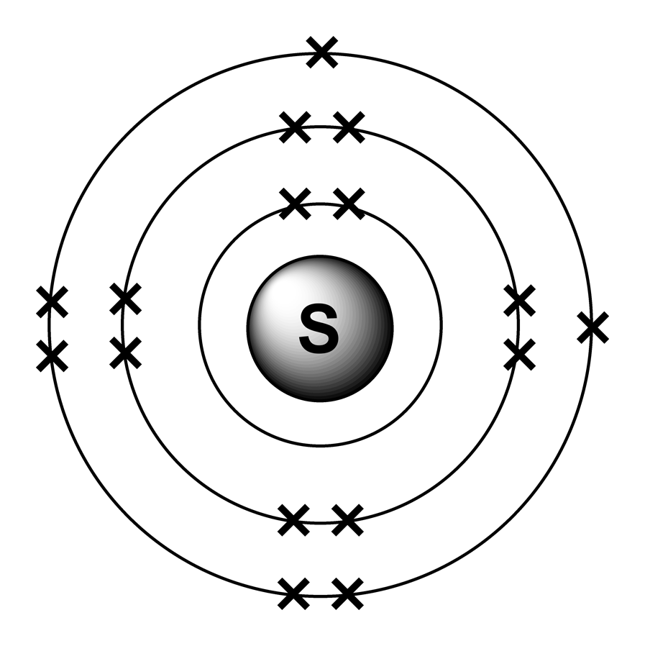
Electron Shells – Energy Levels
Each shells is given a number (principal quantum number) starting with the shell closest to the nucleus.
The further the shell is from the nucleus, the higher the energy and the larger the principal quantum number.

Slide 6
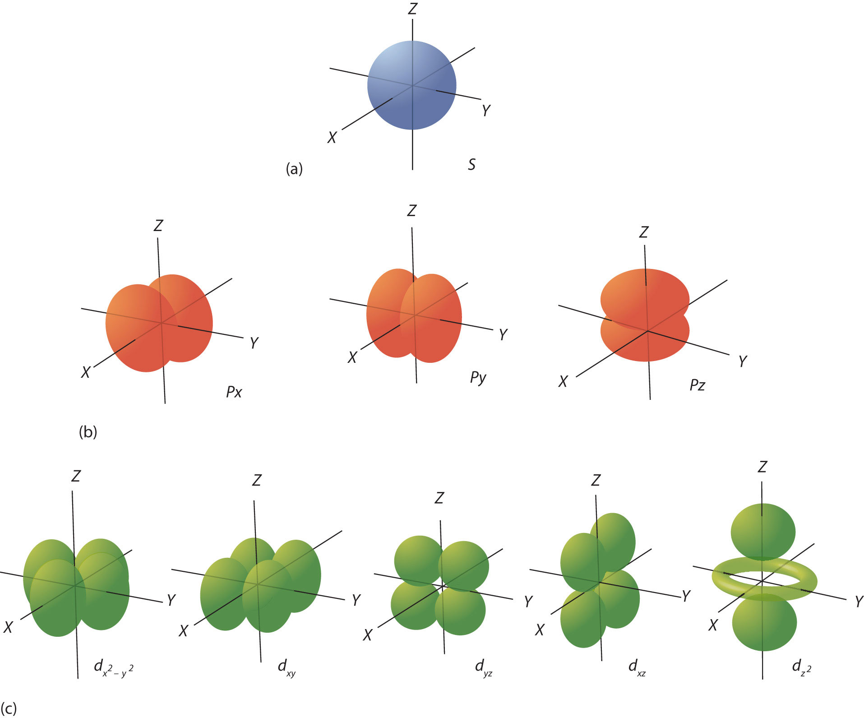
Sub-Shells
Each energy level is divided into sub-shells.
Sub-shells have different shapes.
These shapes represent locations where electrons have a high probability to be.
NOTE: YOU DO NOT NEED TO KNOW THESE SHAPES FOR THE EXAM.

Slide 7
Orbitals
One p-orbital
Each sub-shell is divided into orbitals.
Each orbital holds a maximum of 2 e⁻.
The sub-shells contain different number of orbitals, so hold different numbers of electrons.
P-subshell
NOTE: YOU DO NOT NEED TO KNOW THESE SHAPES FOR THE EXAM.

Slide 8
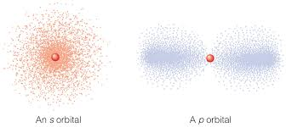
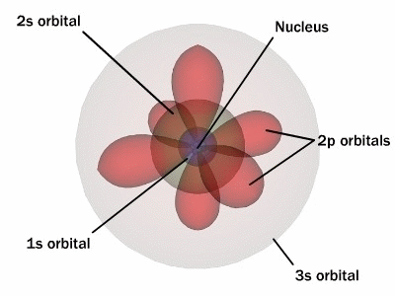
The orbitals overlap!

Slide 9
How many electrons can each energy level hold?
s subshell contains 1 orbital, holding max 2 e⁻.
p subshell contains 3 orbitals, holding max 6 e⁻ (2 e⁻ each).
d subshell contains 5 orbitals, holding max 10 e⁻.
Energy Level | Sub-Shells | Total electrons
1st | 1s | 2
2nd | 2s 2p | 2 + 6 = 8
3rd | 3s 3p 3d | 2 + 6 + 10 = 18
4th | 4s 4p 4d 4f | 2 + 6 + 10 + 14 = 32

Slide 10
Representing Electron Configuration: Sub-Shell Notation
Sub-shell notation gives the number of electrons in each subshell.
Example:
1s²2s²2p⁶3s²3p⁴

Slide 11
Representing Electron Configuration: Sub-Shell Notation
Sub-shell notation gives the number of electrons in each subshell.
Example:
1s²2s²2p⁶3s²3p⁴
Energy level
Sub-shell
# of e⁻

Slide 12
Representing Electron Configuration: Sub-Shell Notation
Sub-shell notation gives the number of electrons in each subshell.
Example:
1s²2s²2p⁶3s²3p⁴
Energy level
Sub-shell
# of e⁻

Slide 13
Representing Electron Configuration: Sub-Shell Notation
Sub-shell notation gives the number of electrons in each subshell.
Example:
1s²2s²2p⁶3s²3p⁴
Energy level
Sub-shell
# of e⁻

Slide 14
Representing Electron Configuration: Orbital Diagrams / Box Diagrams
Each box represents an orbital.
We represent electrons with arrows.
Each orbital can hold up to 2 e⁻, one spin up and one spin down.

Slide 15
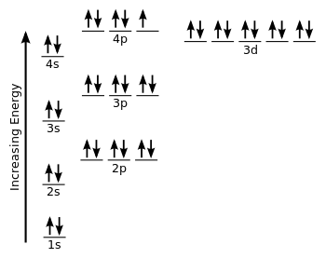
Representing Electron Configuration: Energy Level Diagrams
The orbitals are arranged according to energy of electrons.
Electrons fill the lowest energy orbitals first.
NOTE:
3d orbital is higher in energy than the 4s orbital!
HOWEVER, these orbitals are so close in energy sometimes there are exceptions.

Slide 16
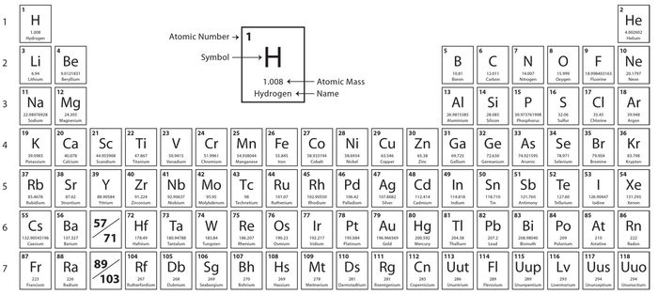
s-block
p-block
d-block (starts energy level 3)

Slide 17
Practice
Complete questions 1-3 on pg. 27 of your textbook.

Slide 18
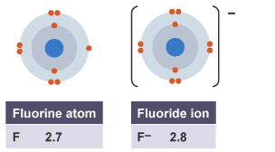
Electron Configurations of Atoms vs Ions
Atoms contain the same number of electrons as protons (Z).
Positive ions contain less electrons.
Negative ions contain more electrons.
Example:
F atom (9 electrons) 1s²2s²2p⁵
F⁻ ion (10 electrons) 1s²2s²2p⁶

Slide 19
Practice
Complete question 4 on pg. 27 of your textbook.

Slide 20
Simplified Electron Configuration
We can shorten the electron configuration by replacing most of the inner electrons with the noble gas with the corresponding number of electrons.
This is often called noble gas notation.
Example:
Ga 1s²2s²2p⁶3s²3p⁶3d¹⁰4s²4p¹ OR [Ar]3d¹⁰4s²4p¹

Slide 21
Practice
Complete question 5 on pg. 27 of your textbook.

Slide 22
Now that you are comfortable… the EXCEPTIONS!
d-block elements have some exceptions
Exception 1
When they form positive ions, they lose 4s e⁻ before the 3d e⁻.
Example
Fe 1s²2s²2p⁶3s²3p⁶3d⁶4s²
Fe³⁺ 1s²2s²2p⁶3s²3p⁶3d⁵

Slide 23
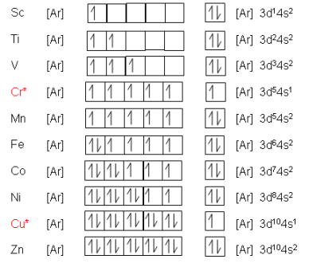
Now that you are comfortable… the EXCEPTIONS!
Exception 2 (and 3)
Chromium (Cr) and Copper (Cu) do NOT follow the same pattern.
This is because they are more stable with all d-orbitals half-full or full.
Cr [Ar]3d⁵4s¹
Cu [Ar]3d¹⁰4s¹

Slide 24
Practice
Complete application questions 1-3 on pg. 28 of your textbook.

Slide 25
L3: Electron Configuration
Learning Objectives:
Represent the electron configurations of atoms and ions up to Z = 36 in terms of shells, sub-shells (s, p, and d), and orbitals using:
Sub-shell notation
Box diagrams
Energy level diagrams

Slide 26
Homework
Revise material from today’s lesson.
Write revision notes.
Complete all practice questions not finished in class.
Looking ahead: Read Section 1-7 from the textbook (pg. 29-34).

