Slide 1
L4: Yield
Learning Objectives:
Describe the difference between theoretical yield and actual yield.
Explain why the actual yield is always less than theoretical yield.
Calculating percentage yield.
Calculating atom economy.
Explain the economic, environmental, and ethical advantages of a high atom economy.

Slide 2
Theoretical Yield vs Actual Yield
Theoretical yield = theoretical amount of product made, obtained from calculation
This is just calculated by calculating the mass produced of the desired product.
Actual yield = amount of product made, measured experimentally

Slide 3
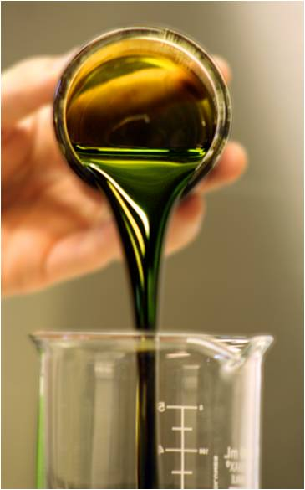
Actual Yield is Always Less
Chemical Reaction
Reaction does not complete
Reversible reaction
Side reactions occur
Equipment/Human Error
Reagents stuck to equipment
Chemical lost during transfer

Slide 4
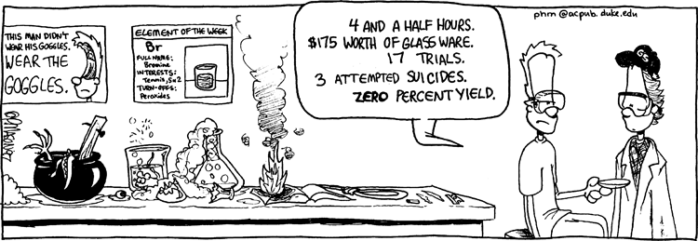

Percentage Yield
percentage yield = $\frac{actual yield}{theoretical yield}$

Slide 5
Let’s calculate!
Complete Q4 and Q7 on pg. 60.

Slide 6
Atom Economy
Atom economy is a measure of how efficient (or wasteful) the chemical reaction itself is.
Atom economy = measure of the proportion of reactant atoms (by mass) that become part of the desired product
The higher the atom economy, the more efficient the reaction.

Slide 7
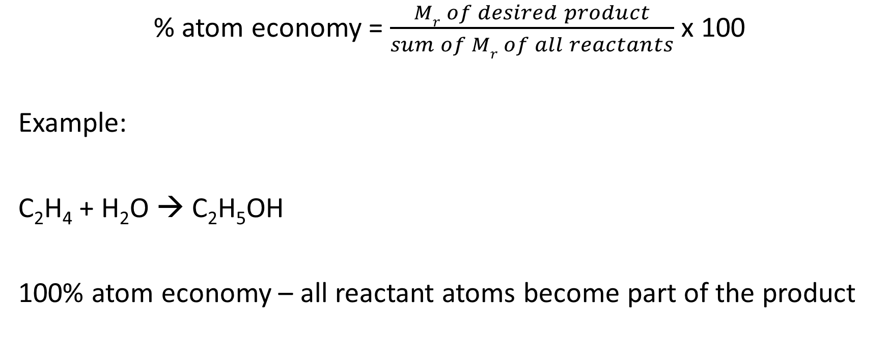
Calculating Atom Economy
% atom economy = $\frac{Mr of desired product}{sum of Mr of all reactants}$ x 100
Example:
C₂H₄ + H₂O → C₂H₅OH
100% atom economy – all reactant atoms become part of the product

Slide 8
Let’s Calculate!
Complete Q1 and Q4.

Slide 9
Advantages of a Higher Atom Economy
Read pg. 61 and write a summary of the economic, environmental, and ethical advantages of a higher atom economy.

Slide 10
Homework
Revise Topic 2 – Amounts of Substance
Complete the Exam Style Questions on pg. 65-67.
Mark your own work and bring in questions to go over next lesson.

