Slide 1
Quiz

Slide 2
L5 Ionisation Energy
Learning Objectives:
Define first ionisation energy.
Write equations for first and successive ionisation energies.
Explain the factors affecting ionisation energy.
Describe the trends in ionisation energies in Period 3 and Group 2.
Explain how the trends in first ionisation energy give evidence for electron configuration in sub-shells and shells.
Explain the trend in successive IE values across a period.

Slide 3
Ionisation Energy
Turn to page 29 in your textbook.
Write the definition for first ionisation energy.
List the factors that affect ionisation energy.

Slide 4
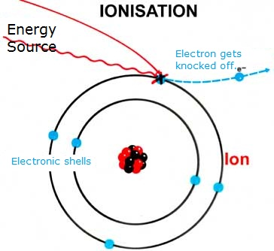
First Ionisation Energy
The energy needed to remove 1 electron from each atom in 1 mole of gaseous atoms to form 1 mole of gaseous 1+ ions.

Slide 5
L5 Ionisation Energy
Learning Objectives:
Define first ionisation energy.
Write equations for first and successive ionisation energies.
Explain the factors affecting ionisation energy.
Describe the trends in ionisation energies in Period 3 and Group 2.
Explain how the trends in ionisation energy give evidence for electron configuration in sub-shells and shells.
Explain the trend in successive IE values across a period.

Slide 6
Equations for Ionisation Energy
+1 ion formed
symbol for electron
M_{(g)} → M⁺_{(g)} + e⁻ 1st ionisation energy = +1314 kJ mol⁻¹
kJ/mol
(kJ per mol)
gaseous atoms and ions

Slide 7
Successive Ionisation Energies
Second ionisation energy – The energy needed to remove 1 electron from each 1+ ion in 1 mole of gaseous ions to form 1 mole of gaseous 2+ ions.

Slide 8
Practice
Write the equations for the first, second, and third ionisation of magnesium.

Slide 9
L5 Ionisation Energy
Learning Objectives:
Define first ionisation energy.
Write equations for first and successive ionisation energies.
Explain the factors affecting ionisation energy.
Describe the trends in ionisation energies in Period 3 and Group 2.
Explain how the trends in ionisation energy give evidence for electron configuration in sub-shells and shells.
Explain the trend in successive IE values across a period.

Slide 10
Ionisation Energy
Ionisation energy is a measure of how strongly the electrons are held onto an atom.
What holds the electrons in place?
Electrostatic force of attraction between the positively charged protons in the nucleus and the negatively charged electrons keeps the electrons around the atom.

Slide 11
What factors affect the strength of the attraction to the nucleus?
Nuclear charge
Distance from the nucleus
Shielding

Slide 12
What factors affect the strength of the attraction to the nucleus?
Nuclear charge
The more protons, the bigger the positive charge, the stronger the electrostatic force of attraction felt by the electrons.

Slide 13
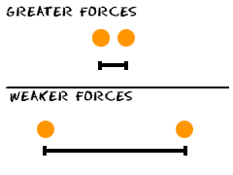
What factors affect the strength of the attraction to the nucleus?
2. Distance from the nucleus
The further away, the weaker the force of attraction.

Slide 14
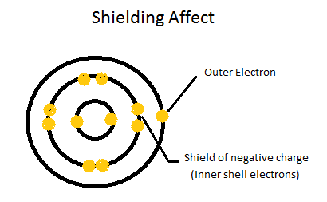
What factors affect the strength of the attraction to the nucleus?
3. Shielding
Outer electrons feel a weaker force of attraction from the nucleus because of the repulsion from the inner electrons.

Slide 15
Effective Nuclear Charge
Shielding causes the outer electrons to feel a decreased pull from the nucleus.
The (smaller) positive charge experienced by the outer electrons is called the effective nuclear charge.

Slide 16
L5 Ionisation Energy
Learning Objectives:
Define first ionisation energy.
Write equations for first and successive ionisation energies.
Explain the factors affecting ionisation energy.
Describe the trends in ionisation energies in Period 3 and Group 2.
Explain how the trends in ionisation energy give evidence for electron configuration in sub-shells and shells.
Explain the trend in successive IE values across a period.

Slide 17
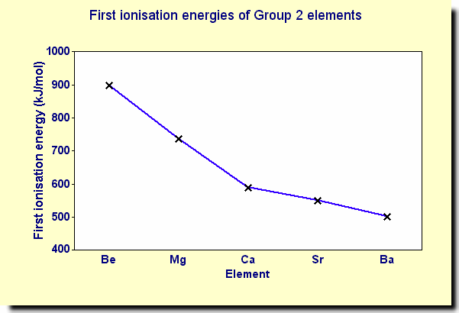
Trends in Ionisation Energy – Group 2
Provides evidence for the existence of electron shells (energy levels).
Down the group:
Increasing number of shells
Outer electrons further from nucleus
Outer electrons have greater shielding from inner electrons
Decrease in effective nuclear charge.
Decrease in first ionisation energy.

Slide 18
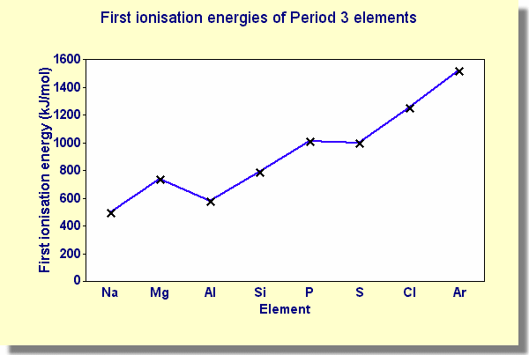
Trends in Ionisation Energy – Period 3
General trend – first ionisation energy increases
Same period = approx. the same distance from nucleus and amount of shielding
Increase in proton number → larger nuclear charge → stronger force of attraction
Requires more energy to remove outer electrons

Slide 19
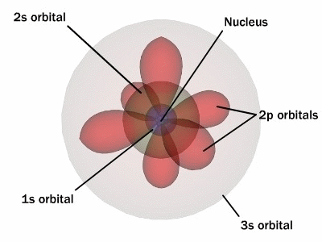
Trends in Ionisation Energy – Period 3
Drop between group 2 and 3
Mg outer electron – 3s
Al outer electron – 3p
3p orbital is higher in energy and slightly further away.
3s electrons also shield the 3p electrons
So, Al’s 3p electron is slightly easier to remove than Mg’s 3s electron.
Provides evidence for the existence of sub-shells

Slide 20
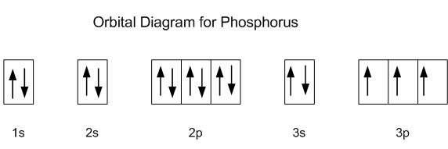
Trends in Ionisation Energy – Period 3
Drop between group 5 and 6.
P and S have identical shielding and their outer electron is being removed from an identical orbital.
Electron Repulsion
Sulfur has a 3p orbital containing 2e⁻. The electrons repel each other. This makes it easier to remove one.
Orbital Diagram for Sulfur

Slide 21
L5 Ionisation Energy
Learning Objectives:
Define first ionisation energy.
Write equations for first and successive ionisation energies.
Explain the factors affecting ionisation energy.
Describe the trends in ionisation energies in Period 3 and Group 2.
Explain how the trends in ionisation energy give evidence for electron configuration in sub-shells and shells.
Explain the trend in successive IE values across a period.

Slide 22
First and Second Ionisation Energy
Second ionisation energy is always higher than the first ionisation energy.
This is because it is more difficult to remove an electron from a positively charged ion compared to a neutral atom.

Slide 23
Successive Ionisation Energy

Slide 24
Successive Ionisation Energies
Na (Group 1)
1st ionisation removes a 3s e⁻
2nd ionisation removes a 2p e⁻ which is in a lower energy level and much more difficult to remove.
So there is a large increase between 1st and 2nd IE values.

Slide 25
Successive Ionisation Energies
Mg (Group 2)
1st and 2nd ionisation removes 3s e⁻
Not until the 3rd ionisation does it remove a 2p e⁻.
So there is a large increase between 2nd and 3rd IE values.

Slide 26
Successive Ionisation Energies
Al (Group 3)
1st, 2nd, and 3rd ionisation removes 3s and 3p e⁻
Not until the 4th ionisation does it remove a 2p e⁻.
So there is a large increase between 3rd and 4th IE values.

Slide 27
Practice

Slide 28
Practice

Slide 29
L5 Ionisation Energy
Learning Objectives:
Define first ionisation energy.
Write equations for first and successive ionisation energies.
Explain the factors affecting ionisation energy.
Describe the trends in ionisation energies in Period 3 and Group 2.
Explain how the trends in ionisation energy give evidence for electron configuration in sub-shells and shells.
Explain the trend in successive IE values across a period.

Slide 30
Homework
Answer application questions on pg. 32-33.
Revise material from today’s lesson.
Write revision notes.
Revise for end of topic test.

