Slide 1
Rate Equations and Gas Equilibria
Rate Equations
Measuring Rates
  Using concentration time graph
3. Determining the Order of a Reaction
  Initial Rates Method
Rate Concentration Graphs
Rate Determining Step
Arrhenius Equation
Gas Equilibria

Slide 2
Rate Equations

Slide 3
Rate Equations
The relationship between the rate of a chemical reaction and the concentration of the reactants is shown by the rate equation of the reaction.
Consider the reaction A + 3B → 2C + 4D
The rate of this chemical reaction is given by the equation
Rate = k[A]^{x}[B]^{y}
[A] is the concentration of A, and [B] is the concentration of B.
x and y are the orders of reaction with respect to A and B respectively.

Slide 4
Order of reaction with respect to a given reactant is the power of that reactant’s concentration in the rate equations.
The sum of these is known as the overall order of reaction.
k is the rate constant of the reaction, the constant of proportionality which is unique to the chemical reaction and temperature.

Slide 5
Rate Constant (k)
Larger k = faster reaction
Always the same for a particular chemical reaction at a particular temperature
Increasing temperature also increases k

Slide 6
Practice
Answer application questions on pg. 53

Slide 7
Measuring Rates

Slide 8
Measuring Rate of Reaction
Rate of reaction is the decrease in the concentration of reactants per unit time, or the increase of concentration of products per unit time.
Units = mol dm⁻³ s⁻¹
If you record amounts of reactant or product at regular intervals, this is called continuous monitoring.

Slide 9
Methods of Measuring Amounts
You can monitor the change in any of these factors:
Gas Volume
pH
Colour
Mass

Slide 10
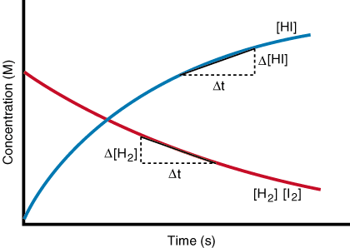
Concentration Time Graph
Rate of reaction = gradient of the graph

Slide 11
Practice
Answer questions on pg. 46
Answer questions on pg. 49

Slide 12
Finding Order of Reaction

Slide 13
Finding Order of a Reaction
In order to write a useful rate equation, we need to determine the orders of the reaction for each reactant.
A + B → C + D
Rate = k[A]^{x}[B]^{y}

Slide 14
Initial Rates Method
Carry out a reaction and calculate the rate.
Repeat the experiment using a different initial concentration of one of the reactants.
Compare the rates between the two experiments and determine the order.
  If the rate did not change, the reaction is zero order
  If you doubled the concentration and the rate also doubled, the reaction is first order for this reactant
  If you doubled the concentration and the rate quadrupled, the reaction is second order

Slide 15
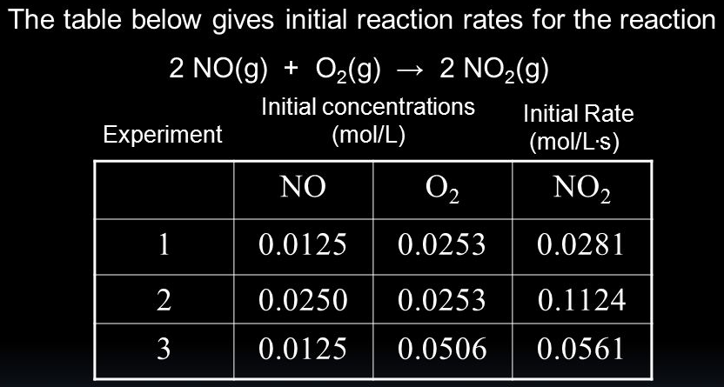
Initial Rates Method

Slide 16
Practice
Answer application questions on pg. 57

Slide 17
Rate-Concentration Graphs

Slide 18
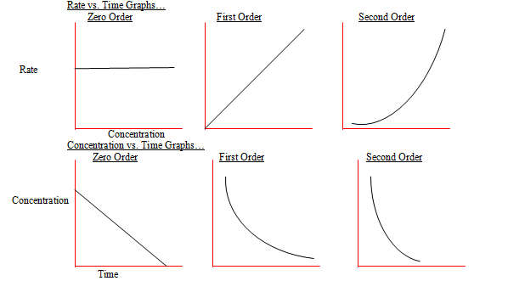
Rate-Concentration Graphs

Slide 19
Practice
Answer application questions on pg. 61

Slide 20
The Rate Determining Step

Slide 21
The Rate Determining Step
Finding the orders of a reaction can provide information about the mechanism of a reaction.
Is it a one step reaction or multistep?
If a reaction has multiple steps, the slowest step is the rate determining step.

Slide 22
Using Rate Equation
If a reactant is zero order = it is NOT involved in the rate determining step
The order of a reaction = the number of molecules of that reactant involved in the rate determining step
This can then be used to figure out which step is the rate determining step or to figure out which possible mechanism is the correct one.

Slide 23
Practice
Answer application questions on pg. 63

Slide 24
Arrhenius Equation

Slide 25
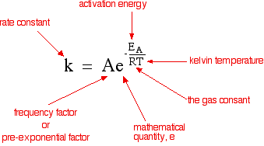
Arrhenius Equation
Arrhenius constant (unique to the reaction)

Slide 26
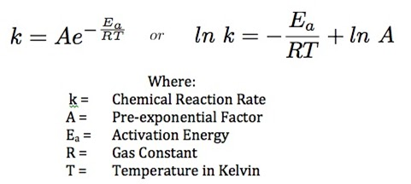
Conclusions from Arrhenius Equation
What happens if you increase activation energy?
Decrease?
What happens if you increase temperature?
Decrease?
k decreases
k increases
k also increases
k also decreases

Slide 27
Using the Arrhenius Equation
The decomposition of N₂O₅ at 308 K has a rate constant of 1.35 x 10⁻⁴ s⁻¹. The Arrhenius constant for this reaction is 4.79 x 10¹³ s⁻¹. Calculate the activation energy of this reaction. (R = 8.31 J K⁻¹ mol⁻¹)
ln(k) = ln( ) = ln(A) + ln( ) = ln(A)
= ln(A) – ln(k)
E_{a} = [ln(A) – ln(k)] x RT

Slide 28
Practice
Answer Q1-2 on pg. 68

Slide 29
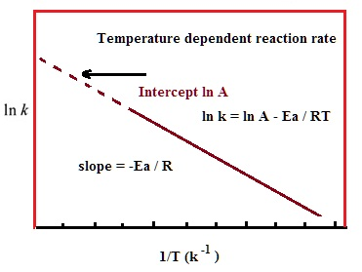
Arrhenius Plots
Plotting ln(k) against 1/T gives you useful data.
y-intercept = ln(A)

Slide 30
Practice
Answer Q3 on pg. 68

Slide 31
Gas Equilibria

Slide 32
Partial Pressure
For equilibrium reactions involving gases we don’t use concentration for the equilibrium equations.
Instead we use partial pressures.
Partial pressure = pressure exerted by one substance in the equilibrium mixture
total pressure = sum of all partial pressures

Slide 33
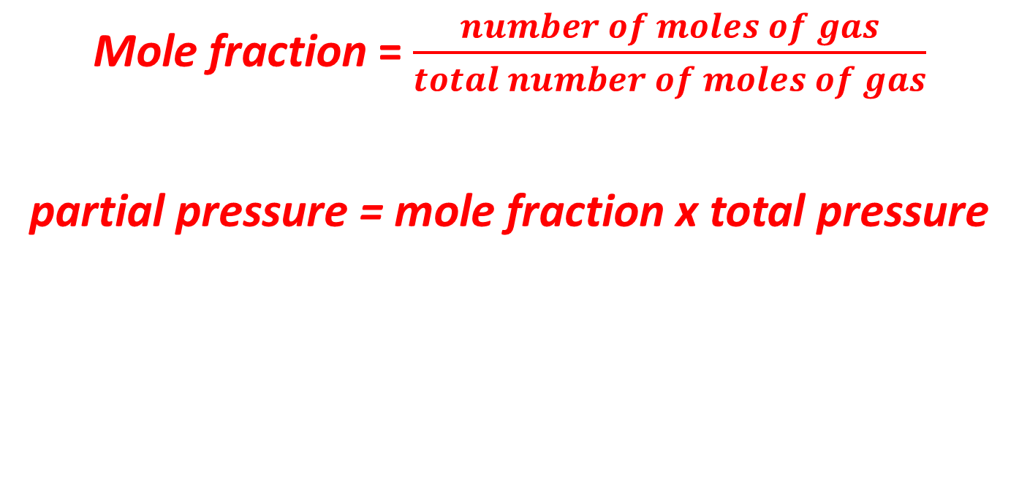
Mole Fractions
Mole fraction = $\frac{number of moles of gas}{total number of moles of gas}$
partial pressure = mole fraction x total pressure

Slide 34

Gas Equilibrium Constant, K_{p}
For the equilbrium
aA + bB dD + eE
K_{p} = $\frac{\left(pD\right)d\left(pE\right)e}{\left(pA\right)a\left(pB\right)b}$
p_{X} = partial pressure of gas X

Slide 35
Practice
Answer questions on pg. 72

Slide 36
Changing Gas Equilibria
Remember Le Chatelier’s Principle?
If a reversible reaction is subjected to a change in temperature, pressure, or concentration, then the equilibrium shifts to counteract the change.
Also applies to gas equilibria!

Slide 37
Practice
Answer questions on pg. 74

