Slide 1
Starter
Answer the following questions.
Where do humans get energy?
What type of energy is this?
What do we use the energy for?

Slide 2
Energy
L2: Energy for Living
Learning Objectives:
Recall that food is fuel for living things.
Calculate energy stored in food using food labels.
Explain the differences in energy requirements for different people.

Slide 3
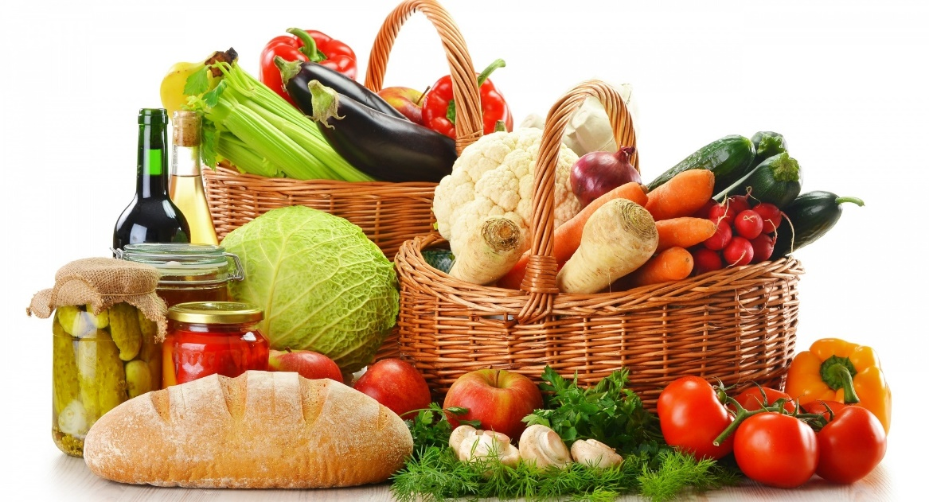
1. Living things get energy from food
Food is a fuel and stores chemical energy.
We use this energy for all life processes such as…
  Growth/repair
  Moving our muscles (the heart and lungs also have muscles that move!)
  Keeping warm

Slide 4
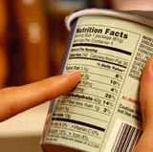
2. Energy is measured in Joules (J) or Kilojoules (kJ)
1 kJ = 1000 J
Different foods contain different amounts of energy.
Food labels contain information about how much energy is in the food.

Slide 5
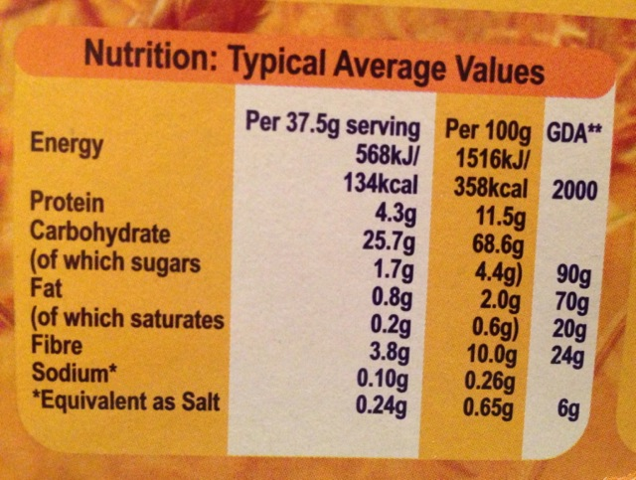
3. Food Labels
This is the amount in one serving.
Serving = typical amount you would eat
This is the amount in 100g of the food.
This is so that you can easily compare different foods.

Slide 6
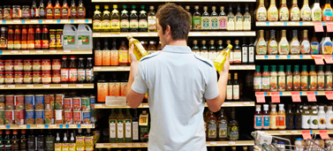
Complete the worksheet on food labels

Slide 7
Analysing Food Labels
Questions
1 a Which food releases the most energy?
b Why do you think this food releases the most energy?
(Hint: Look at how many grams of different things are in 100 g of each food.)
2 a Which food releases the least energy?
b Why do you think this food releases the least energy?
(Hint: Look at how many grams of different things are in 100 g of each food.)
3 Have a look at the food label for the food that releases the most energy. Use the other information on the label to try to suggest which component of the food is responsible for releasing the energy.
4 Extension: What might be a problem with comparing energy in 100g for all foods?

Slide 8
4. Energy requirements
Every cell of your body uses energy.
Different people need different amounts of energy (energy requirements).
What factors cause people to have different energy requirements?
  Age
  Gender
  Genes
  Health/Fitness
  Amount of Activity/Exercise

Slide 9
5. Who uses more energy?
For the following examples state which person uses more energy and explain why.

Slide 10

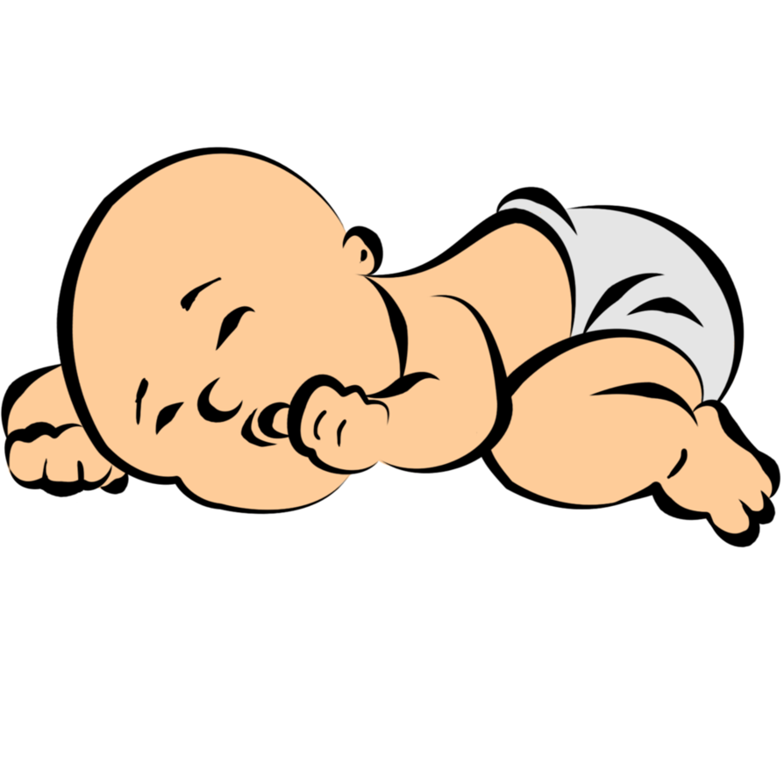
Baby vs Adult

Slide 11


Boys vs Girls

Slide 12
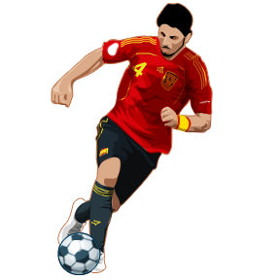

Office Worker vs Football Player

Slide 13


Woman vs Pregnant Woman

Slide 14
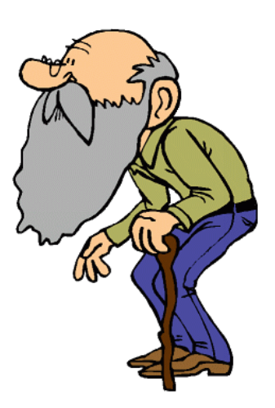
Adult Man vs Elderly Man

