Slide 1
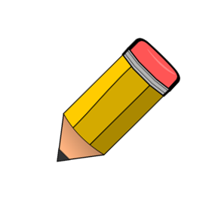
What are the qualities of a good scientist?
What are the qualities of a good scientist?

Slide 2

Introduction to Science
Thinking Scientifically
& Safety in Science

Slide 3
Lesson Objectives
All pupils must
Know why it is important to work safely in a laboratory
Recognise hazards in a laboratory?
Most pupils should
Understand how to evaluate risks and avoid danger
Some pupils could
Recognise hazard symbols and rank levels of danger
Name some applications of science in daily life?

Slide 4
Safety in the laboratory
  Write down a list of all the things going wrong in the next slide.
  For each of your answers, write a safety rule.
Notes:
There are two safety slides: choose which ever you prefer

Slide 5
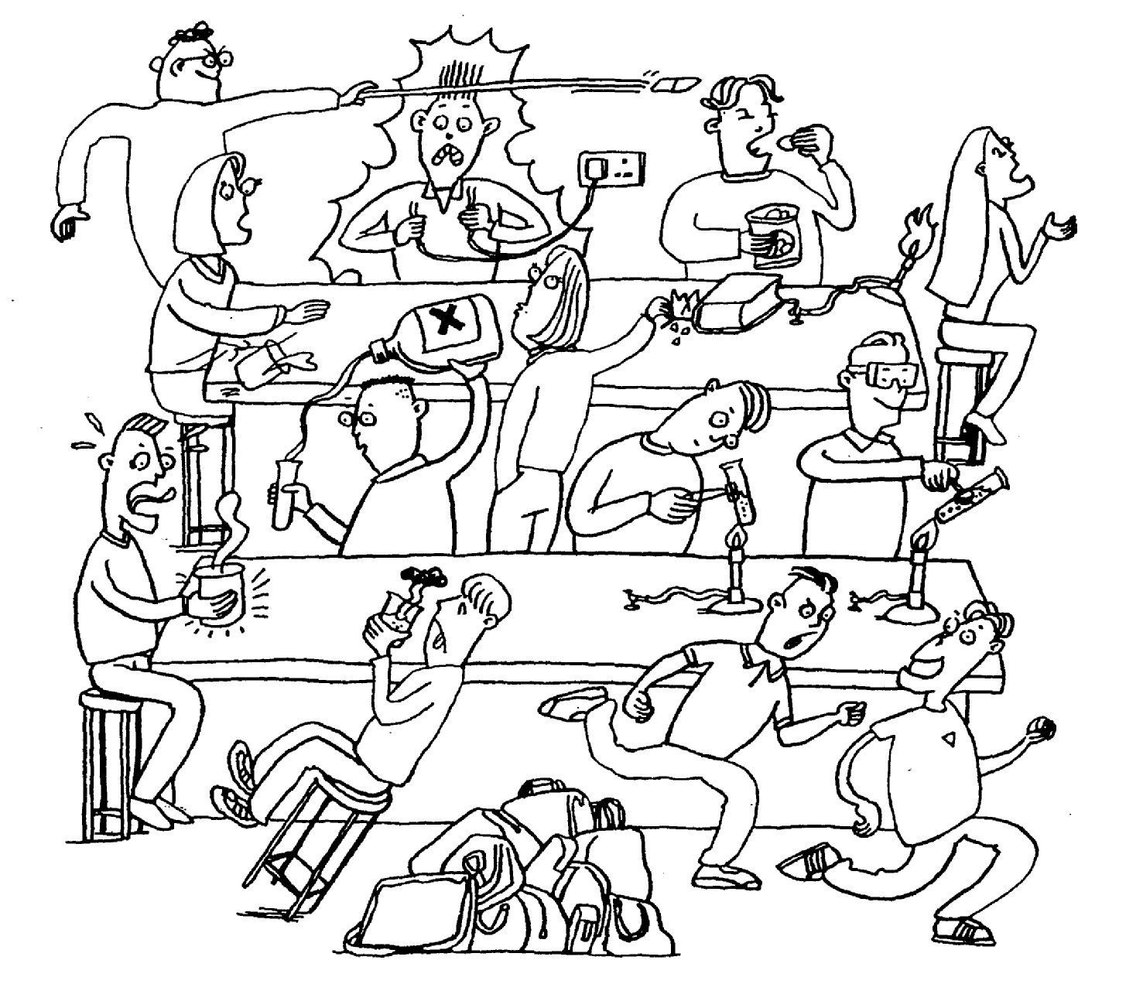
Notes:
Write down a list of all the things going wrong in the next slide. For each of your answers, write a safety rule.

Slide 6
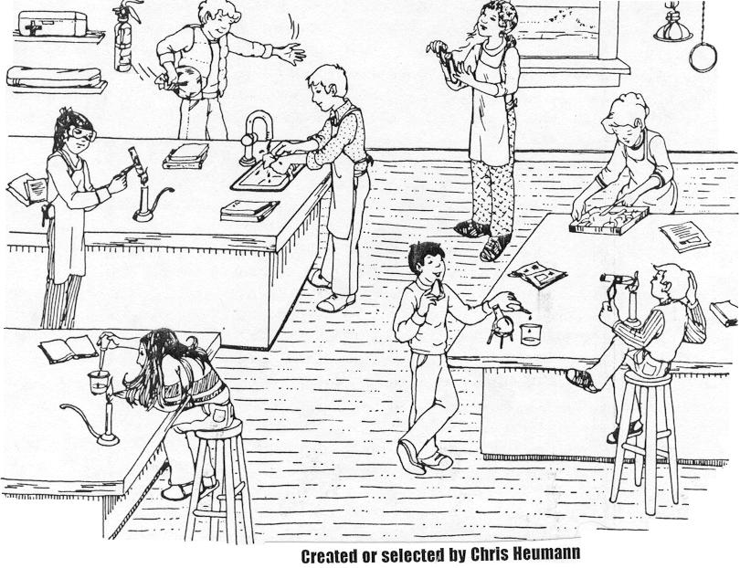
What’s wrong with this picture?

Slide 7
Some safety rules
Never drink in the lab
Little Jimmy was a chemist
Little Jimmy is no more
For what he thought was H2O
Was H2SO4
Now make up your own rhyme!

Slide 8
SAFETY RULES
FOLLOW ALL TEACHER INSTRUCTIONS.
NO eating or drinking.
Do not touch your face or other exposed skin after touching chemicals.
Tie up long hair.
Wear safety goggles when using chemicals.
No running around in the lab.
If you break something, inform a teacher straight away.
Always wipe surfaces clean after conducting experiments.

Slide 9
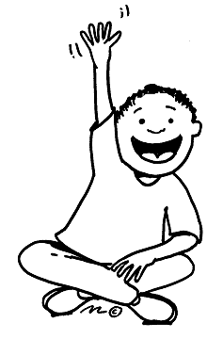
Equipment
In the lab we will be working with a lot of scientific equipment.
Do you know what these are?

Slide 10

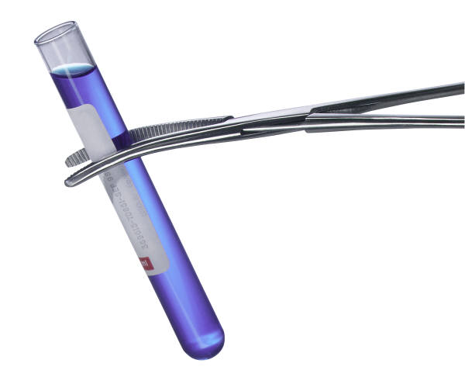
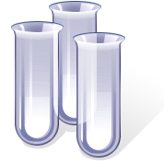

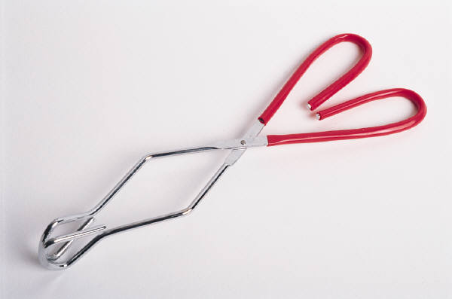
What am I?

Slide 11
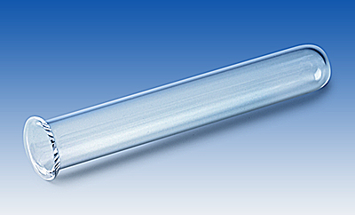
What is it? What is it for?
Test tube
storing or mixing solids and liquids

Slide 12
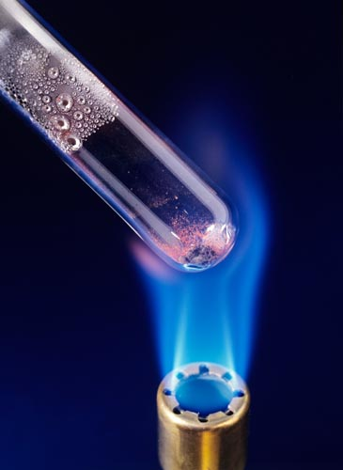
What is it? What is it for?
Boiling tube
Heating or mixing solids and liquids

Slide 13
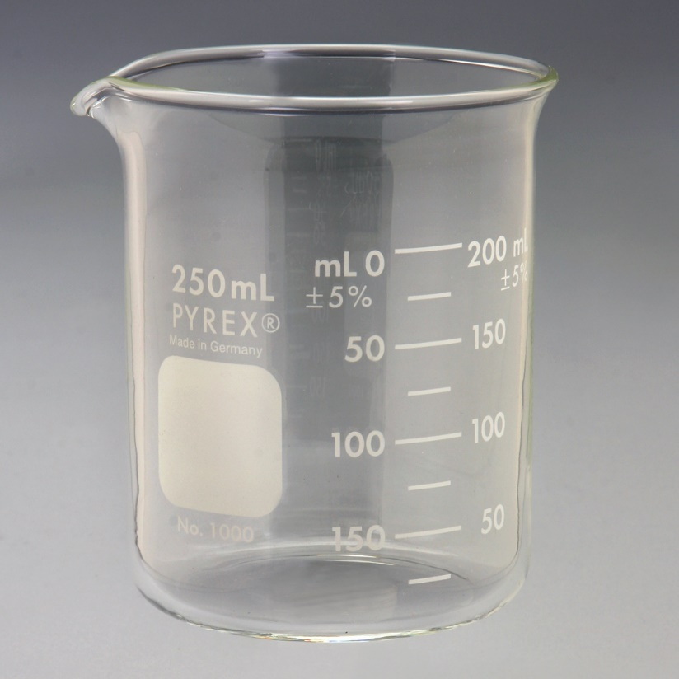
What is it? What is it for?
Beaker
holding liquids or solids (NOT MEASURING)

Slide 14
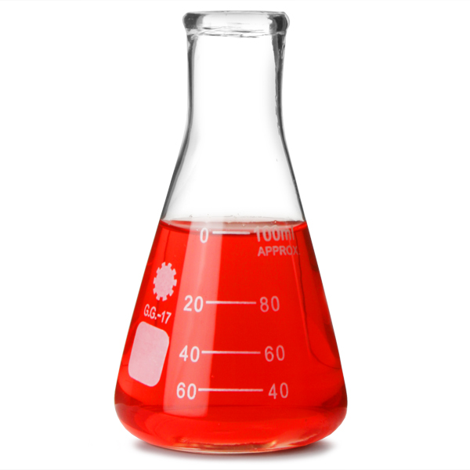
What is it? What is it for?
Conical flask
holding and mixing liquids

Slide 15
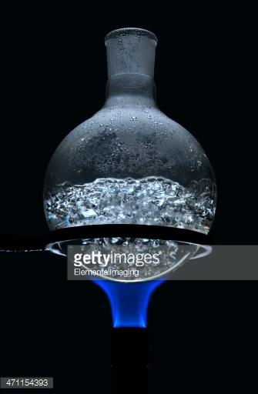
What is it? What is it for?
Round bottomed flask
heating liquids

Slide 16
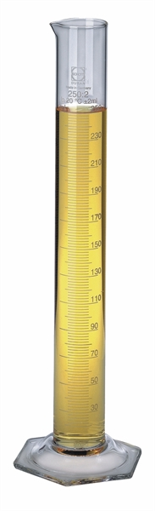
What is it? What is it for?
Measuring cyclinder
Measuring volumes of liquid

Slide 17
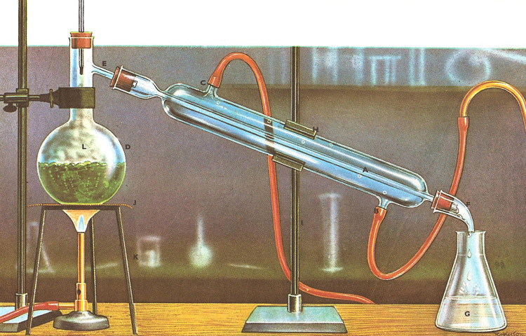
What is it? What is it for?
condenser
Cooling down hot gases so they turn into liquids

Slide 18
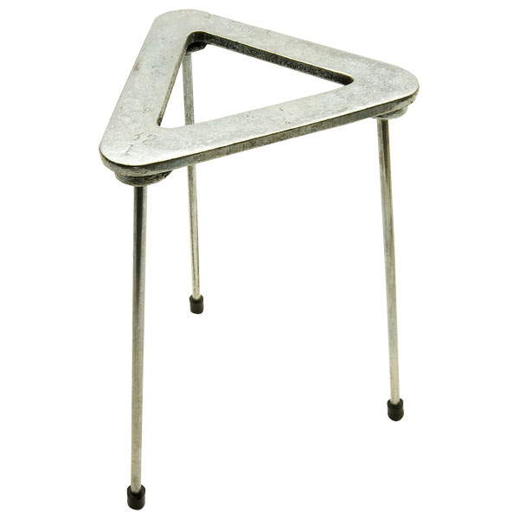
What is it? What is it for?
tripod
heating a beaker, flask or crucible over a Bunsen burner

Slide 19
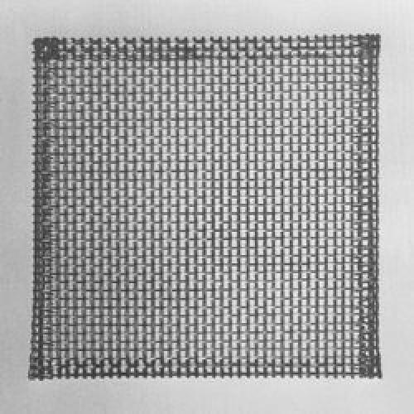
What is it? What is it for?
gauze
supporting a beaker or flask and spreading the heat from the flame

Slide 20
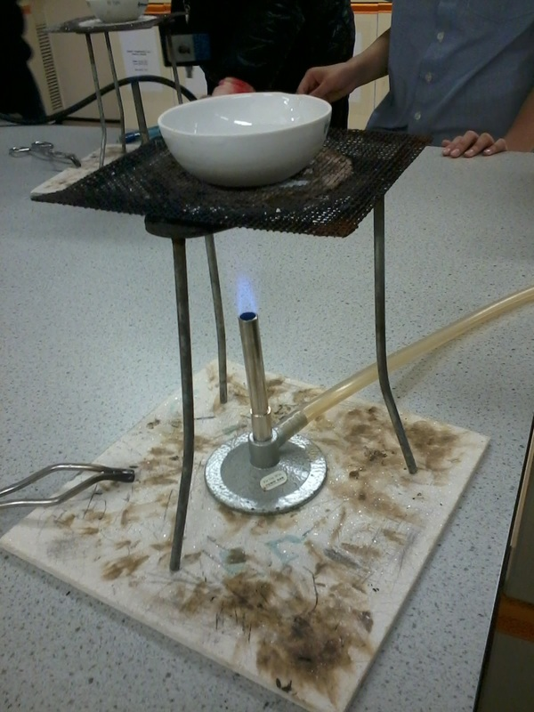
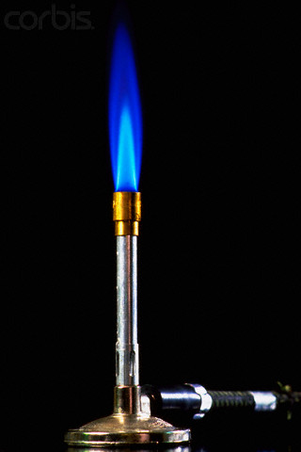
What is it? What is it for?
Bunsen burner
Heating things

Slide 21
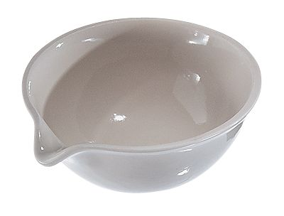
What is it? What is it for?
Evaporating basin
Evaporating water from a solution

Slide 22
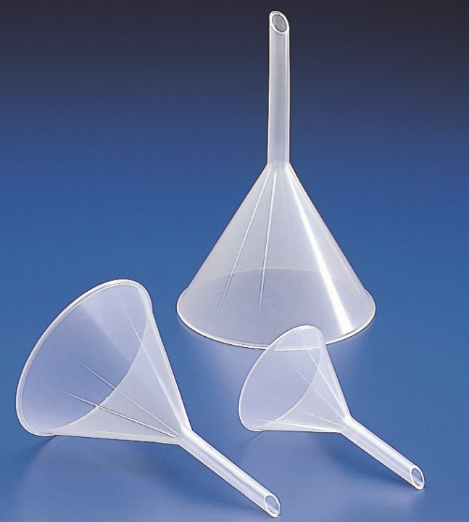
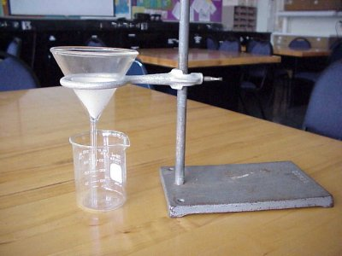
What is it? What is it for?
Filter funnel (with filter paper)
Separating a solid from liquid

Slide 23
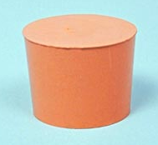
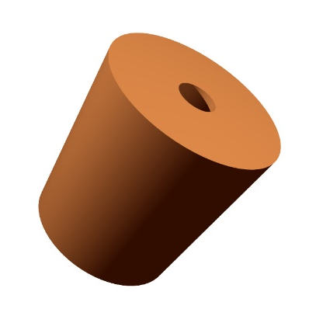
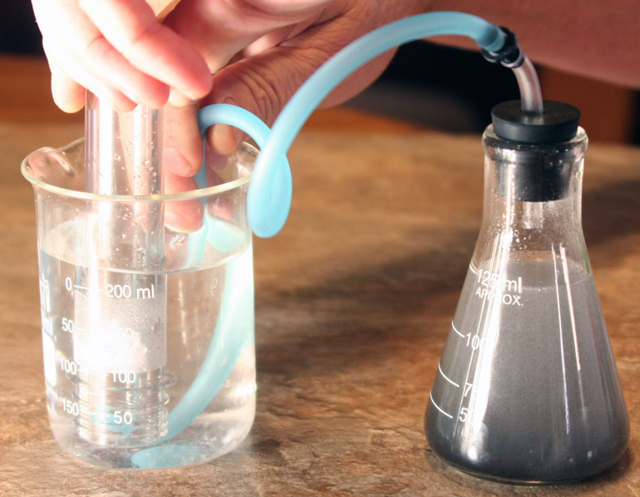
What is it? What is it for?
Rubber bung (with or without hole)
Keeping things in a tube or flask (hole is to put a tube through)

Slide 24
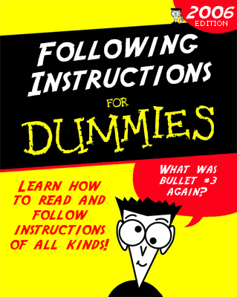
Homework
  Design a poster for your lab, showing one safety rule and the reason for having it.
  Be Creative!

