Slide 1
Starter: Quick Quiz
What gas is produced when metals are reacted with acid?
How do you test to see if this gas is present?
Extension: Write the word equation for magnesium reacting with hydrochloric acid.

Slide 2
L10 Carbonates and Acid
Learning Objectives:
Recall that carbon dioxide gas is released when carbonates react with acid.
Describe the test for carbon dioxide.
Write word equations for the reaction of carbonates with acid.

Slide 3

Calcium + Hydrochloric Acid → Calcium Chloride + Hydrogen
Lithium + Sulphuric Acid → Lithium Sulphate + Hydrogen
Iron + Nitric Acid → Iron Nitrate + Hydrogen
Sodium + Sulphuric Acid→ Sodium Sulphate + Hydrogen
Potassium + Nitric Acid → Potassium Nitrate + Hydrogen

Slide 4
Extension
Zinc + Phosphoric Acid → Zinc Phosphate + Hydrogen
Beryllium + Citric Acid → Beryllium Citrate + Hydrogen
Vanadium + Ethanoic Acid → Vanadium Ethanoate + Hydrogen

Slide 5

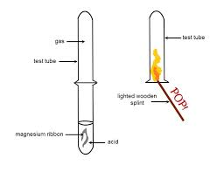
Test for Hydrogen Gas
Collect enough gas in a test tube.
Hold a lit splint or match to the mouth of the test tube.
If the gas burns with a squeaky pop, then the gas is hydrogen.

Slide 6
Practical: Carbonates and Acid
We are now going to investigate another reaction, carbonates reacting with acids.
(HINT: we have discussed this before as this counts as a neutralisation reaction and happens when an indigestion tablet is used)

Slide 7
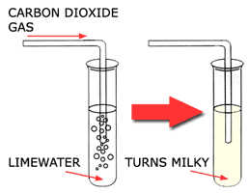
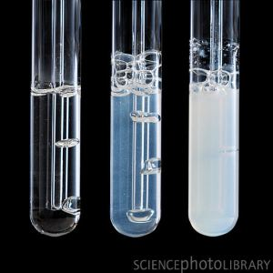
Test for Carbon Dioxide Gas
Bubble the unknown gas into a test tube containing limewater.
If the limewater turns cloudy and white, then the gas was carbon dioxide.

Slide 8
Word Equations for Carbonates Reacting With Acids
Metal Carbonate + Acid → Salt + Water + Carbon Dioxide
The reaction of carbonates with acid always produces carbon dioxide gas.
The salt we name as we have done before.

Slide 9
calcium carbonate + sulphuric acid →
magnesium carbonate + nitric acid →
barium carbonate + hydrochloric acid →
Write an equation for a reaction that forms sodium chloride.
Write an equation for a reaction that forms lithium nitrate.

Slide 10
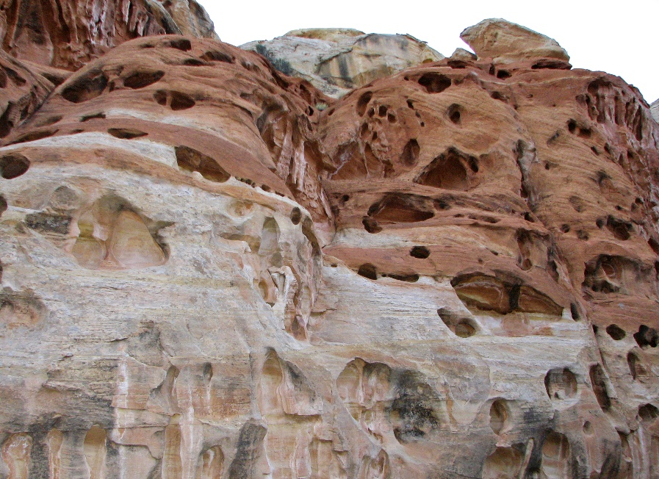
Weathering of Carbonate Rocks
Many rocks contain calcium carbonate.
Rain, which is slightly acidic, wears away the rock when the neutralisation reaction happens.
Acid rain will make the reaction happen even faster.
This wearing away of rock is called chemical weathering.
Chemical weathering made the holes in this rock!

