Slide 1
L11: Combustion
Learning Objectives:
Recall the fire triangle, what is needed for a combustion reaction to happen.
Describe the products of combustion reactions.
Describe what a fuel is.
Write a word equation for a combustion reaction.

Slide 2
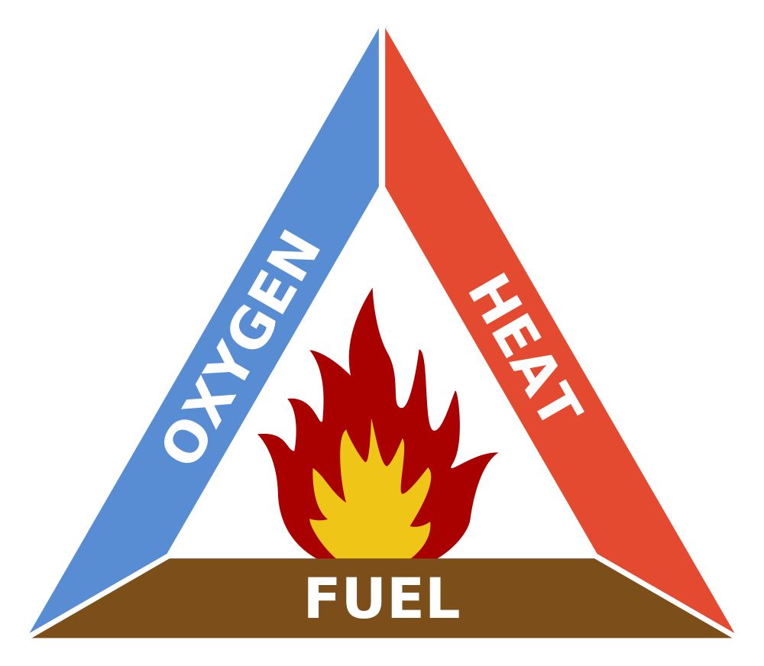
Combustion
Combustion is the chemical reaction when substances burn.
What do you need for combustion?
To put out a fire, remove one of these.

Slide 3

Fuels
Fuels are substances that store energy that is released when the material is burnt.
What are some examples of fuels?
What type of energy is released during combustion?
  Heat
  Light

Slide 4
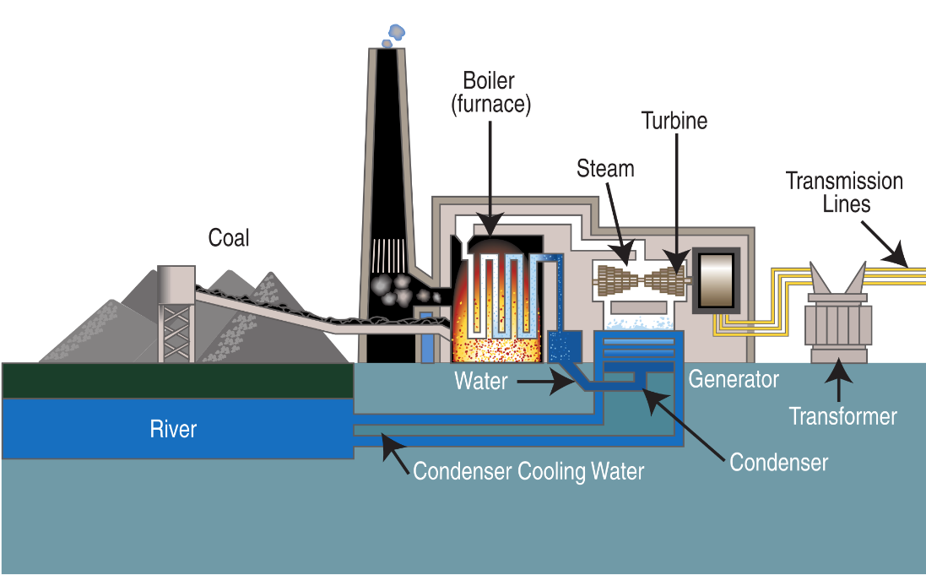
What do we use fuels for?
We use fuels to release heat energy.
This heat energy can be used to generate electricity in power stations.
This is how we get the electricity we need for all of out electrical appliances.

Slide 5
Practical: Burning Fuels Investigation
We are going to do an experiment to see if burning different fuels is the same.

Slide 6
Word Equation for Combustion
Fuel + Oxygen → Carbon Dioxide + Water
Fuel and Oxygen are reactants (starting materials).
Carbon Dioxide and water are products made during the chemical reaction.

