Slide 1
Forces L3: Friction
Learning Objectives:
Describe what the force of friction is.
Explain when it is useful to have high or low friction.
Analyse when it is useful to use lubricants.
Draw force diagrams to show friction forces.

Slide 2
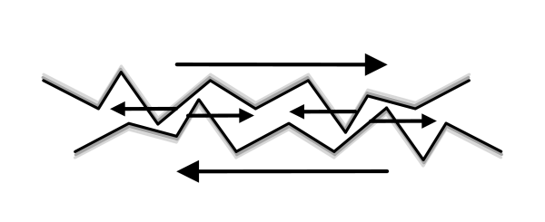
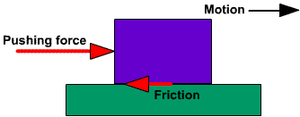
Friction
Friction is a force that happens when two surface move across each other.
A friction force is in the opposite direction to movement.
Surfaces are never completely smooth.
Friction is the force between two surfaces that slows down moving objects.

Slide 3
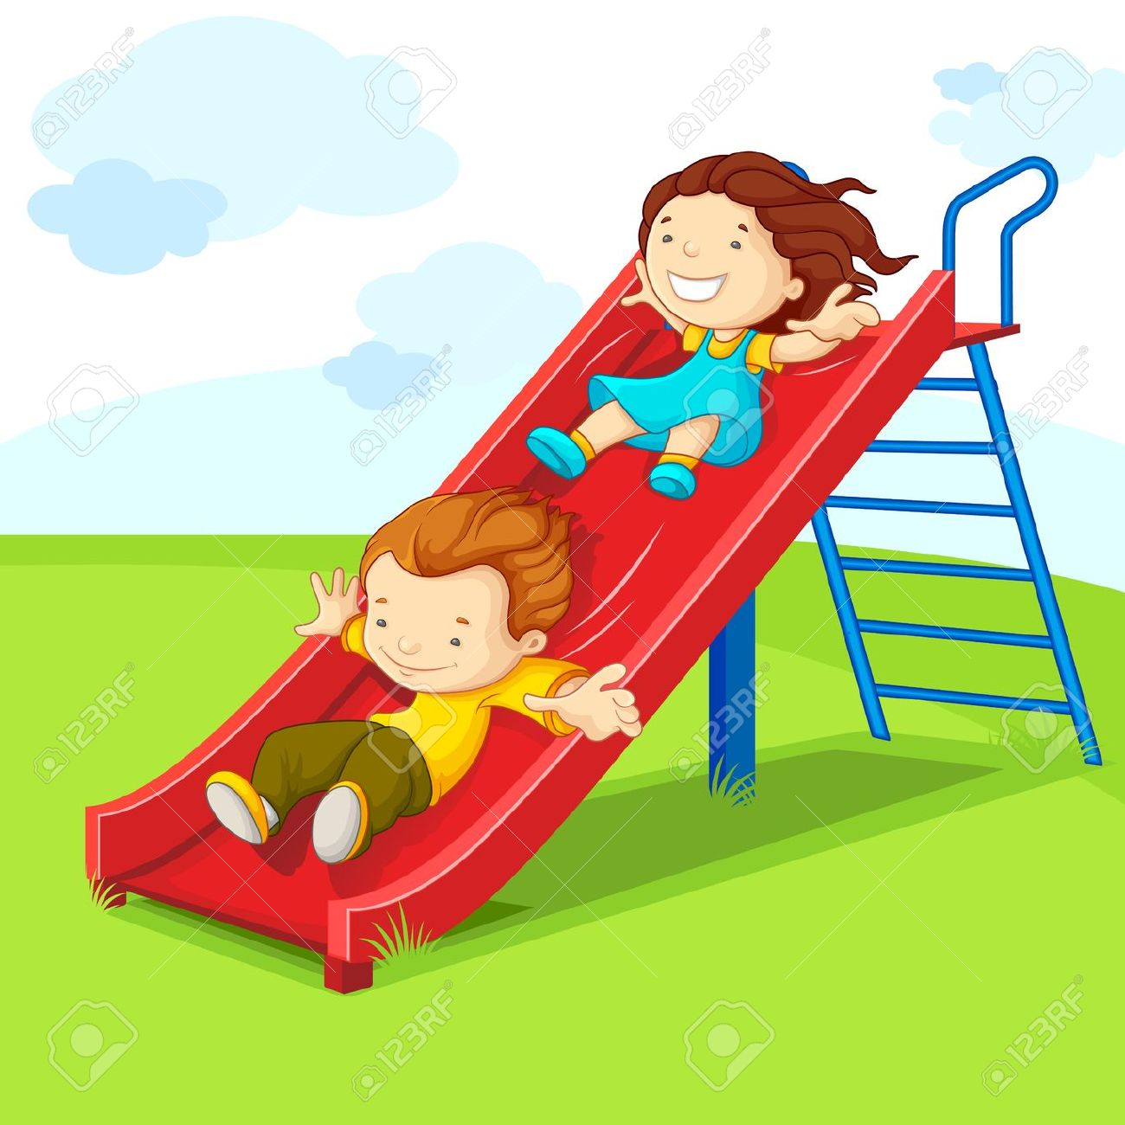
Friction
The frictional force between two smooth surfaces is low.
This is sometimes useful and sometimes not.
The surfaces slide over each other.

Slide 4
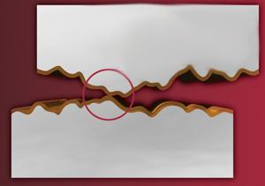
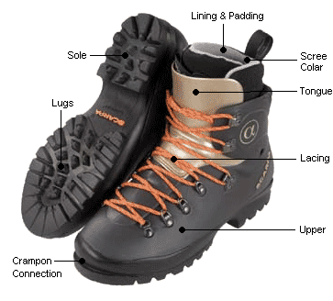
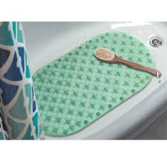
Friction
The frictional forces between two rough surfaces is high.
This means that the surfaces will grip together.

Slide 5
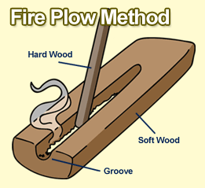
Friction
A high frictional force between two surfaces will cause heat energy to be produced.
(Energy transfer from kinetic to heat energy)

Slide 6
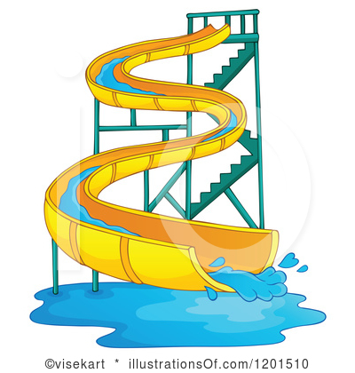
Friction
Putting oil or wax between the surfaces will decrease the frictional force between them.
This is called lubrication.
(Substances that can be used in this way are called lubricants).

Slide 7
Friction and Sport
Jack is going skiing.
Does he want high or low friction between his skis and the snow?
LOW
Explain your answer.
The lower the friction, the less of a force slowing him down.
He will be able to go faster with less friction.

Slide 8
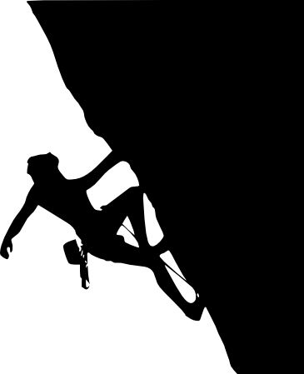
Friction and Sport
2. Jill is climbing.
Where does she need high friction?
HANDS
Explain your answer
Higher friction on her hands help her to grip the rock better, so she does not slip.

Slide 9
Friction and Sport
3. The drawing shows Samir riding his mountain bike.
Draw a circle around the places where there should be a lot of friction.
Explain why.
High friction is needed between the tires and the road to grip the road and move the bicycle forward.

Slide 10
Friction and Sport
b. Draw a square around the places where there should be low friction.
Explain why.
The gears should have low friction so less energy from pedalling is wasted as heat and slowing him down.
c. How can Samir make sure the friction in these places is as low as possible?
Add oil as a lubricant.

Slide 11
In which pictures is higher friction useful? | In which pictures is lower friction useful?

Slide 12
In which pictures is higher friction useful? | In which pictures is lower friction useful?
Matches | Car Engine
Writing | Shuttle
Gymnastics | Skiing
Walking | Skating
Shoelaces | Surfing

Slide 13
Lubrication
1
Gears should be oiled so that they move smoothly and don’t slow down her pedalling.
The brakes slow down the bike using friction so should not be lubricated.
Gravity and drag
Drag and friction
The bike will slow down as the drag is greater through water OR the tires could slip as the water acts as a lubricant.

Slide 14
Lubrication
2
Washing up liquid reduces the friction between the two surfaces.
The washing up liquid acted as a lubricant.
Oil or water could also be used as lubricants.
3
The wax reduces the friction slowing her down.
Air resistance and drag are forces that slow her down.

