Slide 1
Starter: Unscramble the key word
Acids are added to many foods for their tangy and rous taste.
Acids can be ocisrrove, this means it wears materials away.
Acid from food can corrode your ehtet.
Toothpaste is an aaklil and reacts with the acid. This prevents tooth decay.
Alkalis can be autscic, meaning they can cause chemical burns.

Slide 2
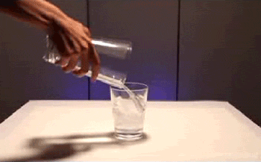
What is happening here?

Slide 3
Chemical Reactions L3: Indicators
Learning Objectives:
All students must be able to…
Describe what an indicator is.
Use indicators to identify if a substance is an acid or alkali.
Most students should be able to…
Recall some indicators.
Some students may be able to…
Describe the colours litmus turns acids and alkalis.

Slide 4
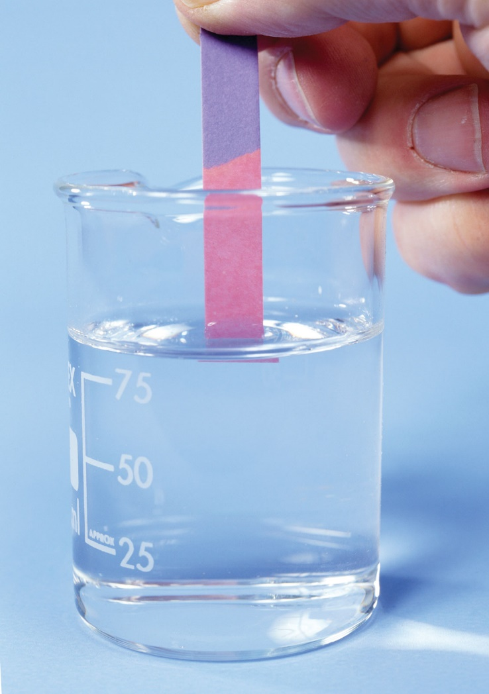
Indicators are substances that change colour when added to acids and alkalis
One example is litmus paper.
Blue litmus paper turns red when dipped in acid.
Red litmus paper turns blue when dipped in alkali.

Slide 5
Practical
We are going to make our own indicator and test it with a variety of substances.
Substance | Colour of Indicator | Acid or Alkali

Slide 6
Homework: Try this at home!
Try some other indicators, add to one acid (like lemon juice or vinegar) and one alkali (like soap or bicarbonate of soda) and record your results (if you can take a picture!)
Do you notice anything the indicators have in common?
Tea
Blackberry
Beets
Red grapes
Blueberries
Carrots
Flower petals
Indicator | Orig. Colour | Colour with Acid | Colour with Alkali

