Slide 1
L4: pH scale
Learning Objectives:
Use the pH scale to describe substances as weak or strong acids or alkalis.
Describe how universal indicator is used to determine the pH of a substance.
Name the pH of a few common substances.

Slide 2

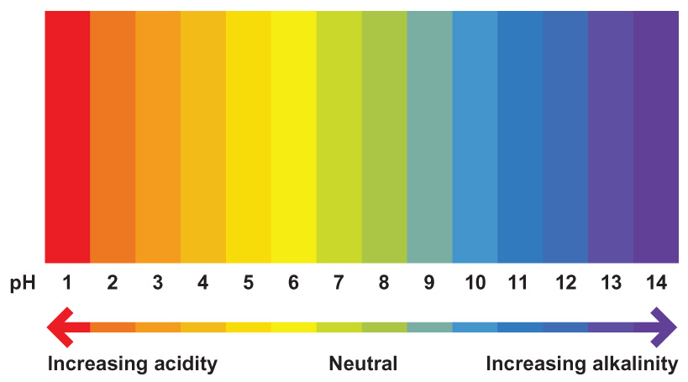
The pH scale is used to describe how acidic or how alkaline a substance is.

Slide 3
The pH scale goes from 0-14.
Acid < below 7 Neutral = 7 Alkali > Above 7

Slide 5
Universal Indicator
Universal indicator (UI) is a more accurate indicator.
UI changes colour depending on the specific pH of a substance.
We are going to do a practical to test the pH of a few different substances using universal indicator.

Slide 6
Make your own pH scale
Make a pH scale poster.

