Slide 1

Match up the substance with the pH
Lemon juice
Hydrochloric acid
Soap
Sodium hydroxide
Water
pH 14
pH 0
pH 3
pH 7
pH 9

Slide 2

Match up the substance with the pH
pH 14
pH 0
pH 3
pH 7
pH 9
Lemon juice
Hydrochloric acid
Soap
Sodium hydroxide
Water

Slide 3
L5: Neutralisation
Learning Objectives:
Understand that when an acid and an alkali are mixed together a neutralisation reaction happens.
Describe how to make a neutral solution from an acid and an alkali.
Write simple word equations to show the products of neutralisation reactions.

Slide 4
Neutralisation
Neutralisation = when an acid and an alkali are mixed together they cancel each other out
The chemical reaction produces two substances which are both neutral (not an acid or an alkali).

Slide 5
Neutralisation reaction
Acid + Alkali → Salt + Water
This is called a word equation. It shows you what happens in the chemical reaction.
On the left is what you start with, these are called the reactants.
On the right is what you make in the reaction, these are called the products.

Slide 6
A neutralisation reaction makes neutral products
Hydrochloric acid + sodium hydroxide → sodium chloride + water
If you add an acid like hydrochloric acid (pH 0) to an alkali like sodium hydroxide (pH 14) you end up with water (which we know is neutral) and a salt (which is also neutral). They “cancel out”.
The pH of the new solution will be in between the two pHs of the reactants. It may not be 7 though because there may be more of either the acid or the alkali.

Slide 7
Practical: Neutralisation Challenge!
We are going to try to make a neutral solution by neutralising a sample of hydrochloric acid with sodium hydroxide.
If you add a little too much, there will be extra alkali and the pH will go over 7.
What do you think we can do to fix that?

Slide 8
What is the salt produced?
A salt is a type of chemical. Table salt (that we eat) is only ONE chemical salt, sodium chloride.
We can make sodium chloride in the following reaction:
Hydrochloric acid + sodium hydroxide → sodium chloride + water
Can you see a way to predict what salt will be made?

Slide 9
Predicting the Salt Produced
Hydrochloric acid + sodium hydroxide → sodium chloride + water
The first part of the name of the salt comes from the first part of the alkali. (The sodium from sodium chloride, comes from sodium hydroxide)
The second part of the name comes from the second part of the acid. (The chloride from sodium chloride, comes from hydrochloric acid).

Slide 10
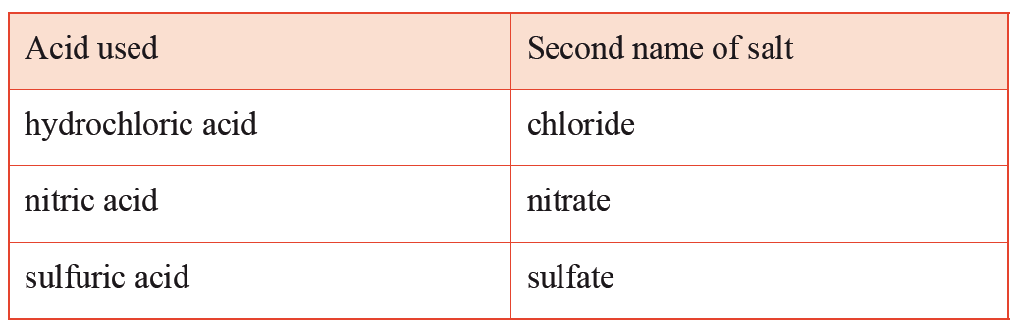
Different Acids Produce Different Salts

Slide 11
Now you try!
Acid + Alkali → Salt + Water
hydrochloric acid + magnesium hydroxide →
nitric acid + sodium hydroxide →
sulphuric acid + calcium hydroxide →

Slide 12
Now you try!
Acid + Alkali → Salt + Water
hydrochloric acid + magnesium hydroxide →
magnesium chloride + water
nitric acid + sodium hydroxide →
sodium nitrate + water
sulphuric acid + calcium hydroxide →
calcium sulphate + water

