Slide 1
Starter: complete the equations
Hydrochloric acid + sodium hydroxide → __________ + ___________
Sulphuric acid + potassium hydroxide → __________ + __________
Nitric acid + ___________ → magnesium nitrate + ____________
__________ + calcium hydroxide → calcium sulphate + __________

Slide 2
Acids and Alkalis L6: Uses of Neutralisation
Learning Objectives:
Recall the uses for neutralisation reactions including:
Indigestion tablets
Toothpaste
Treating acid rain
Baking
Describe how each use involves the neutralisation of acid.
Write word equations for the reaction of acids and carbonates.

Slide 3
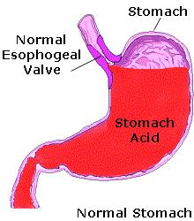
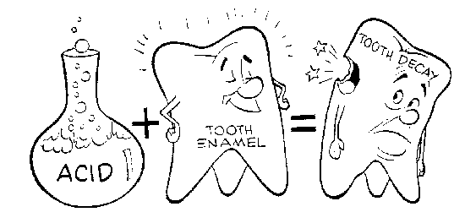
Neutralisation reactions can be very useful
Acids can be harmful as they are corrosive.
Alkalis can be used to neutralise and get rid of harmful acid.
Examples:

Slide 4
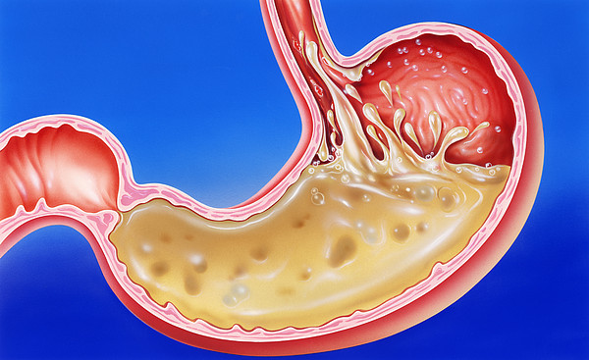
Use 1: Indigestion Tablets
The stomach contains hydrochloric acid, which kills bacteria from food to prevent you getting sick.
BUT, if the stomach has too much acid, this leads to indigestion (stomach pain or heartburn).

Slide 5
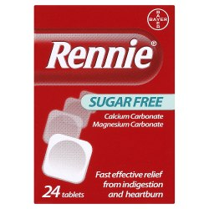
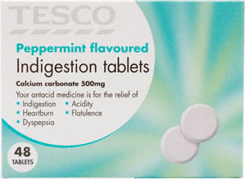
How do we get rid of this extra stomach acid?
Indigestion tablets (medicine) contains an alkali, which reacts with the extra acid and neutralises it.
Can you find the name of the type of alkali used in these tablets?

Slide 6
Carbonates and Hydroxides are both alkalis
Look at the two neutralisation reactions, what is different?
Hydrochloric acid + calcium hydroxide → calcium chloride + water
Hydrochloric acid + calcium carbonate → calcium chloride + water
+ carbon dioxide
When acids react with carbonates, carbon dioxide (a gas) is produced.
This means the tablets will create gas in your stomach and can make you burp.

Slide 7
If tablets with carbonates make you burp, why don’t we use hydroxides instead?
Calcium carbonate – pH = 9.4
Calcium hydroxide – pH = 12.4
Use the information to write an explanation for why we use calcium carbonate instead of calcium hydroxide in indigestion tablets.
Calcium carbonate is a weak alkali so is safe to eat. It will only neutralise a little bit of the stomach acid to get rid of the indigestion but does not neutralise too much stomach acid.
Calcium hydroxide is a strong alkali and is more dangerous.

Slide 8
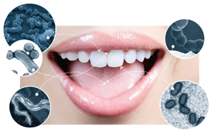
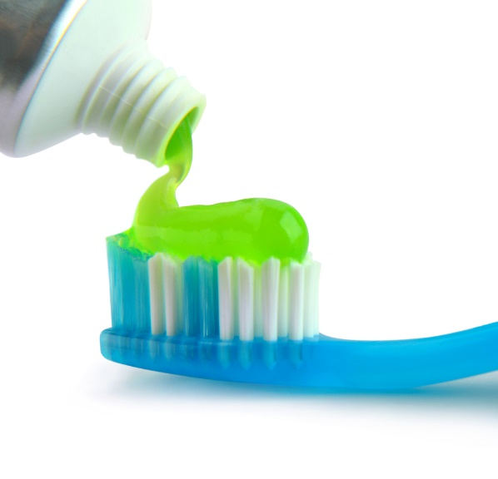
Use 2: Toothpaste
The mouth contains a lot of bacteria.
The bacteria feed on food left in your mouth and produce acid.
This acid corrodes your teeth, leading to tooth decay.
Write an explanation for how you think brushing and toothpaste works.

Slide 9
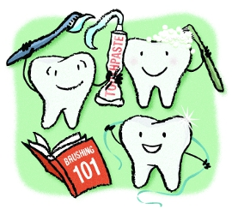
Why should you brush your teeth?
Brushing removes bits of leftover food, so the bacteria have less to eat and make less acid.
The toothpaste is a weak alkali, which neutralises acid in the mouth.
This prevents the acid causing tooth decay.

Slide 10
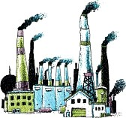
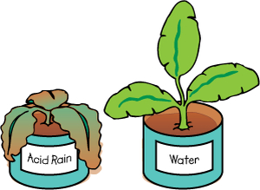
Use 3: Neutralising Acid Rain
Pollution can cause rain to become acidic.
Acid rain can cause rivers, lakes, and soil to become very acidic.
Why is this dangerous?
Animals (like fish) and plants living in rivers in lakes can die.
Plants cannot grow well in acidic soil.

Slide 11
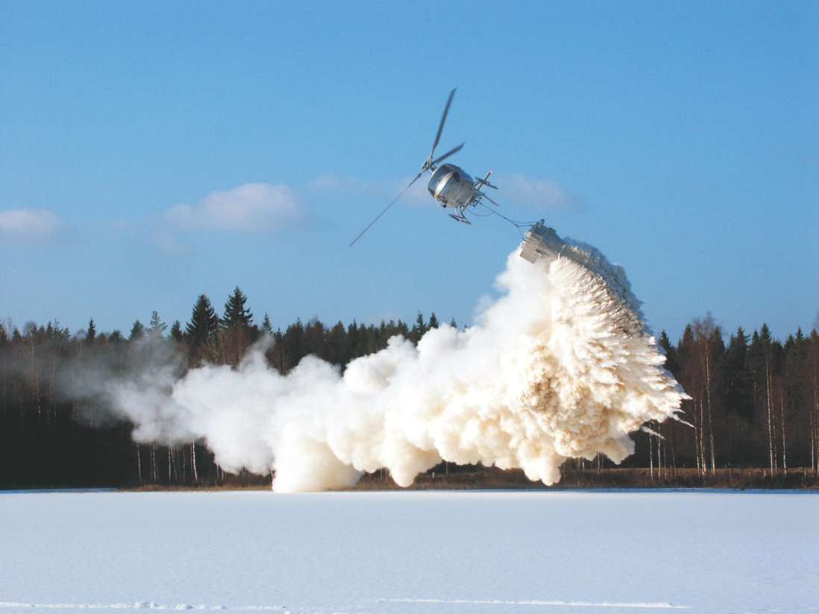
Write a possible solution for acid rain.
Powdered alkali (calcium carbonate) can be added to rivers, lakes, and soil to neutralise the extra acid.

Slide 12
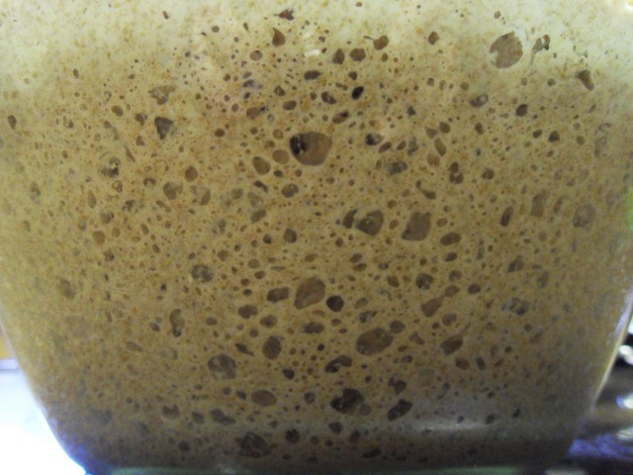
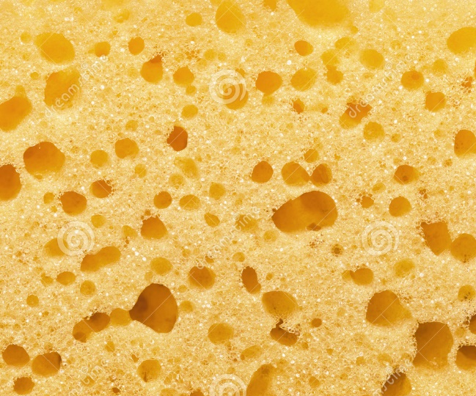
Use 4: Baking
Review
Acid + Carbonate → Salt + Water + Carbon Dioxide
Sodium bicarbonate (an alkali) is often called baking soda or bicarbonate of soda.
Baking powder contains sodium bicarbonate plus an acid, tartaric acid.
This causes carbon dioxide bubbles to form when making batter.
This makes baked goods fluffy instead of hard.

Slide 13
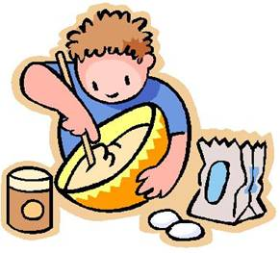
Baking word equation
Sodium bicarbonate + tartaric acid →
_________ tartrate + ________ + __________ ___________

Slide 14
Summary Activity
Choose one of the following summary activities.
Option 1: complete a fill in the blank explanation of the uses.
Option 2: write your own summary of each use of neutralisation.
Use 1: Indigestion tablets
Use 2: Toothpaste
Use 3: Treating Acid Rain
Use 4: Baking

Slide 15
Use 1: Indigestion
Indigestion is caused by too much _____ in the stomach. ______ can be used to _________ and remove the extra ______ .
Use 2: Toothpaste
_________ feed on food in the mouth and produce ______, which can cause tooth decay. Toothpaste contains _______ to neutralise the ______.
Use 3: Acid Rain
________ causes acid rain, which can harm the environment. Powdered ________ can be added to rivers, lakes, and soil to _________ the acid.
Use 4: Baking
Carbonates produce _________ _________ when reacting with acid. This produces bubbles in batter and makes baked goods fluffy.

Slide 16
Use 1: Indigestion
Indigestion is caused by too much acid in the stomach. Alkali can be used to neutralise and remove the extra acid.
Use 2: Toothpaste
Bacteria feed on food in the mouth and produce acid, which can cause tooth decay. Toothpaste contains alkali to neutralise the acid.
Use 3: Acid Rain
Pollution causes acid rain, which can harm the environment. Powdered alkali can be added to rivers, lakes, and soil to neutralise the acid.
Use 4: Baking
Carbonates produce carbon dioxide when reacting with acid. This produces bubbles in batter and makes baked goods fluffy.

