Slide 1

Starter: What is everything made of?
Think
Pair
Share

Slide 2
L8 Chemical Reactions
Learning Objectives:
Recall the signs a chemical reaction has happened.
State the law of conservation of mass.
Draw a particle model diagram for a chemical reaction.
Compare chemical and physical changes.
Explain what happens in a chemical reaction in terms of particles.

Slide 3
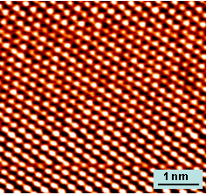
1. Everything is made of particles
Particle = a very small portion of matter
Matter = physical substance
Particle Theory: Everything is made of particles of matter.
There are different types of particles.

Slide 4
2. The Particle Model
Atom: the smallest particle of matter
In the particle model we draw these as a circle.
Elements: Different types of atoms are called different elements.
These are found on the periodic table.
We draw different elements as different coloured circles.
You can also label them with the symbol.
H
C

Slide 5
3. Particle Model: Molecule
Molecule: two or more atoms chemical joined (bonded) together
We draw this as circles that are touching.
Example: Methane
This is the particle model of the gas that we use in our Bunsen burners, methane.
How many atoms? How many elements?
H
H
C
H
H

Slide 6
4. Chemical Formulae
Chemical formula: tells you how many atoms of each element is in a molecule.
Example: Water
H₂O
H
H
O
hydrogen
oxygen
1 atom of oxygen
2 atoms of hydrogen

Slide 7
5. Law of Conservation of Mass
Law of Conservation of Mass = matter cannot be created or destroyed, only rearranged
What this means is that atoms cannot be made or destroyed, only their positions or what atoms they are bonded to can change.
H
H
H
H
O
O
O
H
H
H
H
O

Slide 8
6. What is a chemical reaction?
Chemical reaction = when the atoms are rearranged to form new substances.
Examples:
Neutralisation
Acid + Base → Salt + Water
Burning
Methane + Oxygen → Carbon Dioxide + Water

Slide 9
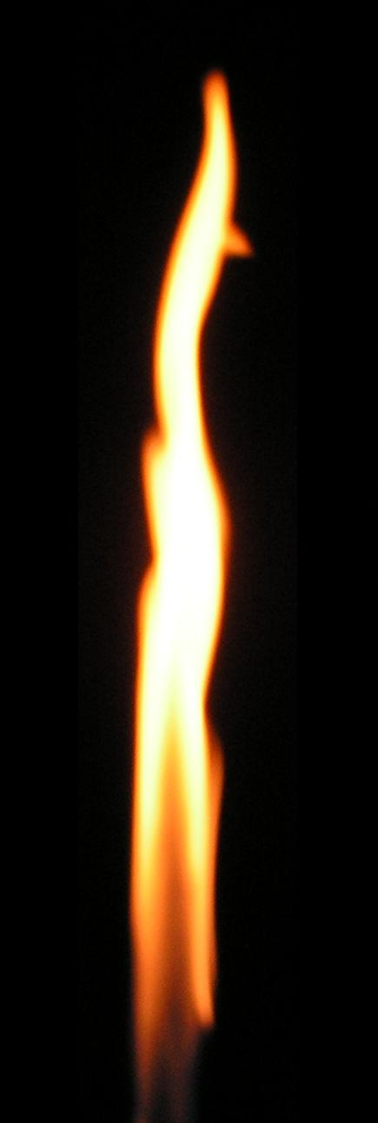
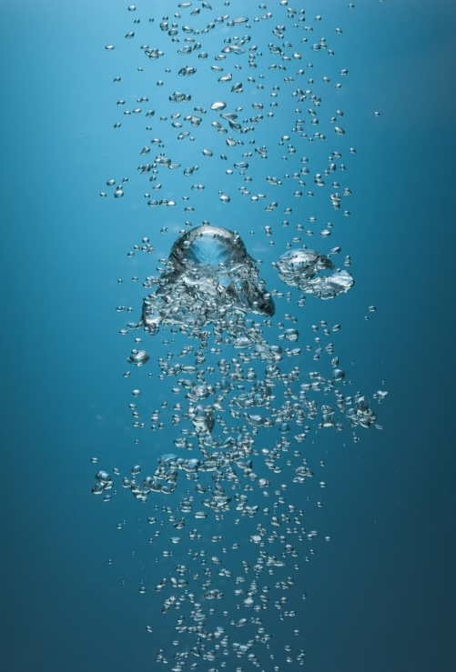
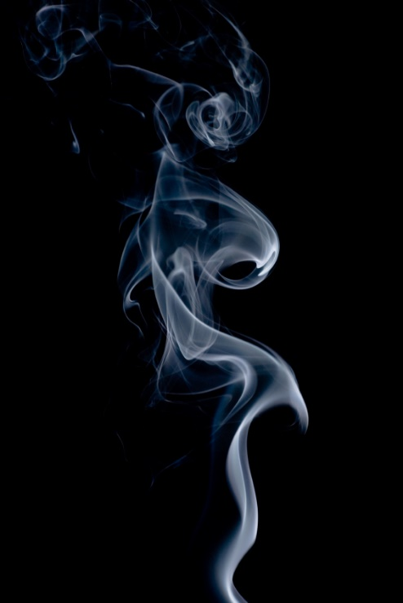
7. How could you tell that a chemical reaction has happened?
Video: 10 Chemical Reactions
Watch the video and write down what you think are signs of a chemical change.
Evidence for a chemical reaction
Colour Change
Energy Given Out (light or heat)
Gas being formed
Notes:
Video: Evidence of a Chemical Reaction

Slide 10
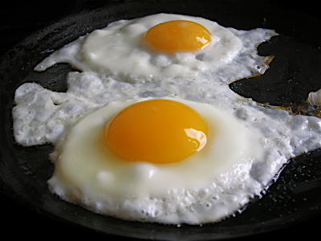
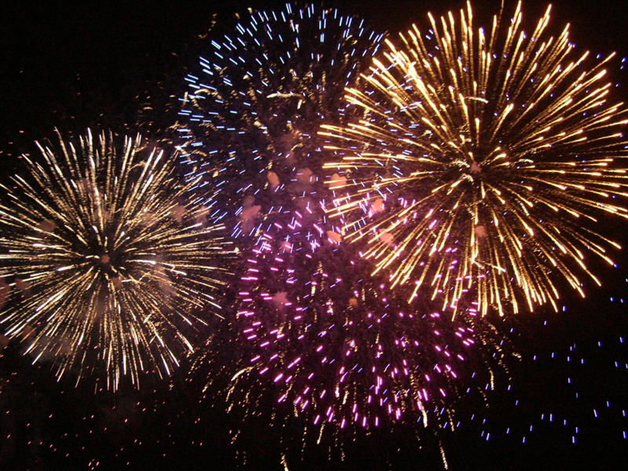
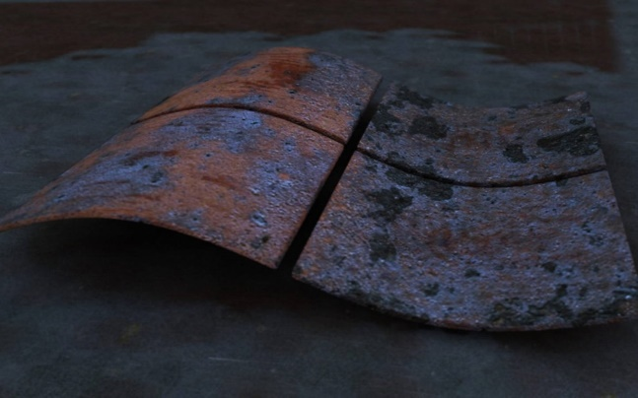
8. Chemical change
Chemical change = a change that involves a chemical reaction, a new substance is always formed, is irreversible
Examples:
Burning
Cooking
Fireworks
Rusting

Slide 11
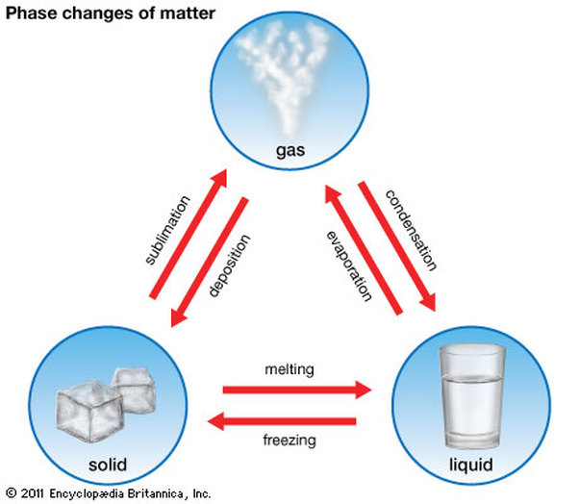
9. What is NOT a chemical change
Physical change = a change where the substance (chemical) remains the same, often reversible
Examples:
Freezing
Melting
Boiling
Cutting
Painting

Slide 12

HW: Extended Writing Task
Describe an example of a chemical change. Explain what a chemical change is and compare it to a physical change. Provide evidence of how you know that this example is a chemical change and not a physical change.

