Slide 1
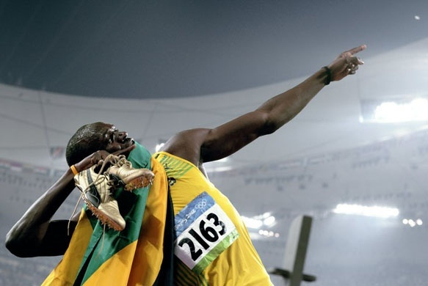
How fast is the fastest man alive?
Notes:
Usain Bolt

Slide 2
Lesson 5 – Speed
Learning Objectives:
Calculate speed using the equation speed = distance / time.
Analyse distance/time graphs.
Carry out an experiment to measure speed.

Slide 3
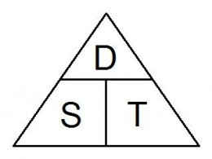
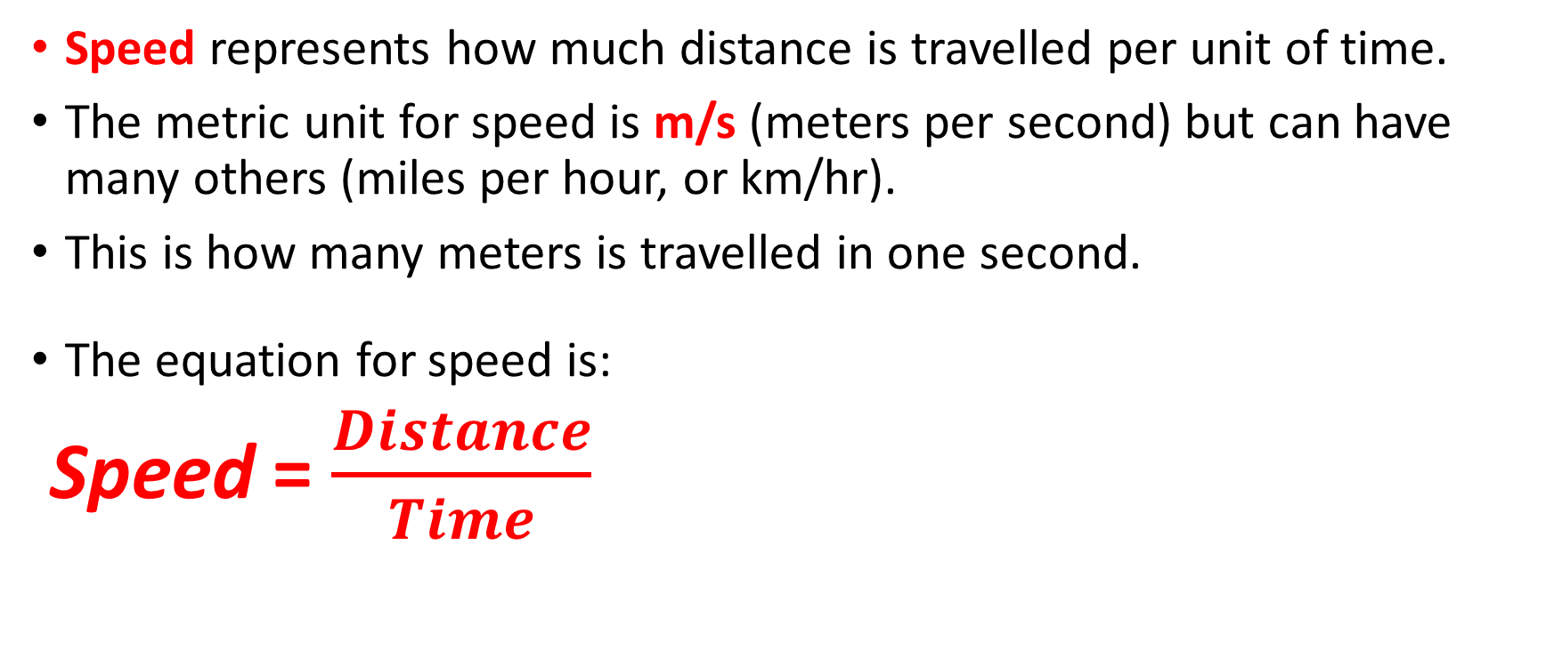
Speed
Speed represents how much distance is travelled per unit of time.
The metric unit for speed is m/s (meters per second) but can have many others (miles per hour, or km/hr).
This is how many meters is travelled in one second.
The equation for speed is:
Speed = $\frac{Distance}{Time}$

Slide 4
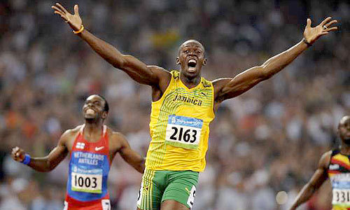
Just how fast is Usain Bolt?
He ran the 100m in 9.58s. What was his average speed?
He ran the 200m in 19.19s. What was his average speed?
Explain why this is only his average speed.
Notes:
Click to watch his world record race
About 23 miles per hour

Slide 5
1. He ran the 100m in 9.58s. What was his average speed?
S = d /t = 100 / 9.58 = 10.44 m/s
2. He ran the 200m in 19.19s. What was his average speed?
S = d / t = 200 / 19.19 = 10.42 m/s
3. He is not running the same speed throughout. He starts off slow and accelerates up to his top speed
Notes:
About 23 miles per hour

Slide 6
Use the formula for speed (speed = distance / time) to write down:
The speed of a car that travels 100m in 3 seconds.
The speed of a ball that travels 20m in 0.5 seconds.
The time it takes a man to walk 1km at a speed of 2m/s.
Extension: Now write 2 of your own questions and show the solution with working

Slide 7
Peer marking – 3 marks per question
s = d/t = 100 / 3 = 33.33 m/s
s = d / t = 20 / 0.5 = 40 m/s
s = d / t
t = d / s = 1000 / 2 = 500s

Slide 8
Experiment- measuring speed
Discuss: What measurements will you need to make in order to calculate the speed of a marble down a ramp?
Independent variable (thing we will change) =
Dependent variable (thing we will measure)=
Which variables I will control (keep the same) in order to have a fair test =
Apparatus I will need:
Draw a simple diagram of how your apparatus will be set up using a ruler and pencil
5. To be safe I will…
6. Method: First, I will set up the apparatus…

Slide 9
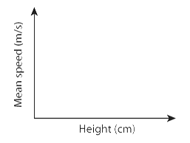
Distance =
Ramp height (cm) | Time 1 (s) | Time 2 (s) | Time 3 (s) | average time (s) | Average speed (m/s)
Display your results on a line graph. You need to use axes like these.
1. How does the height of the ramp affect the speed of the car?
2. How reliable were your results? (Hint: how close were your repeated results to each other?)
3. A Suggest one way to improve your investigation.
B Explain why your suggestions will improve the investigation.

Slide 10
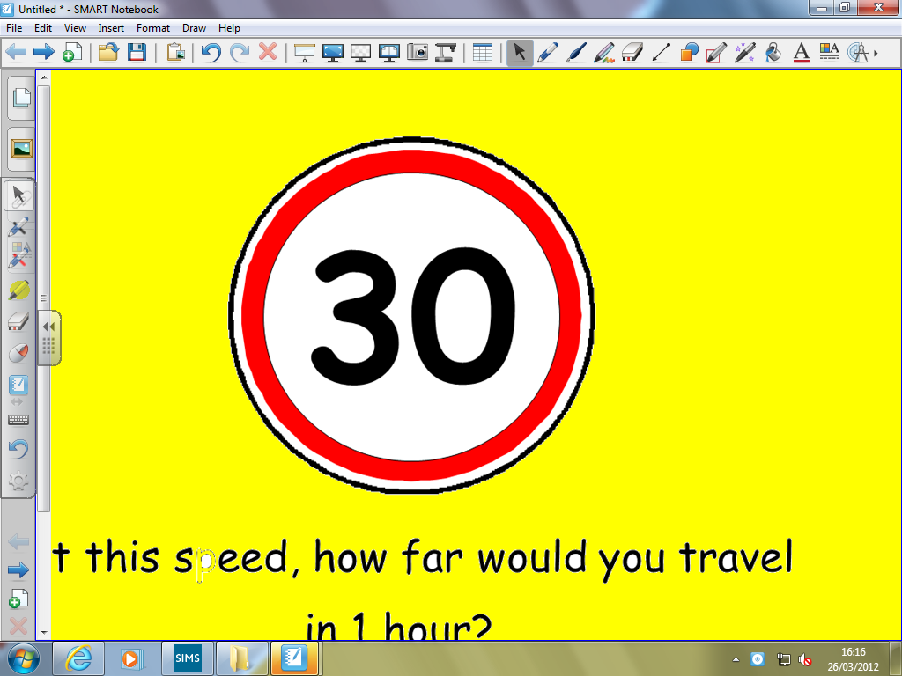




Try these
At this speed, how far would I travel in 1 hour?
30 miles
At this speed, how far would I travel in 2 hours?
30 x 2 =
60 miles
Two lots of 30 minutes in an hour
15 miles
At this speed, how far would I travel in 20 minutes?
Three lots of 20 minutes in an hour
10 miles
Where would you see this sign and what does it mean?
At this speed, how far would I travel in 10 minutes?
Six lots of 10 minutes in an hour
5 miles
Notes:
10

Slide 11
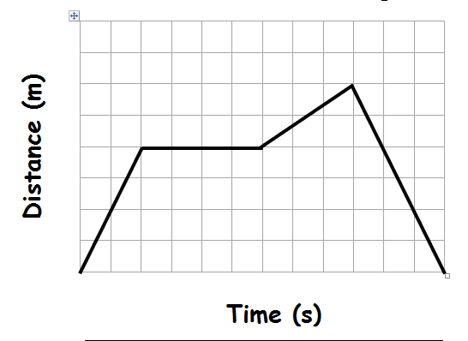
A distance-time graph describes a journey. The slope of the line tells you the speed of the object (i.e. how many metres they travel in how much time). Sketch this graph and match the labels to the lines
High speed
stationary
Low speed
Travelling back to where you started
Notes:
You could also say that the last section (travelling back) is a high speed because it is a steep gradient – it is just a high speed back the opposite direction

Slide 12
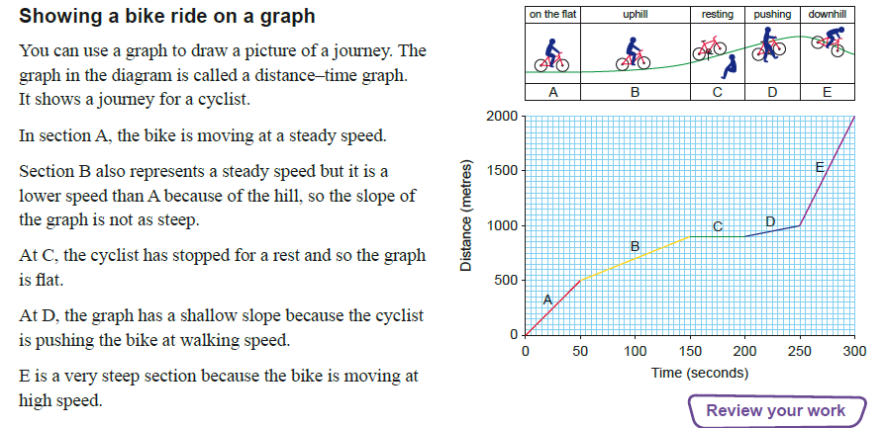
Distance – Time Graph (Steepness = Speed)

Slide 13
Calculating Speed from a Distance Time Graph

Slide 14
Calculating Speed from a Distance Time Graph

Slide 15
Complete the WS

Slide 16
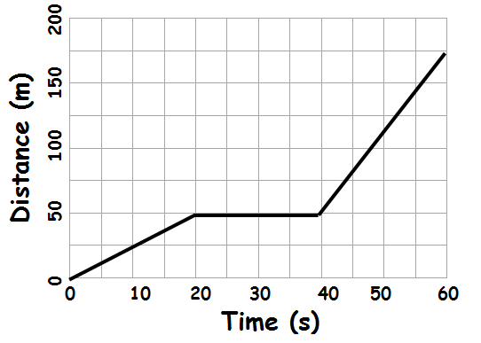
Calculating speed from distance time graphs
Describe this journey. (use numbers from the graph in your description)
What is the speed in the first 20s?
What is the speed from 20 to 40s?
What is the speed from 40 to 60s?
Notes:
Moves with constant speed travelling 50m in 20s, then is stationary for 20s, then travels at a greater speed for 20s, covering a distance of 125m.
S = d/t = 50 / 20 = 2.5 m/s
0 m/s
S = d/t = 125 / 20 = 6.25 m/s

Slide 17
Describe this journey. (use numbers from the graph in your description)
What is the speed in the first 20s?
What is the speed from 20 to 40s?
What is the speed from 40 to 60s?
ANSWERS
1. Moves with constant speed travelling 50m in 20s, then is stationary for 20s, then travels at a greater speed for 20s, covering a distance of 125m.
2. S = d/t = 50 / 20 = 2.5 m/s
3. 0 m/s
4. S = d/t = 125 / 20 = 6.25 m/s
Now do the same for the graphs on your worksheet

