Slide 1
Lesson 6 – Floating and Sinking
Learning Objectives:
Calculate density
Predict if something will float or sink based on it’s density.
Draw force diagrams for floating and sinking objects.

Slide 2
Density
Density = how heavy an object is for it’s size (measured in g/cm³)
Density = $\frac{Mass}{Volume}$
Mass = how much matter is in an object (measured in grams (g))
Volume = how much space an object takes up (measured in cm³)

Slide 3
Calculate the density (show your work)
Pure Water: 10 cm³ has a mass of 10 g
Wood: 100 cm³ has a mass of 75 g
Cork: 8 cm³ has a mass of 2 g
Iron: 5 cm³ has a mass of 40 g
Foam: 300 cm³ has a mass of 30 g
Copper: 5 cm³ has a mass of 45 g
Rubber: 10 cm³ has a mass of 11 g

Slide 4
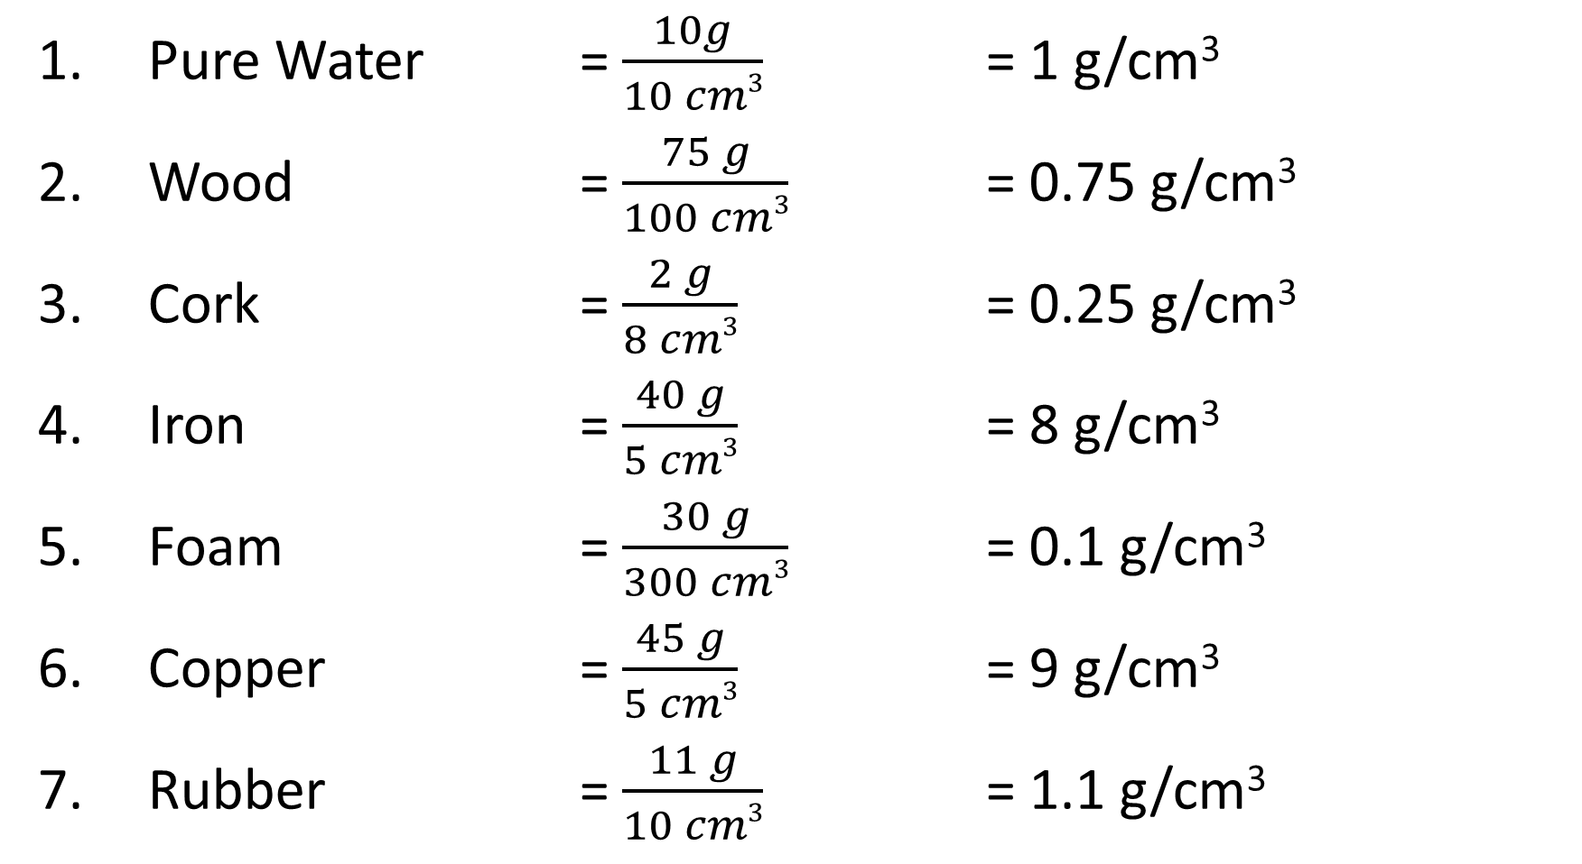
Pure Water = $\frac{10g}{10 cm3}$ = 1 g/cm³
Wood = $\frac{75 g}{100 cm3}$ = 0.75 g/cm³
Cork = $\frac{2 g}{8 cm3}$ = 0.25 g/cm³
Iron = $\frac{40 g}{5 cm3}$ = 8 g/cm³
Foam = $\frac{30 g}{300 cm3}$ = 0.1 g/cm³
Copper = $\frac{45 g}{5 cm3}$ = 9 g/cm³
Rubber = $\frac{11 g}{10 cm3}$ = 1.1 g/cm³

Slide 5
Practical: Will it Float or Sink?
Purpose: We are going to investigate whether or not certain objects will float or sink in water.
Object | Density | Prediction: Float or Sink? | Result: Float or Sink?

Slide 6
Conclusion
The density of water is 1 g/cm³.
Use this information to write a conclusion for the experiment explaining why some materials float and others sink.
Materials with a lower density than water will float.
Materials which have a higher density than water will sink.

Slide 7
Buoyancy (Ability to Float)
Small F_{gravity}
The amount of upthrust (buoyant force) from the water depends on the volume of the object.
If the upthrust is larger than the force of gravity (weight), the object floats.
If the upthrust is smaller than the force of gravity (weight), the object sinks.
Large F_{upthrust}
Large F_{gravity}
Small F_{upthrust}

