Slide 1
How can you make the best hot chocolate?

Slide 2
Solutes, solvents and solutions
Lesson Objectives:
Recall words used to describe mixtures and solutions
Explain why filtering cannot be used to separate solutes from solvents

Slide 3
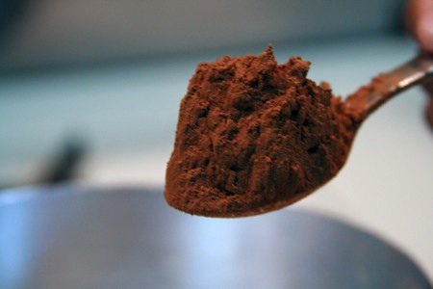
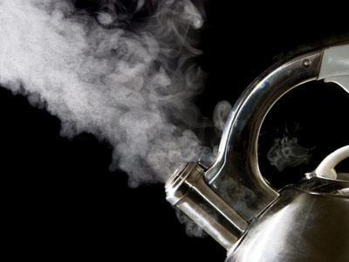
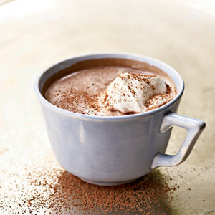
When hot chocolate powder is dissolved in
hot water we form a chocolate drink

Slide 5
The solid dissolved in a liquid is called the solute
The liquid the solid is dissolved in is called the solvent
A solid dissolved in a liquid makes a solution

Slide 6
Solvent, Solute & Solution
Powder = solute
Substance that gets dissolved
Water = solvent
Substance that does the dissolving
Drink = solution
Solute dissolved in solvent

Slide 7
For the following slides name:
The solute
The solvent
The solution

Slide 8
1
Notes:
Coffee
Solute – coffee granules
Solvent – water
Solution - coffee

Slide 9
2
Notes:
Salt water
Solute – NaCl
Solvent – water
Solution – salt water

Slide 10
Task
Think, Pair, Share:
With your partner, think of any solute, solvent
and solutions in the home.
Be prepared to share your answers with the class

Slide 11
Class Ideas
Solute | Solvent | Solution

Slide 12
Task
Group the following into whether they are
solvent, solutes or solutions:
1) Gravy, gravy granules, hot water
2) Coffee granules, hot water, cup of coffee
3) Sea, water, salt

Slide 13
How are you doing so far?
What do we mean by solvent, solute and solution?
Can we give examples?
What do we mean by insoluble or soluble?
Can you group solids into soluble or insoluble?

Slide 14
A solution is always transparent (see through). If a liquid is cloudy or opaque then it is not a solution.

Slide 15
Not all solids dissolve in water
Flour and sand do not dissolve in water
They are both INSOLUBLE
INSOLUBLE = does not dissolve
SOLUBLE = does dissolve
Something may be insoluble in water but soluble in other solvents, e.g. oil, alcohol, acetone.

Slide 16
What do these mean?
Hot chocolate powder dissolves in water.
We say that it is soluble
Cheese doesn’t dissolve in water.
We say it is insoluble

Slide 17
Practical
Aim:
To find out whether a group of solids are soluble or insoluble
Method:
Add a spatula of solid to your test tube.
Add 5ml water to the test tube
Place stopper on top of the test tube
With your thumb on top of the stopper, shake the test tube up and down 25 times.
Record your result in the table
HINT: If you can see through the liquid straight after shaking, the substance is soluble. Sometimes the see through liquid is coloured.

Slide 18
Results
Solid | Soluble | Insoluble
Calcium carbonate
Sodium chloride
Copper oxide
Copper sulphate
Magnesium sulphate
Copper carbonate

Slide 19
Conclusion
The following solids are insoluble in water: …
We know this because…
Extension: Worksheet
Notes:
This is an extension for both the lower ability students and the higher ability students.
Support:
Worksheet 8D L2a
Extension:
Worksheet 8D L2b

Slide 20
Soluble in Water | Insoluble in Water

Slide 21
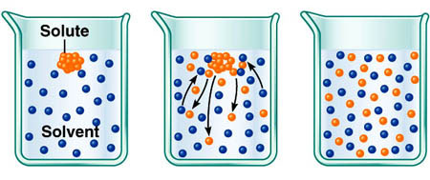
Particle Model
When a solute (solid) dissolves, the particles gain energy from the solute (liquid).
They break apart from each other and mix with the solvent forming a solution.

Slide 22
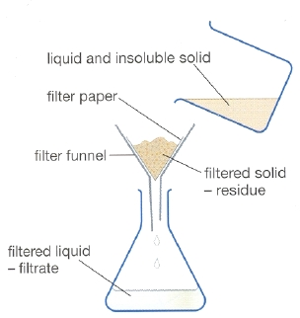
Filtering Separates Insoluble Solids
Dissolved solids have broken up into separate particles.
They can fit through the tiny holes in the filter paper.
Insoluble solids are stuck in clumps and are too big to fit through the filter paper.

Slide 23
Do you have the solution?
What do we mean by solvent, solute and solution?
Can we give examples?
What do we mean by insoluble or soluble?
Can you group solids into soluble or insoluble?

Slide 24
Plenary
Correct the following sentences and write them into your books:
The solvent dissolves in the solute to make a solution
Solutions are always opaque
Something that will not dissolve is called soluble

