Slide 1
L2: Solubility
Learning Objectives:
Understand the term solubility.
Measure solubility in grams per 100 cm³ of solvent.
Draw solubility graphs.

Slide 2
What is solubility?
Do some solutes dissolve more than others?
Can you do anything to make the solute dissolve more?
Solubility = a measure of how much solute will completely dissolve into a solvent

Slide 3
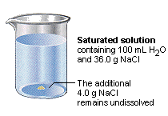
Saturated Solution
Saturated Solution = a solution in which no more solute can dissolve
When you reach the solubility limit, you form a saturated solution.

Slide 4
Practical:
What factors affect solubility?
Purpose: We are going to investigate how temperature affects the solubility of sugar in water.
Method:
Have three different containers with 25 cm³ of different temperatures of water (room, warm, hot).
Add sugar and wait for it to dissolve.
Keep adding sugar until no more will dissolve.
Record how much sugar dissolved in each temperature of water.

Slide 5
Analysis
What was the independent variable?
What was the dependent variable?
What were some control variables?
Draw a bar graph for your results. Why is it we chose a bar graph?
Write a conclusion for your investigation.

Slide 6
How do you measure solubility?
Solubility is a measure of how much solute will dissolve into a certain amount of solvent (usually 100 cm³).
How would you measure this?
Solubility is measured in grams per 100 cm³ of solvent.

Slide 7
Different Solubility
Different substances will have solubility.
For example: different amounts of salt and sugar will dissolve in water.
The higher the temperature of water the higher the solubility.

Slide 8
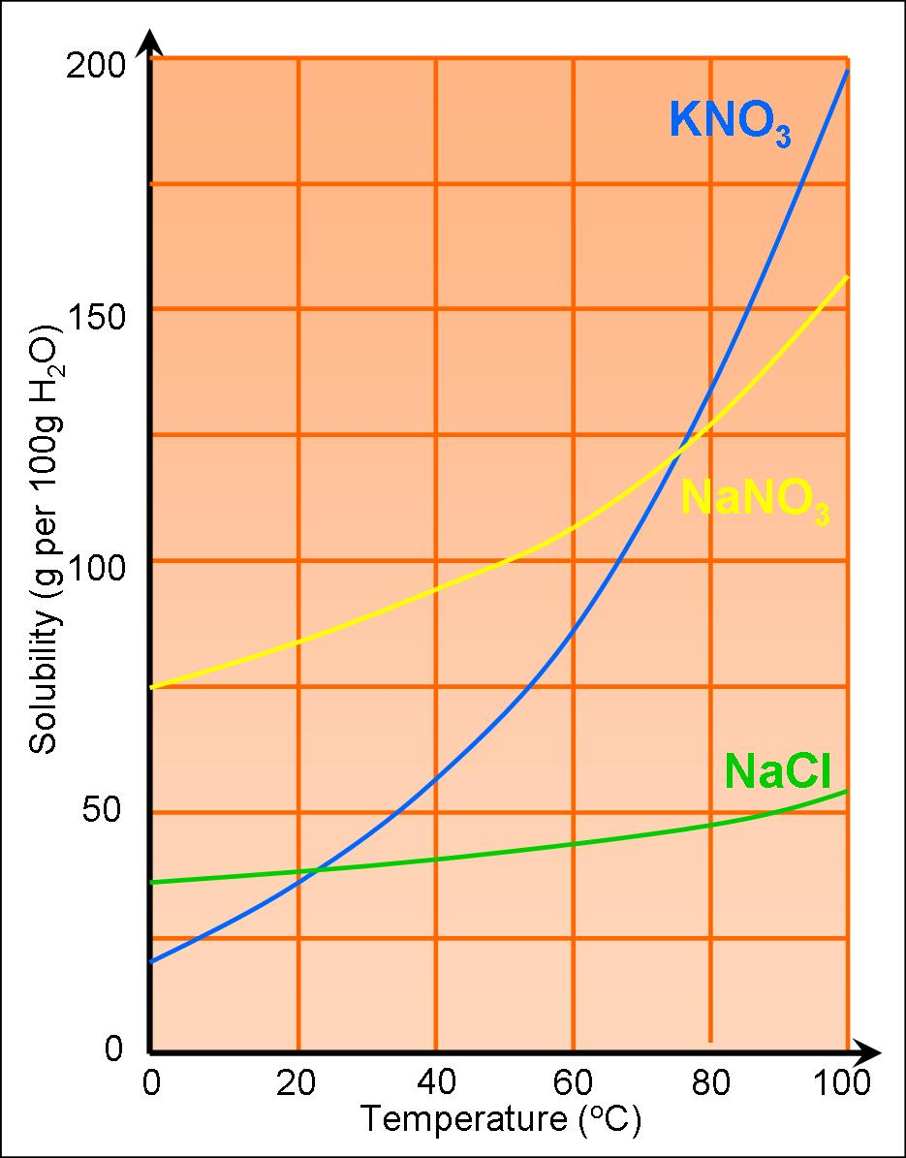
Solubility Graph

