Slide 1

Desert Island Question
How would you get fresh water from sea water?

Slide 2
Distillation
Learning Objectives:
Recall that different substances have different boiling points.
Describe the process of distillation.
Label a diagram of the distillation apparatus.

Slide 3
Distillation
Watch the demonstration of distillation and then answer the following questions.
What was the starting solution?
What part of the solution went through the distillation apparatus?
What are the two main steps of distillation?
Why does this work?

Slide 4
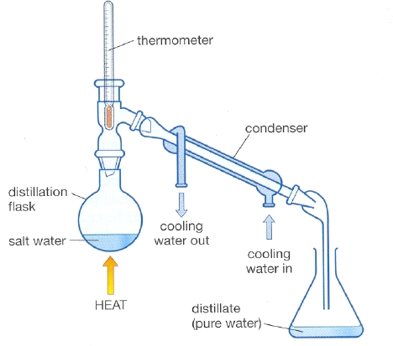
Distillation
Label the diagram on your worksheet.

Slide 5
Distillation
The inky water is heated.
The water in the inky solution boils.
The water evaporates.
Steam travels up the glass tube.
The cold water in the condenser turns the steam to water.
The (pure) water drips down the tube, into the second flask.

