Slide 1
Chromatography
Learning Objectives:
Describe chromatography.
Explain how chromatography is used to separate a mixture of dyes.
Be able to read a chromatogram.

Slide 4
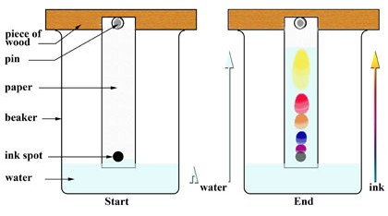
Practical
Pencil Line

Slide 5
Questions
Why is it important to draw the starting line in pencil?
Why is it important that the solvent (water) level is below the pencil line?
Would this experiment work with permanent markers like Sharpies? Why or why not?
How could you modify this experiment to separate colours in nail varnish?

