Slide 1
L5 Separating Rock Salt
Learning Objectives:
Use filtration and crystallisation to separate salt from rock salt.

Slide 4
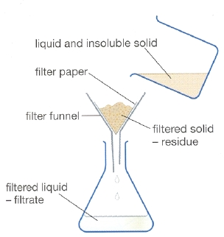
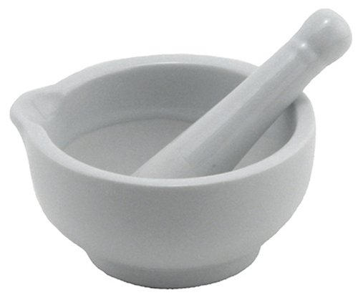
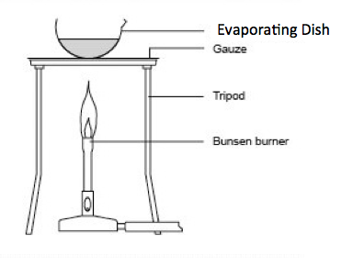
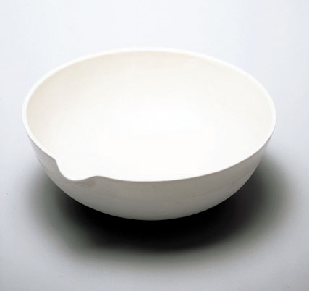
1.
2.
3.
4.

Slide 5
salt

Slide 6
salt

