Slide 1
Lesson 2 – Changes of State
Learning Objectives:
Recall that heating or cooling is involved in changes of state.
Recall the names of different changes of state
Describe the particle model of solids, liquids, and gases.
Explain how energy is involved in changes of state.

Slide 2
Video
https://www.brainpop.com/science/matterandchemistry/matterchangingstates/

Slide 3
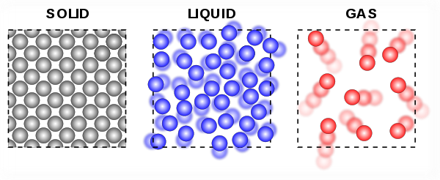
Particle Theory
Particle theory = idea that everything is made of particles
Draw the particle model of solids, liquids, and gases.

Slide 4
Particle Theory
Describe the motion of particles in solids, liquids, and gases.
Solids vibrate in place.
Liquids move and slide past each other.
Gases more quickly and bounce around in all directions.

Slide 5
Energy
How do you add more energy to matter?
What happens to the particles when energy is added?
What happens when matter changes state?
Heating an energy adds thermal energy.
When particles have more energy they move around faster.
If enough energy is added, the particles move so fast that they move apart from each other and change state.

Slide 6
Changes of State
Label the changes of state.
Melting
Boil/Evaporate
Freezing
Condensing

Slide 7

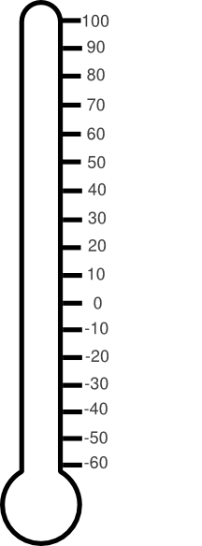

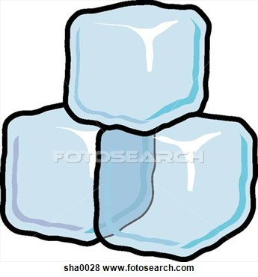
Melting point = the temperature at which a substance melts (turns from a solid into a liquid)
Freezing point = the temperature at which a substance freezes (turns from a liquid to a solid
The melting point and freezing point are actually the same!
Boiling point = the temperature at which a substance boils (rapidly turns from a liquid to a gas)
Boiling Point of Water
Freezing Point / Melting Point of Water

Slide 8
Heating Curve
We are going to investigate what happens to the temperature of water when ice is heated all the way to boiling.

Slide 9
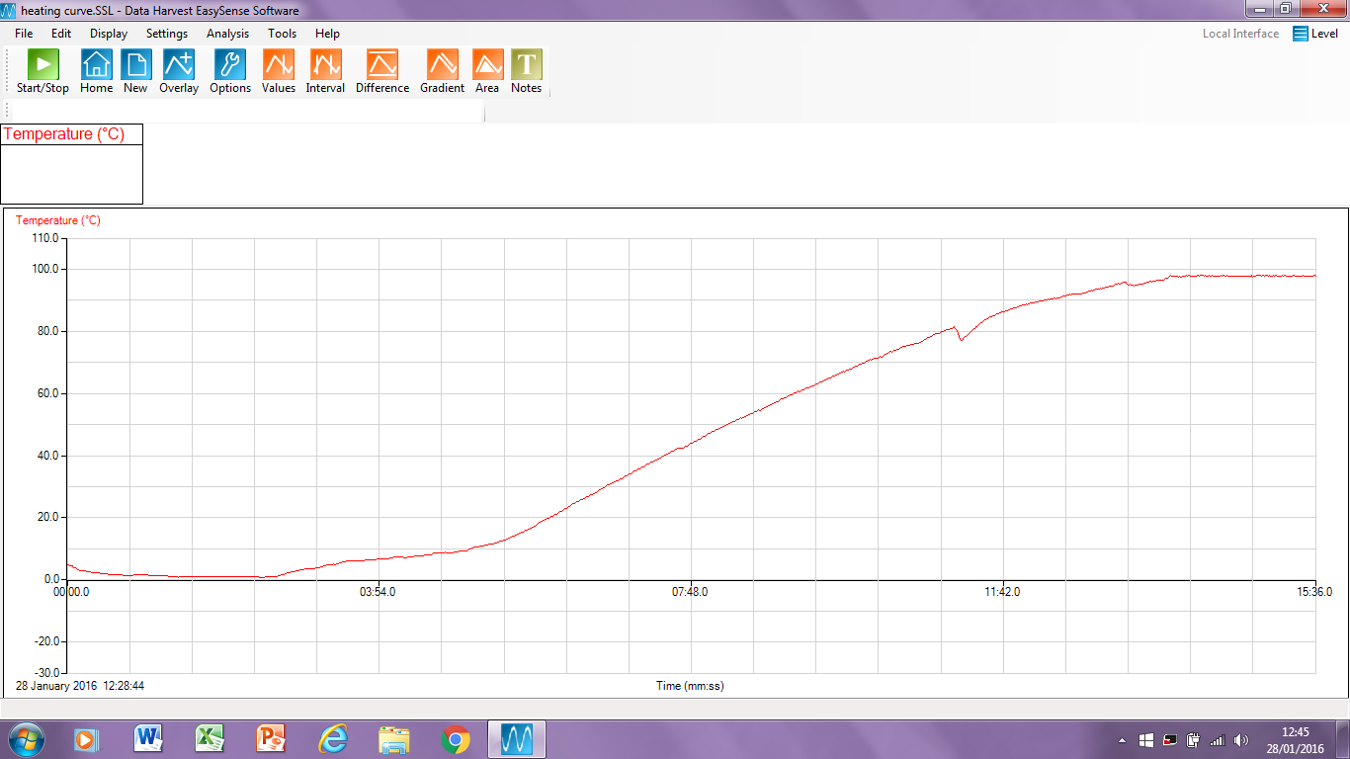

Slide 10
Graphing a Heating Curve
Time | Temperature
(s) | (°C)
0 | 3
30 | 3
60 | 8
90 | 16
120 | 24
150 | 32
180 | 43
210 | 53
240 | 62
270 | 70
300 | 78
330 | 86
360 | 90
390 | 96
420 | 97
450 | 97
480 | 97
Include:
Title
X-axis Label (independent variable)
X-axis Units
Y-axis Label (independent variable)
Y-axis Units
Pencil and Ruler
Appropriate Scale (takes up at least ½ page)
Line (curve) of Best Fit
Points Accurately Plotted

Slide 11
Changes of state – heating curve
boiling ⇒
condensing⇐
gas
liquid ⇔ gas
temperature
liquid
melting ⇒
freezing⇐
solid ⇔ liquid
solid
time

Slide 12
Melting Point? Boiling Point?
Boiling Point
gas
temperature
liquid
Melting Point
solid
time

