Slide 1
Cell Division
Lesson Objective:
To be able to describe how new cells are made.
Describe the steps in cell division.
Explain why cell division is important for organisms to grow and repair.

Slide 2
When does the body need to produce new cells?
Think of the following situations…..
growth
Your body loses cells and cells are constantly dying but
your skin doesn’t disappear and you don’t get smaller.
repair
You cut your finger. The wound is eventually healed and
weeks later you cannot even see where the cut used to be.
reproduction
Your body can make sex cells. In humans, these cells are
sperm or egg cells. These cells contain the same genetic
information that can be found in other body cells.

Slide 3
How does the body produce new cells?
The body needs to produce new cells for three main reasons:
  growth
  repair
  reproduction
How does it produce these cells?
The body is constantly producing new cells from old cells dividing. This is called cell division.

Slide 4
Where do cells come from?
Cell division occurs extremely quickly and each new cell is also able to divide.
Cell division makes it possible for the body to:
grow quickly;
repair cuts and replace dead cells quickly;
produce an enormous number of reproductive cells.

Slide 5
Where do cells come from?
New cells are produced by cell division,
but this doesn’t mean that cells split in half.
What would be the problem if cells did split in half to produce new cells ?
There wouldn’t be much of the cells left!
What actually happens is that cells have to make new copies of the material inside them, as well as new membranes before they divide.
Just before a cell divides, it appears to grow slightly as it reproduces everything inside itself.
The nucleus doubles in size and then divides into two equal halves.

Slide 6
Cell division

Slide 7
Put the steps in the correct order
The cell then starts cell division again.
The cell splits into two identical cells.
The nucleus containing DNA (instruction for the cell) divides.
A new cell membrane forms.
The cells take in nutrients and grow.

Slide 8
Cell Division
The nucleus containing DNA (instruction for the cell) divides.
A new cell membrane forms.
The cell splits into two identical cells.
The cells take in nutrients and grow.
The cell then starts cell division again.

Slide 9
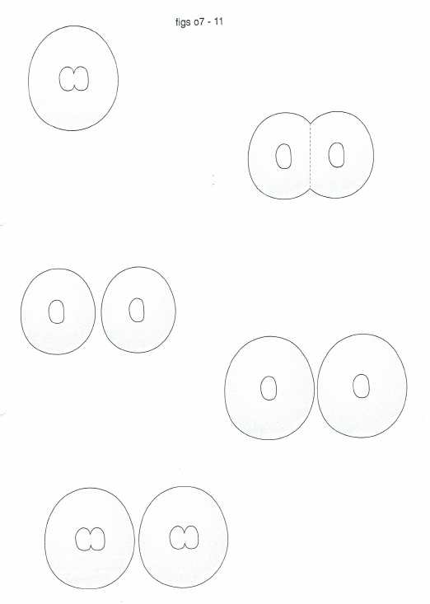
1. The nucleus containing DNA (instruction for the cell) divides.
2. A new cell membrane forms.
3. The cell splits into two identical cells.
4. The cells take in nutrients and grow.
5. The cell then starts cell division again.

Slide 10
How does a cell divide?
Cell has a nucleus with all the instructions in it.
The cell makes copy of the instructions.
Cell then splits into two cells.
Each of the small cells then grow to become full size.

Slide 11
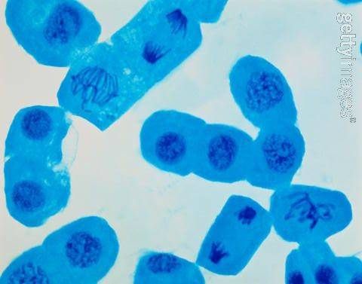

Slide 12
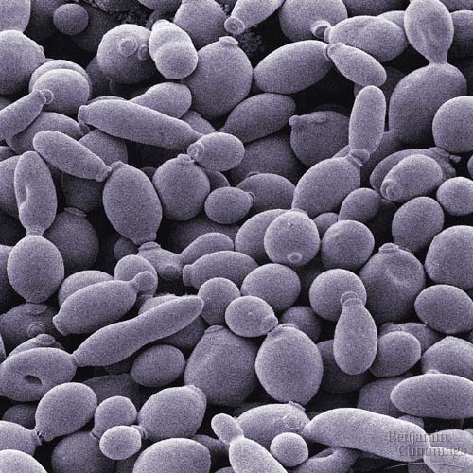

Slide 13
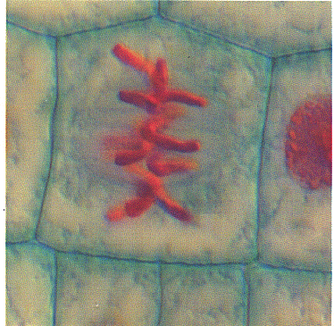
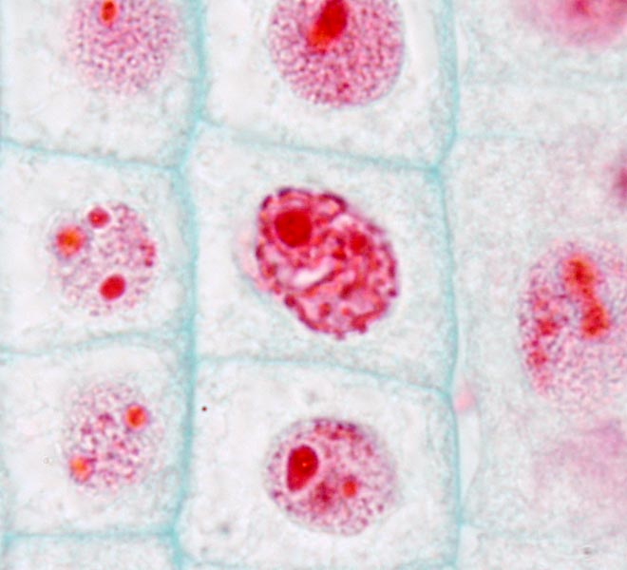
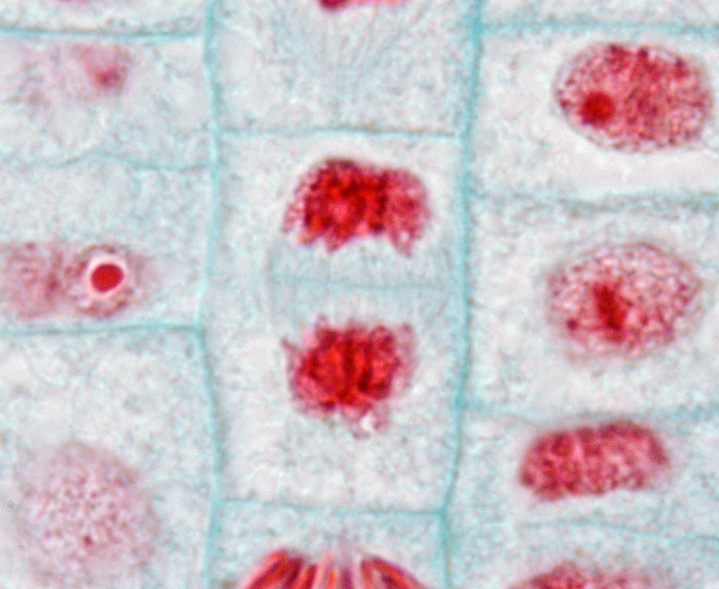
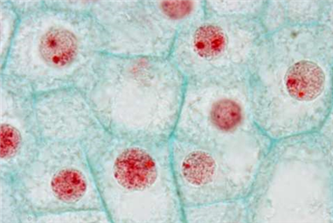
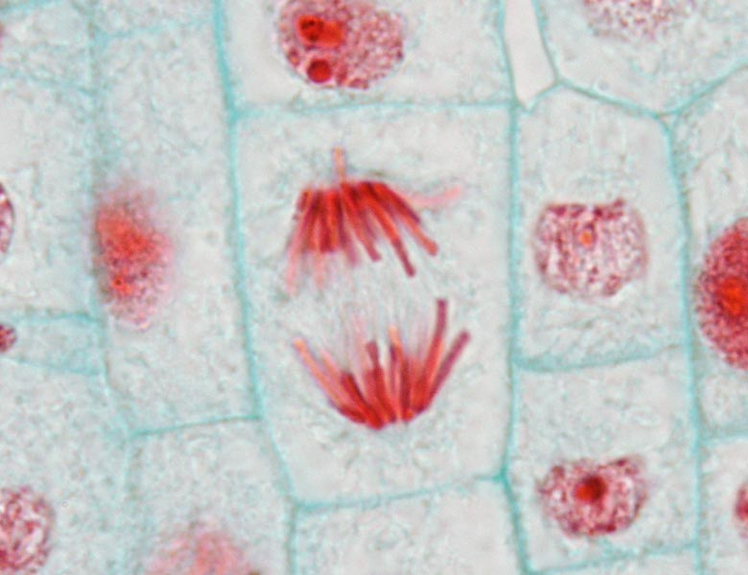
Microscope 1
Microscope 2
Microscope 3
Microscope 4
Microscope 5
Notes:
The correct order is 5, 2, 1, 4, 3

Slide 14
Why do we need cell division in our body?
For growth
For repair
For reproduction-special cells carry the information to make a new organism.

Slide 15
Organelle
Organ System
As cells have lots of different functions they are often specialised to do a particular job. This means that they have special features that make them well adapted at carrying out these functions.
Organism
Cell
Tissue
Organ
Human
Muscle cell
Muscle
Nucleus
Circulatory system
Heart

Slide 16
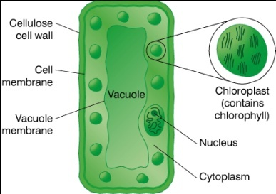
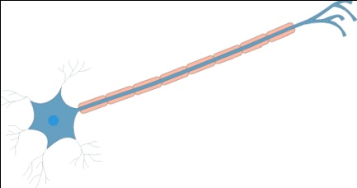
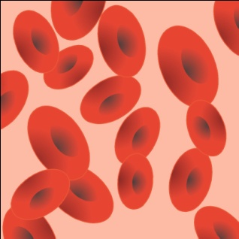
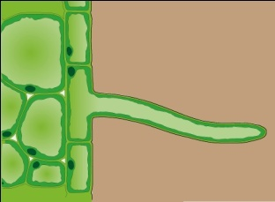

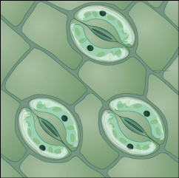
Examples of Specialised Cells
Plant
Leaf palisade cell
Root hair cell
Guard cell
Xylem cell
Epidermal cell
Animal
Muscle cell
Nerve cell
White blood cell
Red blood cell
Ovum (egg cell)
Fat cell
Sperm
Cilliated epithelial cell

Slide 17
A typical animal cell

Slide 18
A typical plant cell

Slide 19
What’s wrong with these sentences?
The vacuole contains a substance called cytoplasm
Animals cells have a nucleus, cytoplasm and cell wall
Chloroplasts have a substance called chloroform
Cytoplasm controls the cell
Cell membrane lets everything into the cell

Slide 20
Quiz
Cells

Slide 21
1. What three organelles (parts of a cell) do both animal and plant cells have?
Cell wall, cell membrane, nucleus
Cell membrane, nucleus, cytoplasm
Cell membrane, nucleus, chloroplasts
Cell wall, vacuole, chloroplasts

Slide 22
2. What three organelles (parts of a cell) just plant cells have?
Cell wall, cell membrane, nucleus
Cell membrane, nucleus, cytoplasm
Cell membrane, nucleus, chloroplasts
Cell wall, vacuole, chloroplasts

Slide 23
3. Which part of the microscope do you look through?
Eyepiece
Stage
Mirror
Focusing knob

Slide 24
4. Which part of the microscope do you turn to get a better picture?
Eyepiece
Stage
Mirror
Focusing knob

Slide 25
5. Which of these shows the correct order of smallest to biggest?
Organ system → tissue → organ → cell
Cell → organ → tissue→ organ system
Cell → tissue → organ → organ system
Cell → tissue → organ system → organ

Slide 26
6. Why is it important for scientists to study cell division?
So they can treat diseases like cancer, find out how we grow and maybe find ways to make us younger for longer.
So they can make us live forever and nothing else.
Because they need something to study as they make lots of money.
It is important because Miss Radford says so.

Slide 27
7. Why might someone need an organ transplant?
They just fancy having some newer, fresher organs.
Every 20 years our organs get worn out so they need replacing.
One of their organs may be not working properly or have stopped working all together.
There is a 2-4-1 deal down at the local hospital.

Slide 28
8. What are “cells”?
The building blocks which make up every living organism.
Tiny powerhouses of plants which keep them growing as they don’t eat.
Building blocks which only make up humans.
Tiny powerhouses that only cats have.

Slide 29
9. What are tissues?
Tiny building blocks which make up every organism.
One type of cell only all joined together like bricks in a wall.
More than one type of cell joined together like bricks in a wall.
They are something that scientists made up and they don’t really exist.

Slide 30
10. What are “organs”?
Tiny building blocks which make up every organism.
One type of cell only all joined together like bricks in a wall.
One or more types of tissue working together.
They are something that scientists made up and they don’t really exist.

Slide 31
11. What is a “specialised” cell?
A cell which can do any kind of job.
One type of cell only all joined together like bricks in a wall.
One or more types of tissue working together.
A cell adapted to do only one type of job.

Slide 32
12. Why do we need cells to divide?
So that we can get bigger.
So that we can grow, repair ourselves and reproduce.
So that bits of us don’t keep falling off.
So that we don’t get too tired when our cells get worn out.

Slide 33
13. What is an “organ system”?
A group of organs which are all the same colour.
A group of organs which are all the same size.
A group of organs which are all completely different from one another.
A group of organs that all carry out a similar jobs, grouped together by the 7 life processes.

Slide 34
1. What three organelles (parts of a cell) do both animal and plant cells have?
Cell wall, cell membrane, nucleus
Cell membrane, nucleus, cytoplasm
Cell membrane, nucleus, chloroplasts
Cell wall, vacuole, chloroplasts

Slide 35
2. What three organelles (parts of a cell) just plant cells have?
Cell wall, cell membrane, nucleus
Cell membrane, nucleus, cytoplasm
Cell membrane, nucleus, chloroplasts
Cell wall, vacuole, chloroplasts

Slide 36
3. Which part of the microscope do you look through?
Eyepiece
Stage
Mirror
Focusing knob

Slide 37
4. Which part of the microscope do you turn to get a better picture?
Eyepiece
Stage
Mirror
Focusing knob

Slide 38
5. Which of these shoes the correct order of smallest to biggest?
Organ system → tissue → organ → cell
Cell → organ → tissue→ organ system
Cell → tissue → organ → organ system
Cell → tissue → organ system → organ

Slide 39
6. Why is it important for scientists to study cell division?
So they can treat diseases like cancer, find out how we grow and maybe find ways to make us younger for longer.
So they can make us live forever and nothing else.
Because they need something to study as they make lots of money.
It is important because Miss Radford says so.

Slide 40
7. Why might someone need an organ transplant?
They just fancy having some newer, fresher organs.
Every 20 years our organs get worn out so they need replacing.
One of their organs may be not working properly or have stopped working all together.
There is a 2-4-1 deal down at the local hospital.

Slide 41
8. What are “cells”?
The building blocks which make up every living organism.
Tiny powerhouses of plants which keep them growing as they don’t eat.
Building blocks which only make up humans.
Tiny powerhouses that only cats have.

Slide 42
9. What are tissues?
Tiny building blocks which make up every organism.
One type of cell only all joined together like bricks in a wall.
More than one type of cell joined together like bricks in a wall.
They are something that scientists made up and they don’t really exist.

Slide 43
10. What are “organs”?
Tiny building blocks which make up every organism.
One type of cell only all joined together like bricks in a wall.
One or more types of tissue working together.
They are something that scientists made up and they don’t really exist.

Slide 44
11. What is a “specialised” cell?
A cell which can do any kind of job.
One type of cell only all joined together like bricks in a wall.
One or more types of tissue working together.
A cell adapted to do only one type of job.

Slide 45
12. Why do we need cells to divide?
So that we can get bigger.
So that we can grow, repair ourselves and reproduce.
So that bits of us don’t keep falling off.
So that we don’t get too tired when our cells get worn out.

Slide 46
13. What is an “organ system”?
A group of organs which are all the same colour.
A group of organs which are all the same size.
A group of organs which are all completely different from one another.
A group of organs that all carry out a similar job, grouped together by the 7 live processes.

