Slide 1
Atomic structure

Slide 2
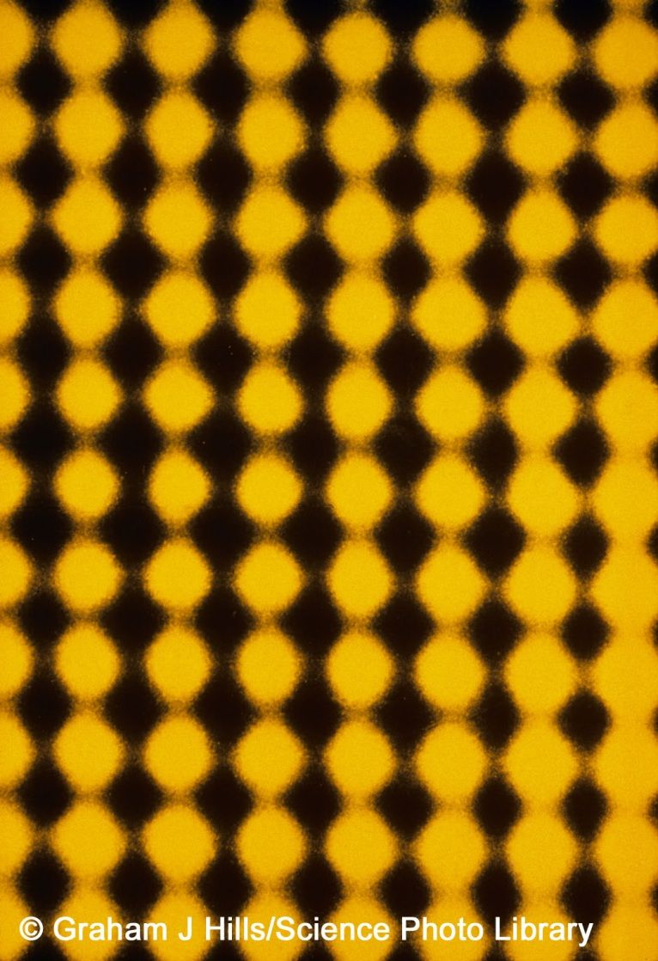
Atoms – the building blocks
All substances are made from very tiny particles called atoms.
John Dalton had ideas about the existence of atoms about 200 years ago but only relatively recently have special microscopes (called electron microscopes) been invented that can ‘see’ atoms.
The yellow blobs in this image are individual gold atoms, as seen through an electron microscope.
Notes:
Acknowledgment
The image is a false-colour high-resolution transmission electron micrograph (HREM) of the atomic lattice of a thin gold crystal. Magnified 16 million times at 35mm size, each yellow blob represents an individual gold atom. The micrograph has been enhanced by optical image- processing techniques. The centre to centre spacing of the atoms is 2.04 angstroms (0. 204 nanometres); this represents the practical limit of resolution of the modern electron microscope.
Credit: Graham J Hills/Science Photo Library

Slide 3
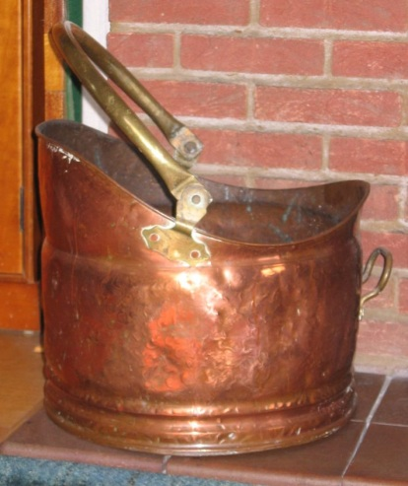
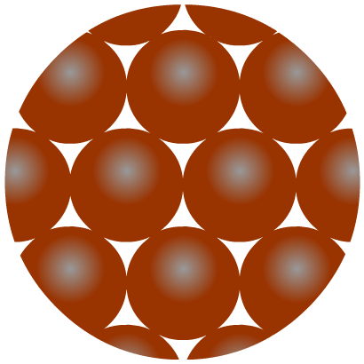
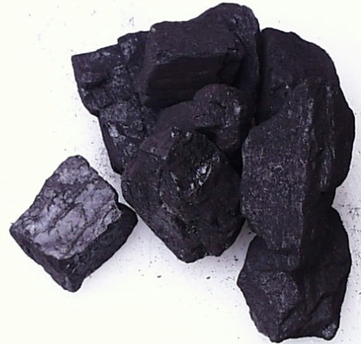
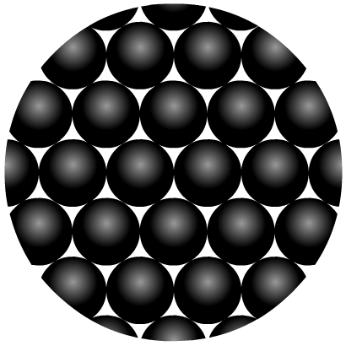
Elements – different types of atom
Elements are the simplest substances. There are about 100 different elements.
Each element is made up of just one particular type of atom, which is different to the atoms in any other element.
Copper is an
element made up of
copper atoms only.
Carbon is an
element made up of
carbon atoms only.

Slide 4
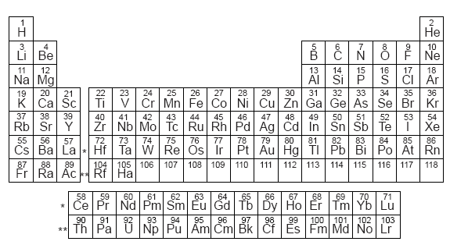
The elements are the building blocks of all matter.
They are arranged in the periodic table-there are similarities
between the elements is a column (we will discuss this more at
another time)
Each element has a symbol-you need to learn some of these

Slide 5
Even smaller particles
For some time people thought that atoms were the smallest particles and could not be broken into anything smaller.
Scientists now know that atoms are actually made from even smaller subatomic particles. There are three types:
proton
neutron
electron
It is the different numbers of these that make the atoms of
one element different from the atoms of a different element

Slide 6
Where are subatomic particles found?
Protons, neutrons and electrons are NOT evenly distributed in an atom.
The protons and neutrons exist in a dense core at the centre of the atom. This is called the nucleus.
The electrons are spread out around the edge of the atom. They orbit the nucleus in layers called shells.

Slide 7
The atom: check it out!
Draw a labelled diagram of the atom showing the nucleus and labelling protons, neutrons and electrons.
nucleus
electron
neutron
proton

Slide 8
The Amazing Atomic Zoom

Slide 9
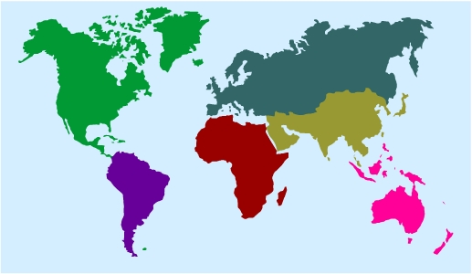
How small is an atom?
Atoms are extremely small – they are about 0.0000000001 m wide.
To make an atom the size of a football it would have to be enlarged by about 3,000,000,000 times.
N
X3,000,000,000
If a football was enlarged by the same amount it would stretch from the UK to the USA.

Slide 10
The size of an atom is about 1 X 10⁻¹⁰ m
(nine zeros and then a 1!)
This is often written as 0.1nm (nanometer)
1 nanometer is 10⁻⁹ m
The nucleus is about 1 X 10⁻¹⁴ m
If an atom was the size of a football pitch, the nucleus
would be the size of an apple in the centre

Slide 11
Properties of subatomic particles
There are two properties of subatomic particles that are especially important:
1. Mass
2. Electrical charge
Particle | Mass | Charge
proton | 1 | +1
neutron | 1 | 0
electron | almost 0 | -1
The atoms of an element contain equal numbers of protons and electrons and so have no overall charge.

Slide 12
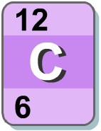
How many protons?
The atoms of any particular element always contain the same number of protons. For example:
hydrogen atoms always contain 1 proton;
carbon atoms always contain 6 protons;
magnesium atoms always contain 12 protons,
The number of protons in an atom is known as its atomic number or proton number.
It is the smaller of the two numbers shown in most periodic tables.

Slide 13
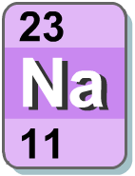
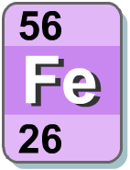
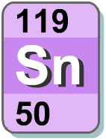
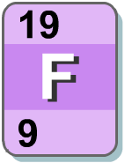
What’s the atomic number?
What are the atomic numbers of these elements?
sodium
iron
tin
fluorine
11
26
50
9

Slide 14
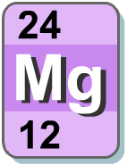
Mass number
Electrons have a mass of almost zero, which means that the mass of each atom results almost entirely from the number of protons and neutrons in the nucleus.
The sum of the protons and neutrons in an atom’s nucleus is the mass number. It is the larger of the two numbers shown in most periodic tables.
Atom | Protons | Neutrons | Mass number
hydrogen | 1 | 0 | 1
lithium | 3 | 4 | 7
aluminium | 13 | 14 | 27

Slide 15
What’s the mass number?
Mass number = number of protons + number of neutrons
What is the mass number of these atoms?
Atom | Protons | Neutrons | Mass number
helium | 2 | 2
copper | 29 | 35
cobalt | 27 | 32
iodine | 53 | 74
germanium | 32 | 41
4
64
59
127
73

Slide 16
How many neutrons?
Number of neutrons = mass number - number of protons
= mass number - atomic number
How many neutrons are there in these atoms?
Atom | Mass number | Atomic number | Number of neutrons
helium | 4 | 2
fluorine | 19 | 9
strontium | 88 | 38
zirconium | 91 | 40
uranium | 238 | 92
2
10
50
51
146

Slide 17
Isotopes
An isotope is an atom with a different number of neutrons:
Notice that the mass number is different. How many neutrons does each isotope have?
16
17
18
O
O
O
8
8
8
Each isotope has 8 protons – if it didn’t then it just wouldn’t be oxygen any more.

Slide 18
Calculate the number of protons, electrons and neutrons shown below -
12
C
6
13
C
6
14
C
6

Slide 19
Calculating the number of electrons
What are the missing numbers?
Atom | Protons | Neutrons | Electrons | Atomic number | Mass number
boron | 5 | 6
potassium | 19 | 20
chromium | 24 | 28
mercury | 80 | 121
argon | 18 | 22
5
5
11
19
19
39
24
24
52
80
80
201
18
18
40

