Slide 1
Atoms, elements, molecules compounds and mixtures

Slide 2
Key Terms
Atom = smallest unique particle of matter
Element = all the atoms of an element are the same
Molecule = two or more atoms chemically joined (can be the same type or different)
Compound = two or more atoms of different elements chemically joined
Mixture = two or more elements or compounds not chemically joined

Slide 3
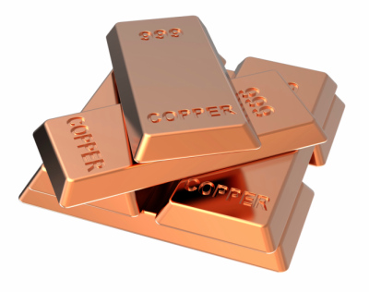
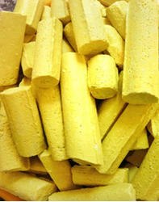
The elements in the periodic table are the building blocks of all matter.
Elements are made from only one type of particle known as an atom.
Atoms are the smallest part of an element that can exist
This copper only contains
copper atoms
This sulphur only contains sulphur atoms

Slide 4
Do you know any elements that are gases that exist as atoms?

Slide 5
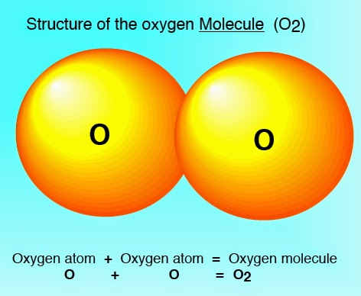
When atoms are chemically bonded together they are called molecules
Some elements exist as atoms, but some exist as molecules
For example, oxygen gas exists as two oxygen atoms chemically bonded-O₂
The atoms can only be separated when a chemical reaction takes place

Slide 6
Compounds
Compounds are a special type of molecule.
Compound = two or more atoms of different elements chemically joined
Example: Methane (CH₄)
Molecule
Also a compound
H
H
C
H
H
A MOLECULE OF THE COMPOUND METHANE

Slide 7
molecules
If the atoms are the same
then it is a molecule of an
element eg H₂ -hydrogen
If the atoms are different
then it is a molecule of a
compound eg CH₄ methane

Slide 8
Compound | How many different types of atom? | How many atoms?
Iron sulphide FeS
Magnesium chloride MgCl₂
Calcium carbonate CaCO₃
Butane C₃H₈
Copper sulphate CuSO₄
Calcium ethanoate Ca(C₂H₃O₂)₂
2
2
2
3
3
5
2
11
3
6
4
15

Slide 9
Naming compounds
If the compound has just 2 elements, a metal and a non-metal, the name ends in -ide
If the compound has 3 elements, and one of them is oxygen, the name ends with -ate
You try the naming compounds worksheet

Slide 10
You already know how to write word equations for chemical reactions
You will need to be able to write balanced symbol equations for reactions

Slide 11
Mixtures
This is when elements and compounds are just mixed together .
Mixtures can be separated using physical changes
Air is a mixture of different gases.
Oxygen, nitrogen, argon, carbon dioxide and water vapour are all in the air.

Slide 12
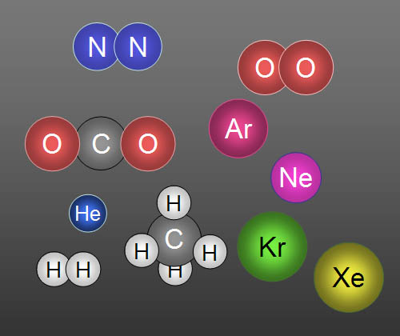
….and others!
www.youtube.com/watch?v=vUybtRlaLLw
Separation of the gases in air

Slide 13
Air is a mixture of gases-Some of the different gases in the air
 | Is it an element? | Is it a molecule? | Is it a compound? | draw
oxygen
nitrogen
Carbon dioxide
argon
water
yes
yes
no
yes
yes
no
no
yes
yes
yes
no
no
no
yes
yes

