Slide 1
Starter
Sort the elements into a sensible arrangement. You can do so however you like.
Write down a short explanation of how and why you chose to arrange the elements the way you did.

Slide 2
Lesson 4 – Periodic Table
Learning Objectives:
Describe the history of the development of the modern periodic table.
Explain how the periodic table is organised.
Locate on the periodic table and explain the properties of metals and non-metals.
Analyse the properties of Group 0, Group 1, and Group 7 elements.
Link the arrangement of groups on the periodic table to electron configuration and chemical properties.

Slide 3
Video: Periodic Table of Elements
https://www.brainpop.com/science/matterandchemistry/periodictableofelements/

Slide 4
Arranged from left to right, top to bottom, by atomic number (no. of protons).
Elements with similar properties are in the same column or group.
Patterns of properties repeat periodically (regular intervals), the rows are called periods.

Slide 5
Group 1

Slide 6
Period 4

Slide 7
Label the Periodic Table
Label: Group 1, 2, 3, 4, 5, 6, 7, 0 (8).
Label: Number of outer shell electrons for each group.
Label: Periods 1, 2, 3, 4, 5, 6, 7
Label: Halogens, Alkali Metals, Alkali Earth Metals, Noble Gases, and Transition Metals.
Label or Colour: Metals, Semi-metals (metalloids), and Non-metals.
Label: +1, +2, -1, 0 charge
Notes:
http://www.ptable.com/
interactive periodic table

Slide 8
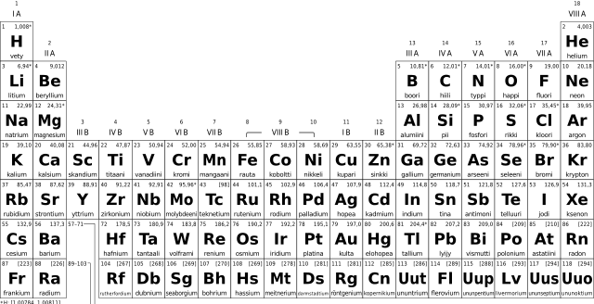
Group
1
Group
4
Group
6
Group
8 (0)
Group
2
Groups (Columns)
Group
3
Group
5
Group
7

Slide 9
Periods (Rows)
Period
1
Period
2
Period
3
Period
4

Slide 10
Charge +1
Charge
0
Charge
+2
Groups (Columns)
Charge
-1

Slide 11
Alkali Metals
Alkaline Earth Metals
Noble Gases
Halogens
Transition Metals

Slide 12
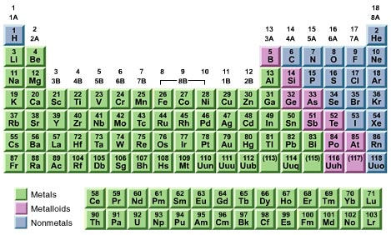
Metals vs. Non-Metals

Slide 13
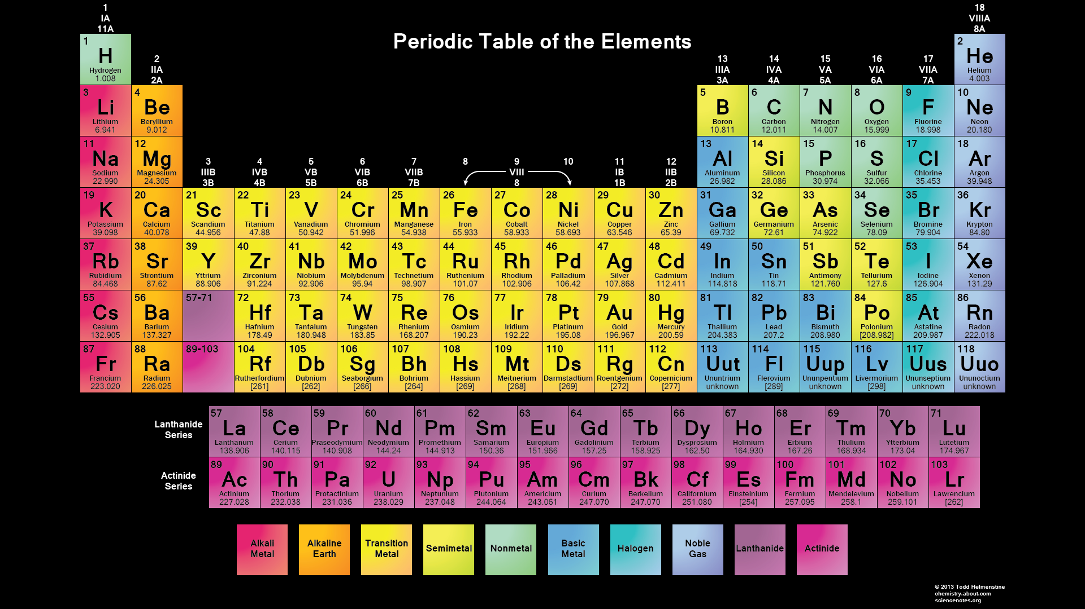
Group
1
Group
4
Group
6
Group
8 (0)
Group
2
Groups (Columns)
Group
3
Group
5
Group
7
1 e⁻
outer shell
2 e⁻
outer shell
3 e⁻
o.s.
4 e⁻
o.s.
5 e⁻
o.s.
6 e⁻
o.s.
7 e⁻
o.s.
8* e⁻
o.s.
* Except He

Slide 14
Periods (Rows)
Period
1
Period
2
Period
3
Period
4

Slide 15
Alkali Metals
Alkaline Earth Metals
Noble Gases
Halogens
Metalloids
Transition Metals

Slide 16
+1 charge
0 charge
+2 charge
Groups (Columns)
-1 charge
Loses 1 e-
Loses 2 e-
Gains 1 e-
N/A

Slide 17
Video: Development of the Periodic Table
Watch the video and answer the following questions.
How did the earliest scientists organise the elements?
How did Mendeleev group elements into what he called “families”?
What was so amazing about Mendeleev's table?
Notes:
Video: C1.4 development of the periodic table
By mass
By similar properties
Predicted properties of elements not yet discovered

Slide 18
Development of the Periodic Table
Read the article and BRIEFLY summarise the contribution of the following scientists to the development of the Periodic Table.
Johann Dobereiner
A.E.Beguyer de Chancourtois
John Newlands
Dmitri Mendeleev
Henry Moseley
Glenn Seaborg
Notes:
Higher ability
Mendeleev is only scientists whose work students need to know by name

Slide 19
Development of the Periodic Table
Read the article and BRIEFLY summarise the contributions and changes to the development of the Periodic Table.
John Newlands
Dmitri Mendeleev
Modern Periodic Table
Notes:
Mendeleev is only scientists whose work students need to know by name

Slide 20
Can you predict the mystery elements?
http://ca.pbslearningmedia.org/asset/phy03_int_ptable/
Fill in the letters for the mystery elements into the correct locations on the periodic table using the information given.

