Slide 1
Periodic Table Quiz
What is the lightest element on the periodic table?
How many elements are there?
What is the name for columns?
What is the name for rows?
What do all the elements in the same column have in common?
What do all the elements in the same row have in common?

Slide 2
Lesson 5 – Groups of the Periodic Table
Learning Objectives:
Identify metals and non-metals on the periodic table.
Locate and describe the properties of Groups 1, 7, and 0.
Explain the differences between metals and non-metals on the basis of their characteristic physical and chemical properties.
Explain how properties of the elements in groups depend on the outer shell of electrons of the atoms and predict properties from given trends down the group.
Compare chemical and physical properties between Group 0, 1, and 7.

Slide 3
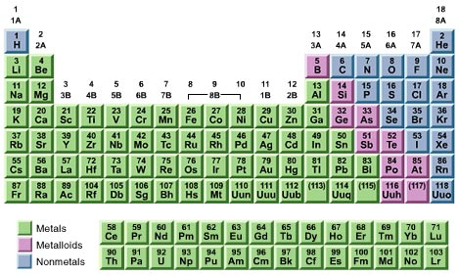
Metals
The majority of elements are metals.
They are located on the bottom left of the periodic table.
Physical Properties:
Good conductors
Malleable
High melting/boiling pts
High density
Lustrous (shiny)

Slide 4
Metals
Chemical Properties
Metals have very few electrons in their outer shell.
They lose these outer electrons to become stable. (Full shell = stable)
When they lose electrons there are now more protons (+) than electrons (-).
Metals form positive (+) ions.

Slide 5
 | Metals | Non-Metals
Location on Periodic Table | Bottom left of periodic table | Top right of the periodic table
State of Matter | Solid at room temp | Most are gases
MP/BP | High melting/boiling pts | Low melting/boiling pts
Physical Properties | Good conductors | Poor conductors
 | Malleable | Brittle (solids)
Chemical Properties | Form positive ions | Form negative ions (or do not form ions)
 | Lose electrons | Gain or share electrons

Slide 6
Group 0 (8/18) Noble Gases
https://www.youtube.com/watch?v=qNaBMvJXdJ4&index=70&list=PLW0gavSzhMlReKGMVfUt6YuNQsO0bqSMV

Slide 7
Noble Gases Summary
The elements in Group 0 of the periodic table are called the noble gases.
They are unreactive and do not easily form molecules because their atoms have stable arrangements of electrons.
The noble gases have eight electrons in their outer energy level, except for helium, which has only two electrons.
The boiling points of the noble gases increase with increasing relative atomic mass (going down the group).

Slide 8
Group 1 – Alkali Metals
https://www.youtube.com/watch?v=CmiitvJiCPc
Group 2 – Alkaline Earth Metals
https://www.youtube.com/watch?v=8qh5myTmcRs

Slide 9
Alkali Metals Summary
The elements in Group 1 of the periodic table, known as the alkali metals.
Are metals with low density (the first three are less dense than water)
React with non-metals by losing 1 electron to form positive ions (+1 charge)
Reaction with water gives off hydrogen gas and a metal hydroxide (OH)
Alkali Metal + Water → Hydrogen + Alkali Metal Hydroxide
The alkali metal hydroxide are white solids that dissolve to form alkaline solutions.
The reactivity increases as you go down the group. This is because the farther away the electron is from the nucleus, the easier it is to remove.

Slide 10
Group 7 – Halogens
https://www.youtube.com/watch?v=yW_C10cEzMk

Slide 11
Halogens Summary
The elements in Group 7 of the periodic table, known as the halogens.
They are non-metals. Fluorine and chlorine are gases, bromine is a liquid, and iodine is a solid.
They are all diatomic molecules (found in pairs).
React with metals by gaining one electron and forming negative ions (-1 charge).
The melting and boiling points increases down the group.
The reactivity decreases as you go down the group. This is because the farther away the electron is from the nucleus, the more difficult it is to attract.

Slide 12
Summary
http://www.bbc.co.uk/schools/gcsebitesize/science/add_edexcel/periodic_table/groupsact.shtml

