Slide 1
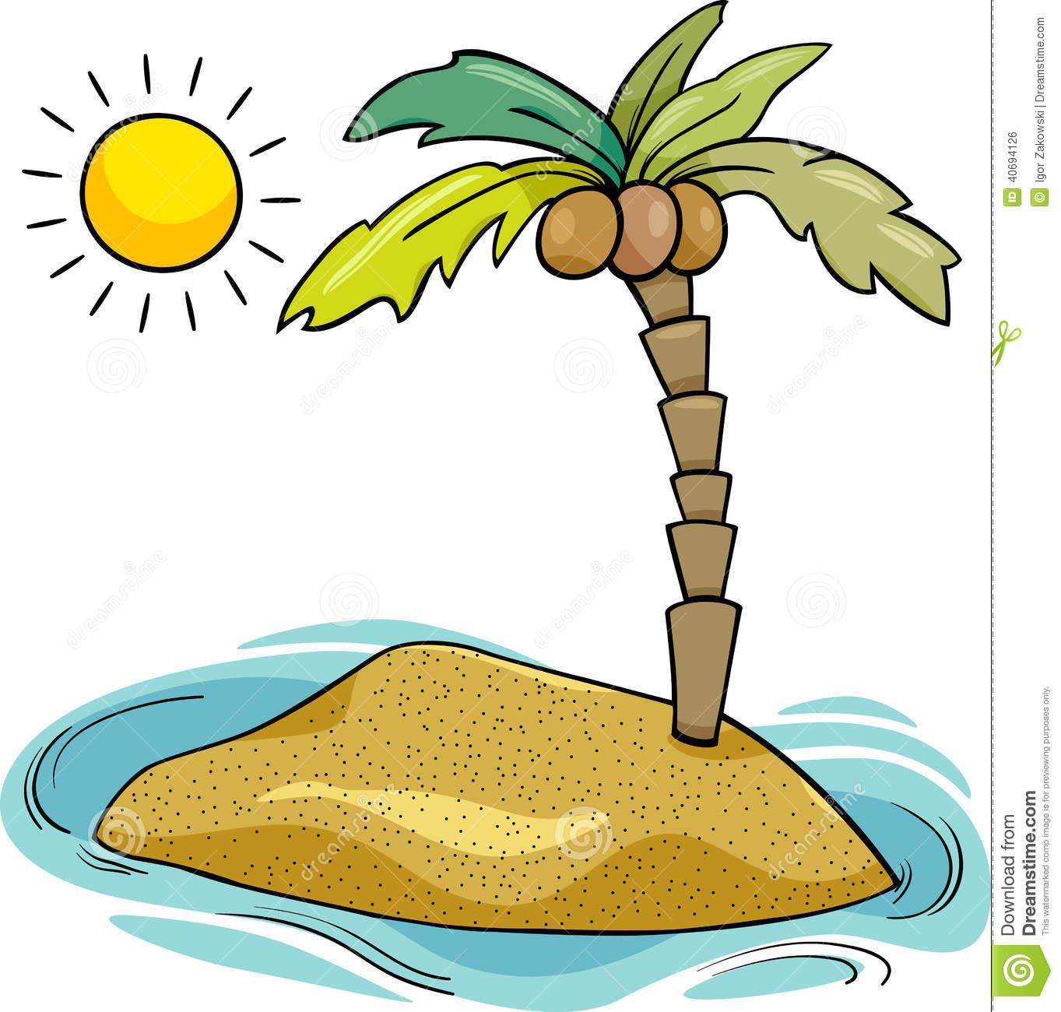
Desert Island Survival Challenge
Describe how you could get drinkable fresh water from salt water.

Slide 2
Lesson 7 – Separating Mixtures
Learning Objectives:
Describe that a mixture consists of two or more elements or compounds not chemically combined together and where the chemical properties of each substance in the mixture are unchanged.
Explain the following method of separating mixtures; a) filtration, b) crystallisation, c) simple distillation, d) fractional distillation, and e) chromatography.
Suggest suitable separation and purification techniques for mixtures when given appropriate information.

Slide 3
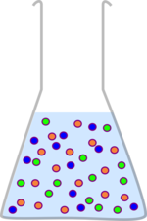
Mixtures
A mixture consists of two or more elements or compounds not chemically combined together.
The chemical properties of each substance in the mixture are unchanged.
Mixtures can be separated by physical processes (NO chemical reactions involved).

Slide 4
What do you know about…
Separation Techniques?
Write down explanations for the following separation techniques. How does it work? What types of mixtures does it separate? Include ideas about particles in your explanations if you can.
Filtration
Crystallisation
Distillation
Fractional Distillation
Chromatography

Slide 5
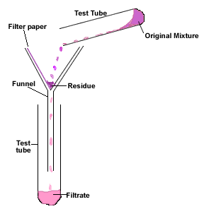
Filtration
Separates: insoluble solids from a liquid
Physical Property: solubility
How does it work:
Filter paper contains small holes that allow water molecules and soluble particles to pass through (filtrate).
Insoluble solids have atoms which are still bonded together in a large molecule that cannot pass through the holes and is trapped by the filter paper (residue).
Residue =
Insoluble solid
Filtrate =
Filtered liquid

Slide 6
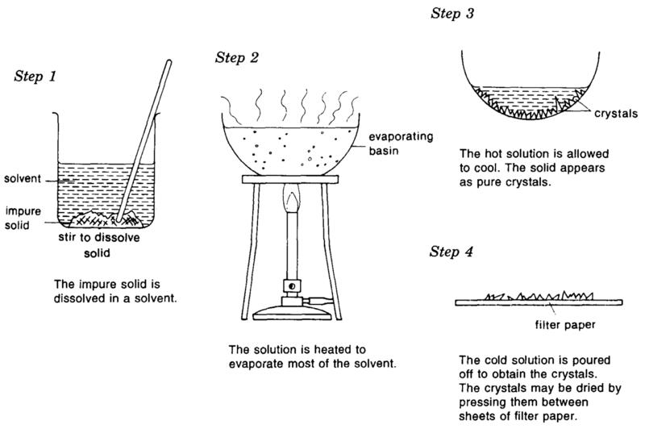
Crystallisation
Separates: soluble solids from a solution
Physical Property: solubility
How does it work:
Evaporating a liquid from a solution will produce a supersaturated solution (there is more solute in the solution than the solubility limit).
Once the solution cools, the solid cannot stay in solution past it’s solubility limit and crystallises.

Slide 7
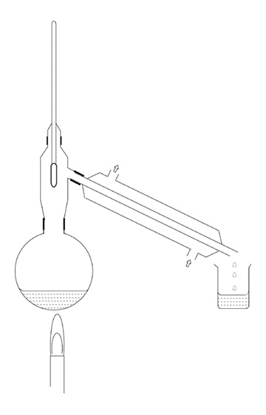
Distillation
Thermometer
Separates: liquid from a solution or mixture of two liquids
Physical Property: boiling point
How does it work:
Mixtures is heated to the boiling point of one liquid (but not hot enough to boil the second).
The liquid evaporates and enters the condenser.
The condenser cools the gas back into a liquid to be collected (distillate).
Condenser
Mixture
Distillate =
Pure Liquid
Heat source

Slide 8
Fractional Distillation
Separates: multiple liquids from a mixture
Physical Property: boiling point
How does it work: METHOD 1
Mixtures is heated to the boiling point of liquid 1 (but not hot enough to boil the second).
The liquid evaporates and enters the condenser.
The condenser cools the gas back into a liquid to be collected.
Heat the mixture further to the boiling point of liquid 2 and repeat.
Notes:
http://www.rsc.org/learn-chemistry/wiki/Expt:The_fractional_distillation_of_crude_oil

Slide 9
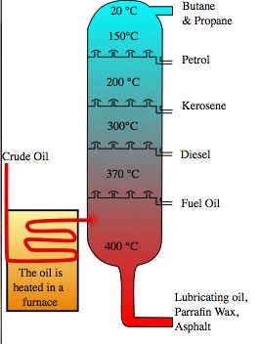
Fractional Distillation
How does it work: METHOD 2
Heat the mixture at a high temperature until ALL liquids evaporate.
Cool the liquids at different temperatures.
Liquids condense at different locations with different temperatures (relating to their boiling points)
Each liquid mixture obtained is called a fraction.
Fractions = mixtures collected at different temperatures

Slide 10
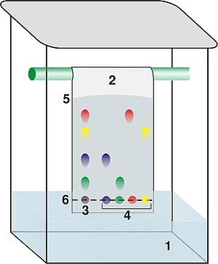
Chromatography
Chromatogram = result showing the separation of the coloured substances
Separates: dyes from a mixture of dyes
Physical Property: solubility and interaction with paper molecules
How does it work:
A spot of the mixture of dyes is placed on chromatography paper (draw a pencil line).
Only the very bottom of chromatography paper is dipped into a solvent (usually water).
Paper absorbs the solvent and carries the dyes up the paper.
Different molecules will interact with the solvent and paper different amounts so will travel different distances up the paper.

