Slide 1
L2: Defence Against Disease
Learning Objectives:
Describe the body’s first line of defence against pathogens.
Describe the ways the immune system deals with pathogens.
Explain how white blood cells deal with pathogens in different ways.
Evaluate the effectiveness of vaccinations in preventing disease.

Slide 2
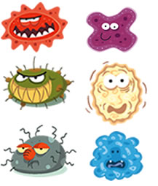
Pathogen
A pathogen is a micro-organism that causes disease.
Examples:
Flu virus
Salmonella bacteria

Slide 3
Defence Against Disease
The body has two main ways of defending itself against pathogens.
Non-specific defence system: prevents pathogens from getting in
Immune system: destroys pathogens that do enter

Slide 4
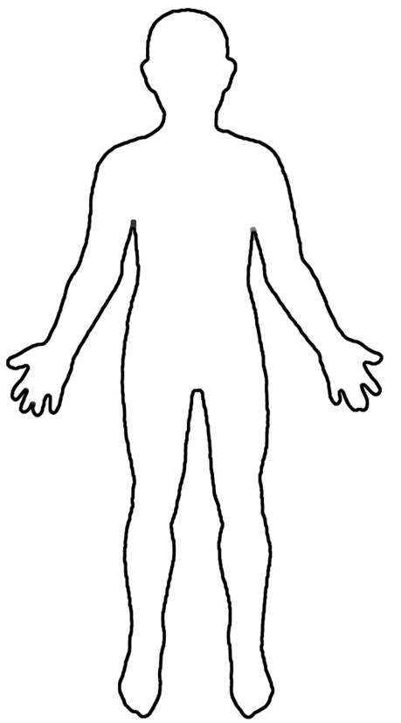
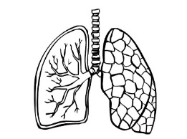
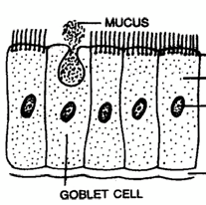
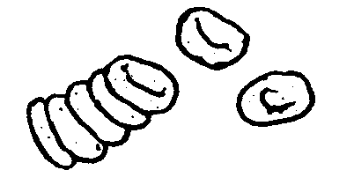
Chemicals in tears have antiseptic properties (kills bacteria).
Cells in the airways produce mucus. Pathogens get stuck to the mucus. Cilia (tiny hairs) sweep the mucus into the stomach.
The skin is the very first barrier that prevents microbes entering.
CILIA
The blood clots forming a scab to stop microbes from entering.
Hydrochloric acid in the stomach kills bacteria.

Slide 5
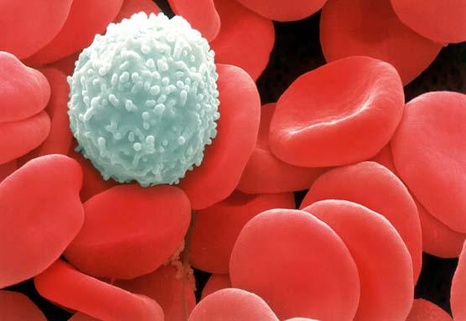
Second Line of Defence: Immune System
White blood cells are a vital part of the immune system as they deal with pathogens that do enter the body.

Slide 6
White Blood Cells
They deal with pathogens in three main ways:
Phagocytosis – ingesting pathogens
Producing Antitoxins – these counteract the toxins produced by pathogens
Producing Antibodies – these tag and disable pathogens (these also make you immune to a disease)

Slide 7
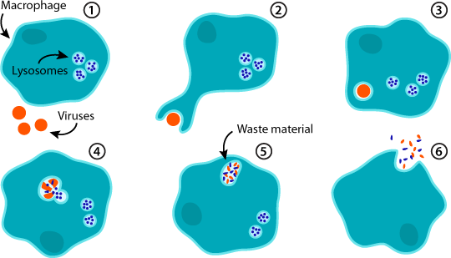
White Blood Cells Ingest Pathogens

Slide 8
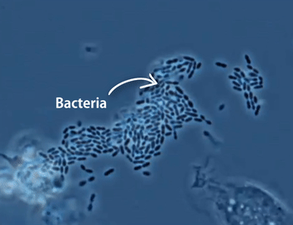
Phagocytosis

Slide 9
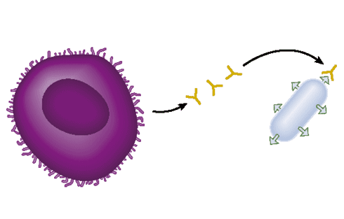
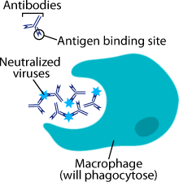
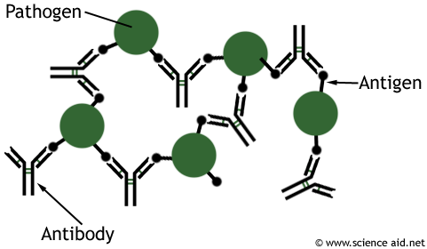
Antibodies
1.
White blood cells produce antibodies that recognise specific germ.
Antibodies tag and disable pathogens and make them stick together.
Other white blood cells recognise the antibodies and ingest the pathogens.
2.
3.

Slide 10
Produce Antitoxins
White blood cells produce antitoxins that get rid of toxins (poisons) made by germs.

Slide 11
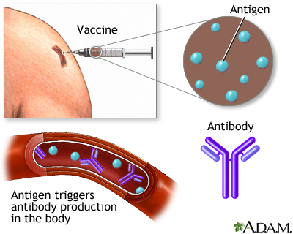
Immunisations (Vaccinations)
A vaccine containing dead or inactivated pathogen is injected into your body.
The immune system will then respond as if it was the real disease causing microbe.

Slide 12
Immunisations (Vaccinations)
Your body will then make antibodies and memory cells recognising the microbe.

Slide 13
Immunity
You are now immune to the disease caused by that pathogen.
If the pathogen enters your body, the immune system will recognise it quickly and defeat it before it makes you ill.

