Slide 1
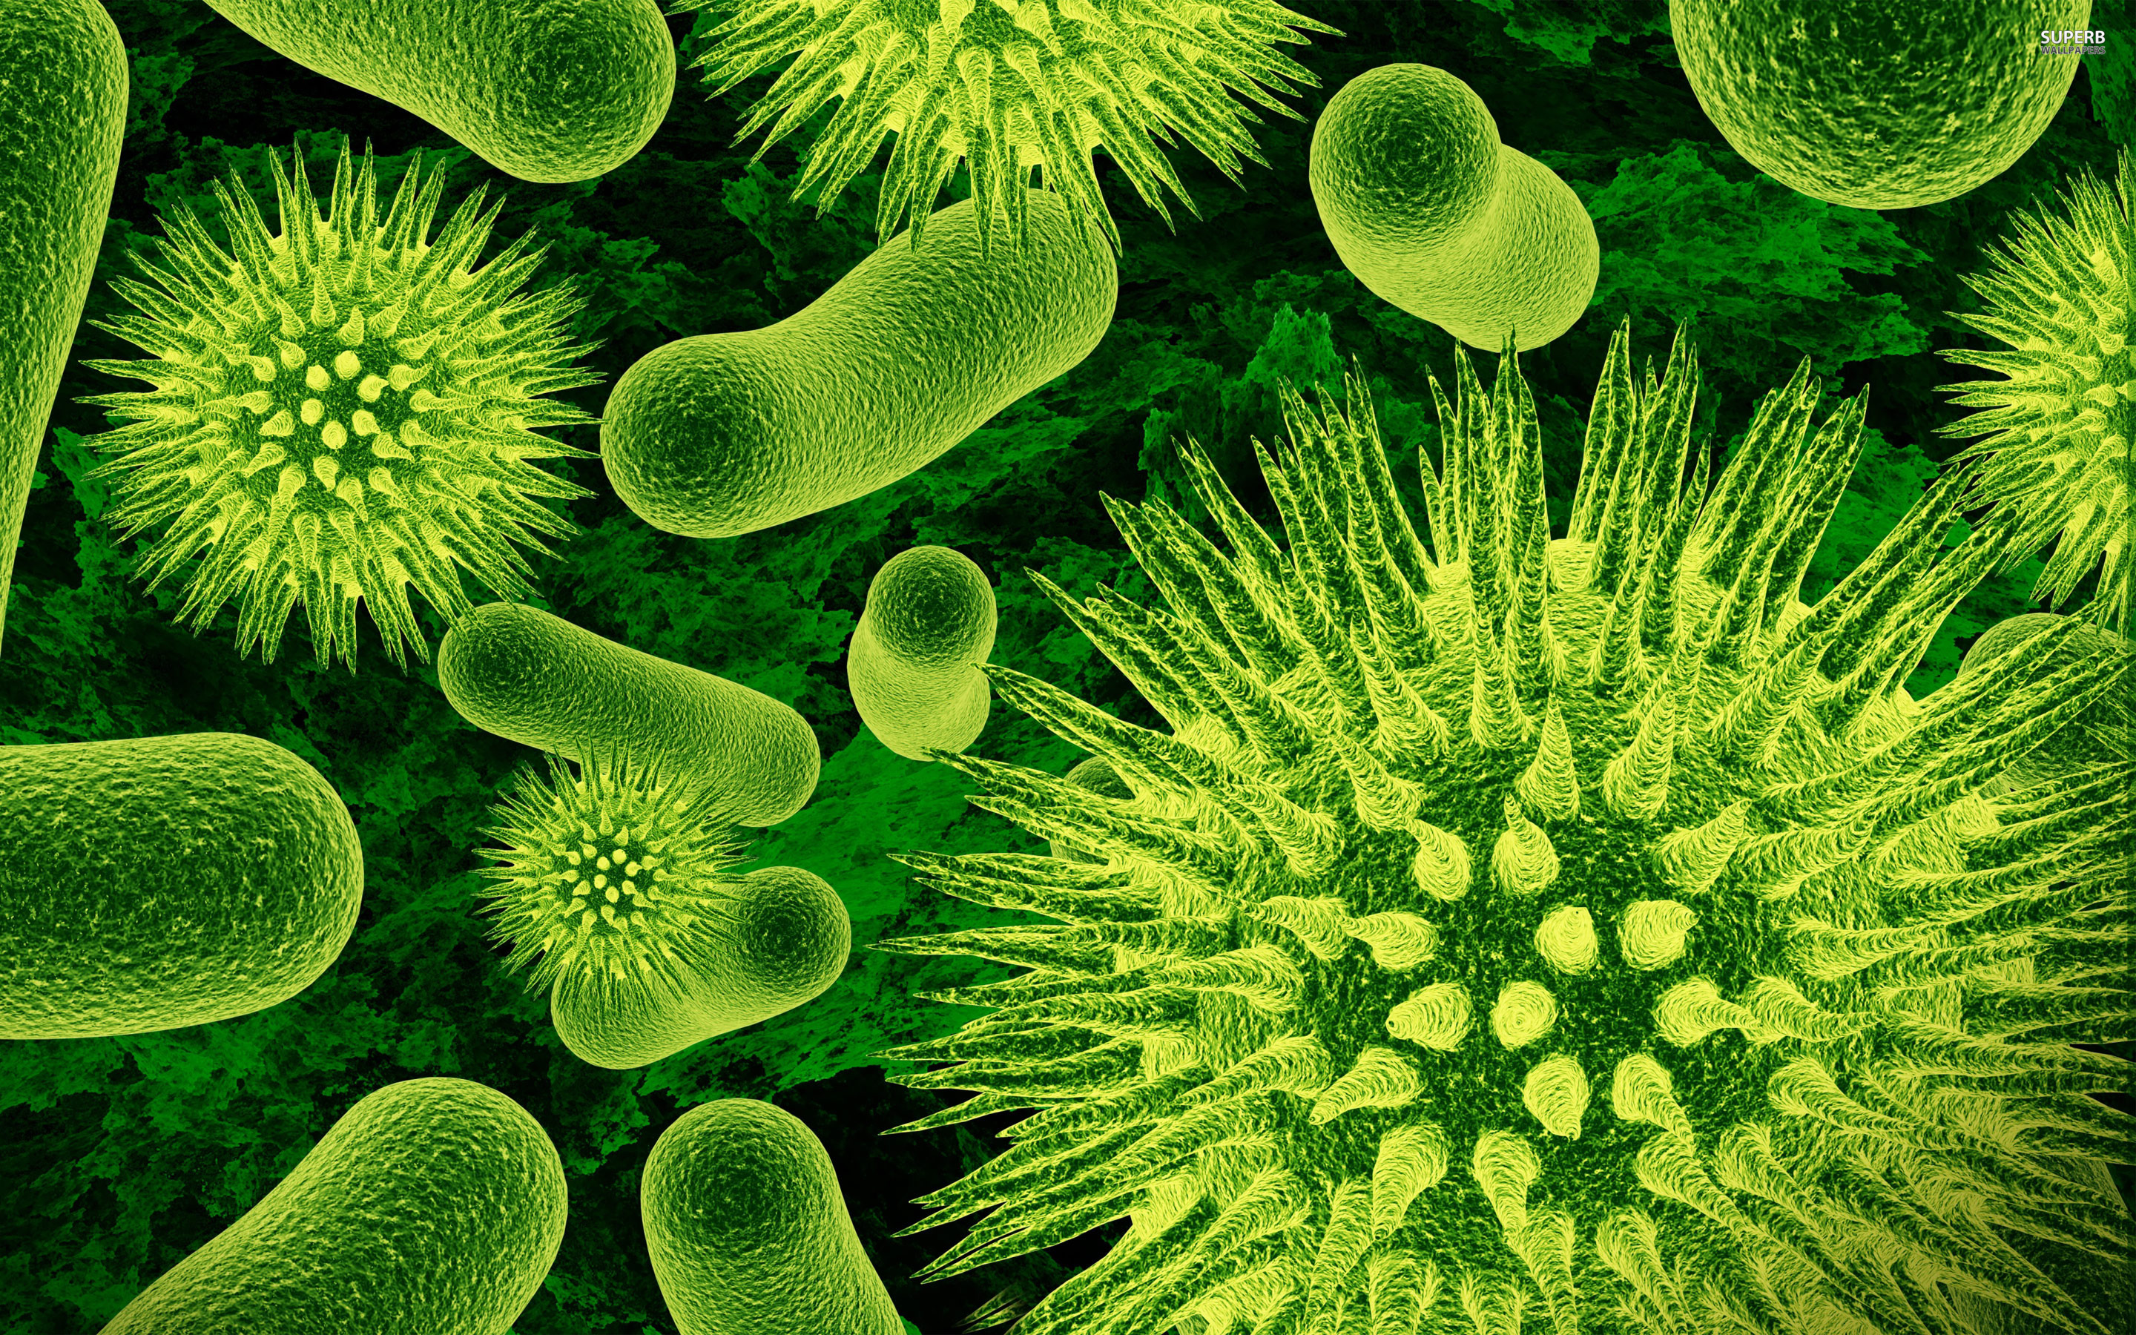

Slide 2
Microbes and Disease L1 Introduction to Microbes
Learning Objectives:
Understand what a microorganism (microbe) is and give some examples.
Compare different types of microbes.
Analyse the benefits and hazards of microorganisms.

Slide 3
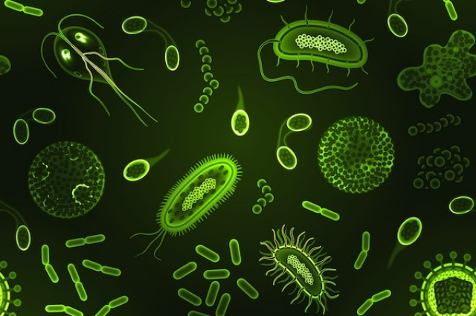
Microorganisms (Microbes)
Microorganisms = living things that are too small to see without a microscope
Microbe is a shorter name for microorganism.
Can you think of any types of microbes?

Slide 4
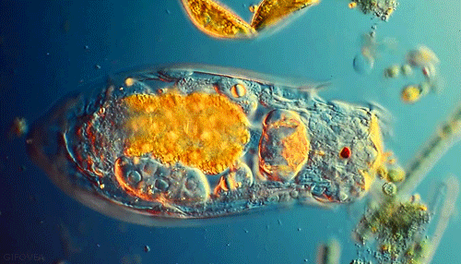
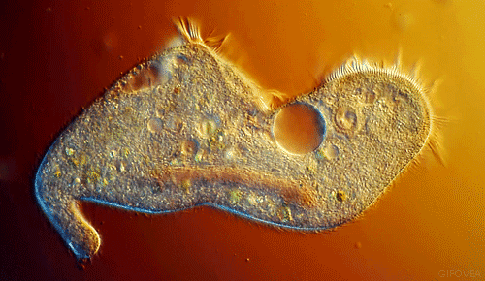
Types of Microbes
Bacteria
Fungi
Viruses

Slide 5
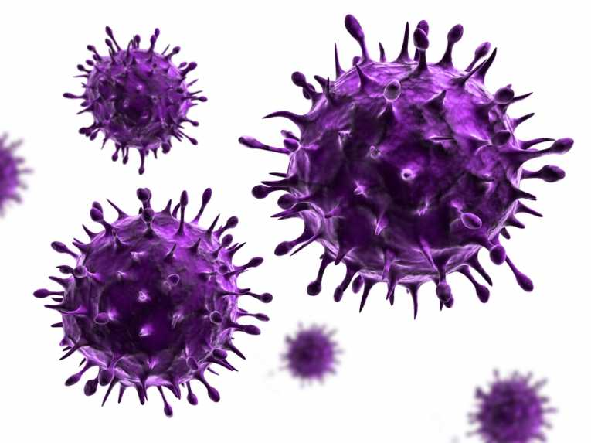
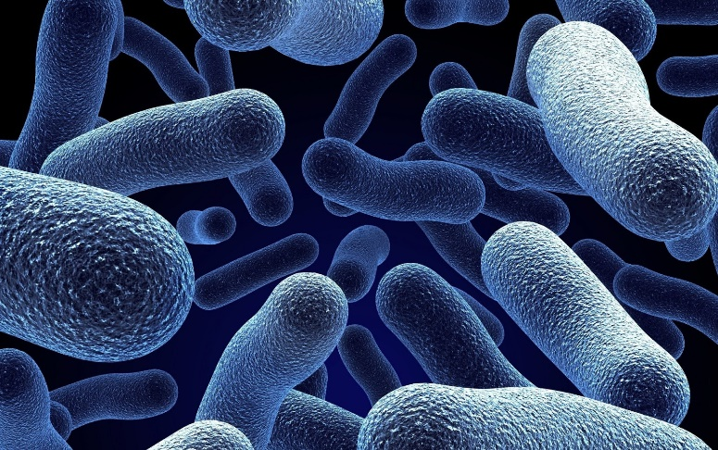
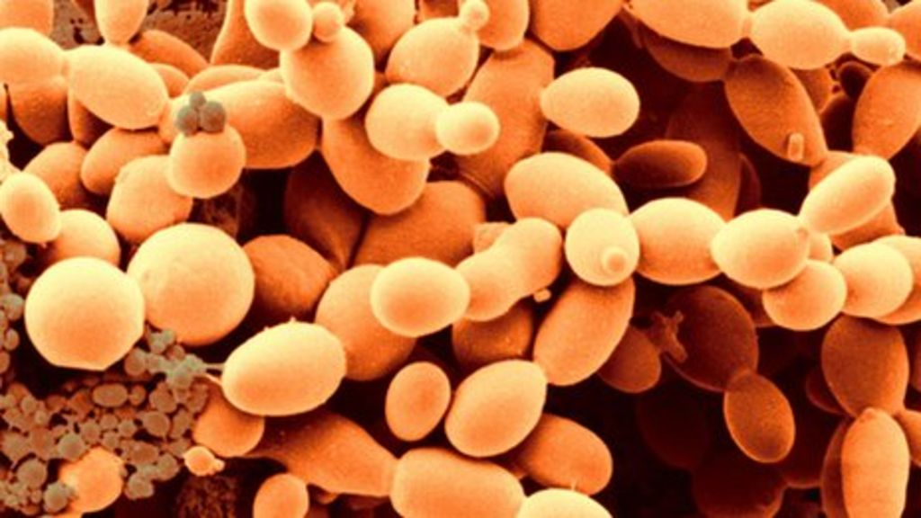
We are going to learn about:
Virus
Bacteria
Fungi

Slide 6
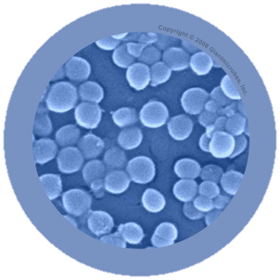
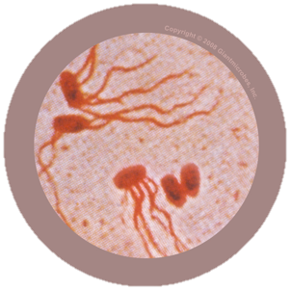
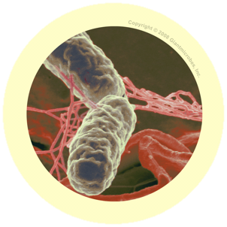
Bacteria: What are they?
Bacteria are simple, single celled micro organisms.
Single celled means they are only made of 1 cell!

Slide 7
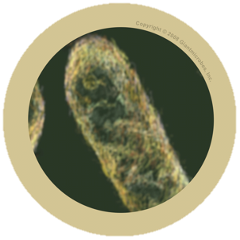
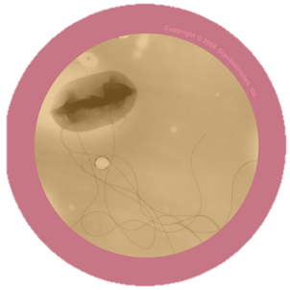
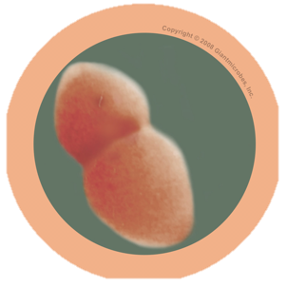
Bacteria: Where are they found?
Bacteria are everywhere!
Food
Soil
Air
There are 100 billion inside your body!
Some are good, most are harmless, but some make you sick.

Slide 8
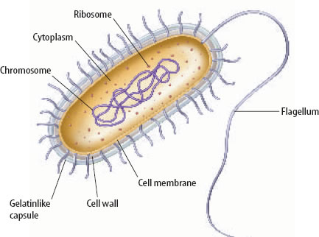
Bacteria: What do they look like?
Bacteria can be different shapes (rods, balls, spirals).
They are much smaller than animal cells (x10 smaller).
They are much simpler and do NOT have a nucleus.

Slide 9
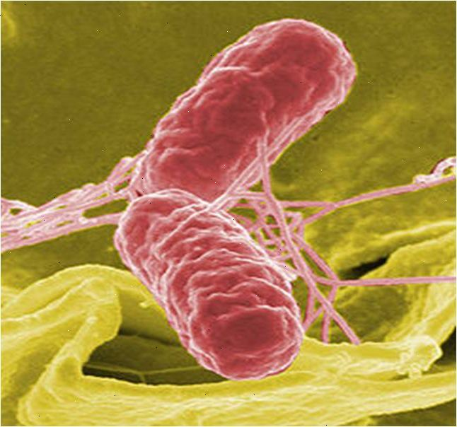
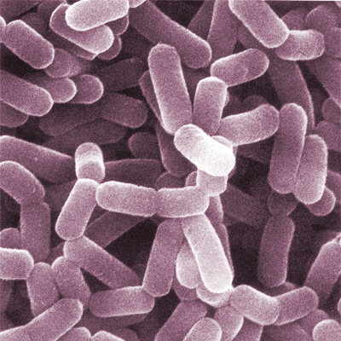
Bacteria: Examples
Bad – Salmonella causes food poisoning.
Good – lactobacillus makes cheese and yoghurt

Slide 10
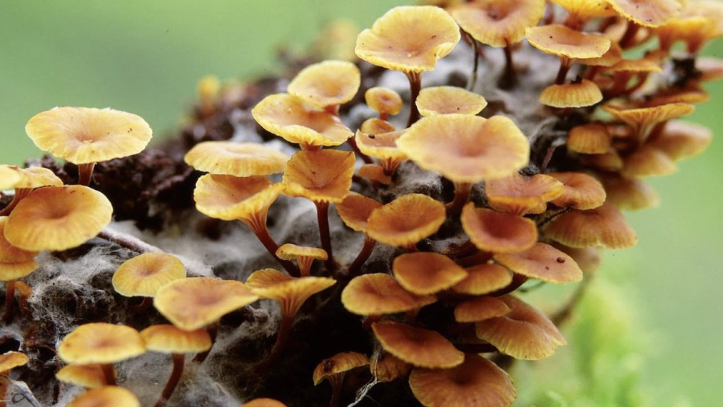
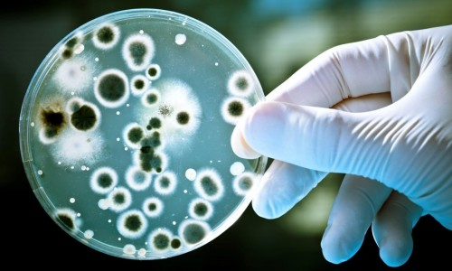
Fungi: What are they?
Fungi are a group of organisms that feed by digesting food outside of their bodies and absorbing the nutrients.
Some are multicellular (mushrooms) and some are single celled microbes.

Slide 11
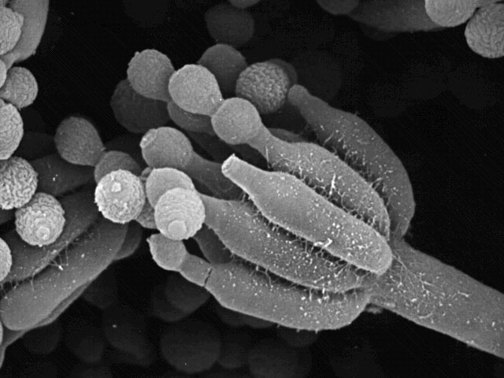
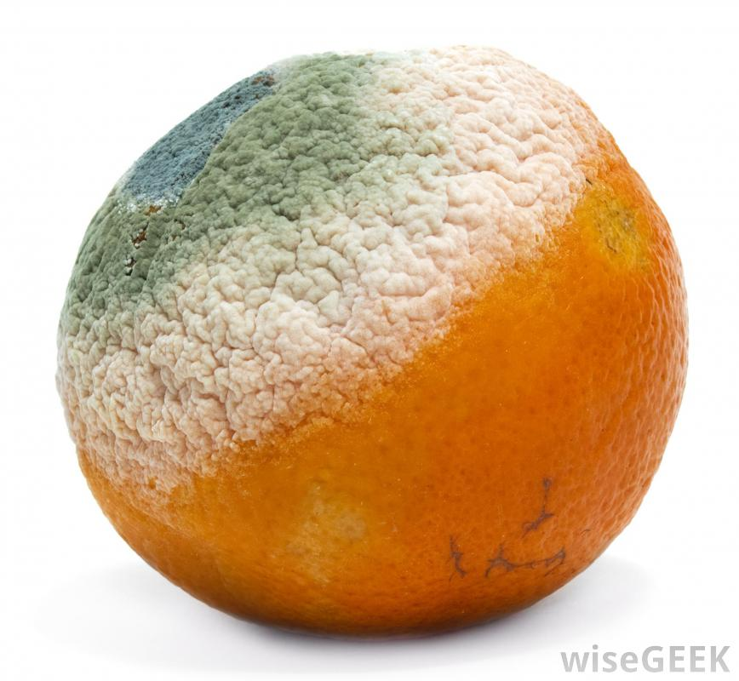
Fungi: Where are they found?
Fungi are everywhere.
They produce spores (like seeds), which can spread and reproduce.

Slide 12
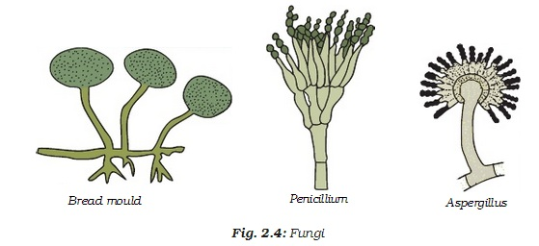
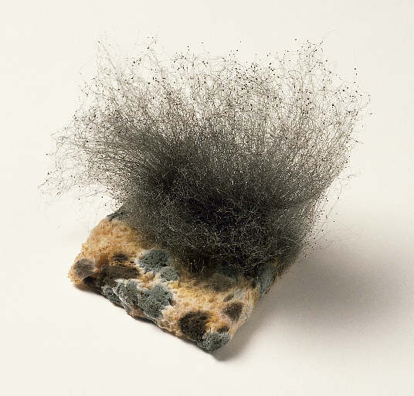
Fungi: What do they look like?
Microscopic fungi are larger than bacteria and are more complex (have a nucleus).
They often look like moulds with little hair-like extensions (hyphae) that fungi use for feeding.

Slide 13
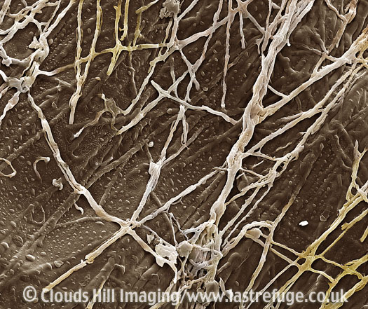
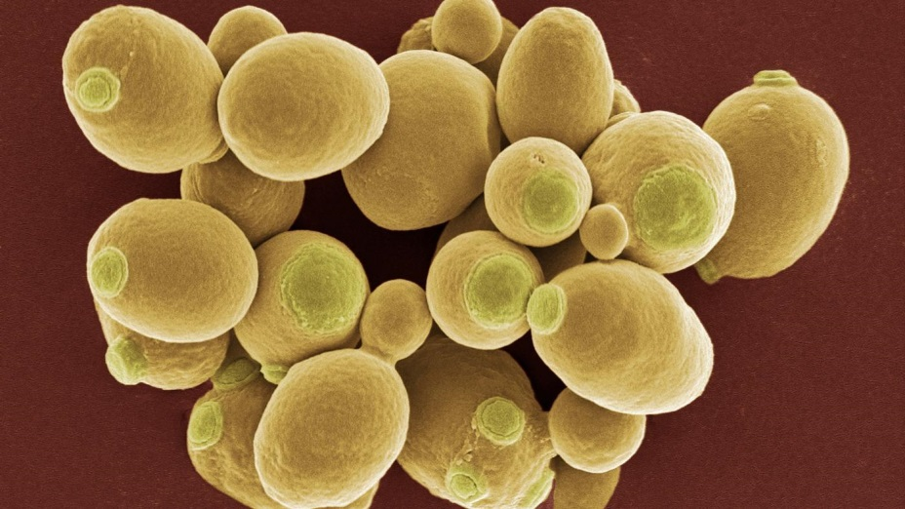
Fungi: Examples
Bad – mould and some types cause infections like Athlete’s foot
Good – yeast, Penicillin (antibiotic)

Slide 14
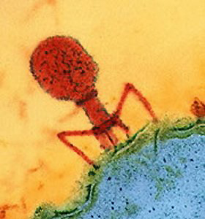
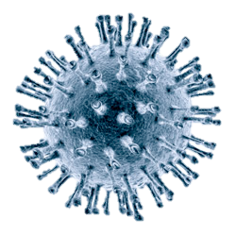
Viruses: What are they?
Viruses are the smallest type of microbe, even smaller than bacteria.
They cannot reproduce without using another cell.
Some people argue that viruses aren’t even alive.

Slide 15
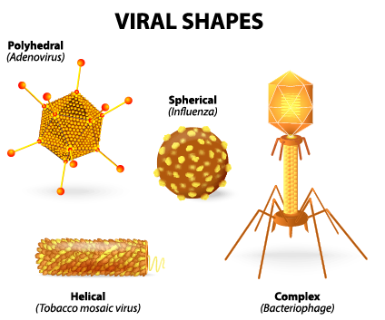
Viruses: Where are they found?
Viruses can be found almost everywhere!
They’re all over the planet, in soil, water and air, just waiting around for cells to infect.
Mainly they live inside infected organisms.

Slide 16
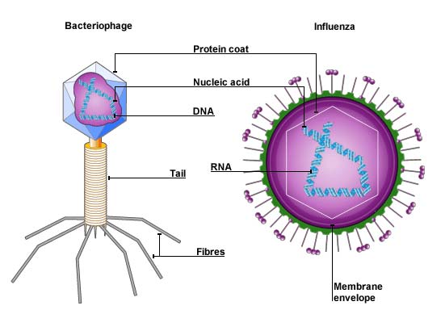
Viruses: What do they look like?
Viruses are very simple – typically they have just a strand of genes surrounded by a protein coat.
Viruses are often geometric shapes.
Sometimes the protein coat is surrounded by an ‘envelope’.

Slide 17
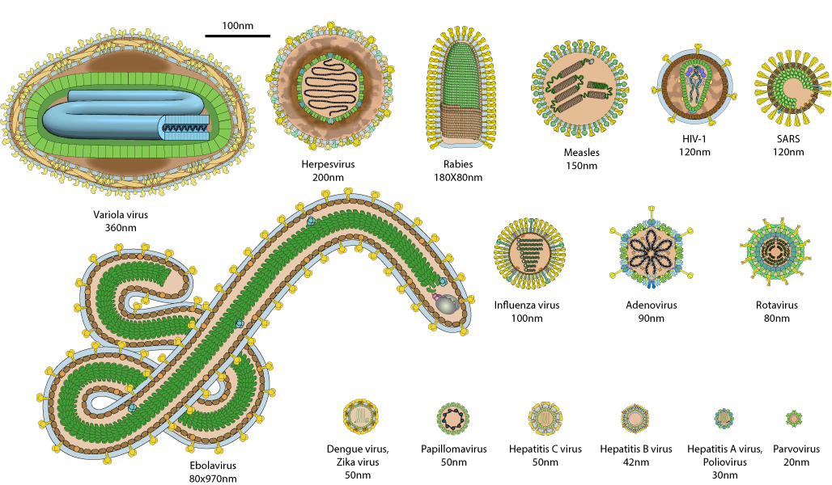
Viruses: Examples
Bad - Lots! Flu, Chicken pox, Common cold, Meningitis, Ebola
Good - None! Although some are now used in medical research.
Not all viruses infect humans – some infect other animals, plants and even bacteria.

Slide 18
Read the article on useful microbes
Bacteria | Fungi
Draw the table.
Cut out the pictures for uses of microbes.
Paste them the correct place on the table.

Slide 19
Video: You are Mainly Microbe
http://ca.pbslearningmedia.org/resource/feb3f1ed-4041-456e-9bf0-a6f7c224c49d/you-are-mainly-microbe-meet-your-microbiome-its-okay-to-be-smart-pbs-digital-studios/

