Slide 1
Starter Quiz
What is the pH scale?
What does it measure?
What range of values does it have?
How do you use the pH scale?
What can you use to measure pH?
Notes:
pH scale used to measure how acidic or alkaline a solution is.
Range 0-14
Less than 7 is acid (lower the number the more acidic), 7 is neutral, above 7 is alkaline (higher the number the more alkaline).
Universal indicator, pH paper, pH meters can be used to measure pH

Slide 2
Unit 4: Chemical Changes L1: Acids and Alkalis
Learning Objectives:
Understand how to use the pH scale.
Define acid, alkali, and base.
Write equations for neutralisation.
Define pH scale as it relates to H⁺ concentration.
Explain the difference between dilute and concentrated, strong and weak acids.
Describe the use of universal indicator to measure pH.
Draw a pH curve graph for neutralisation.

Slide 3
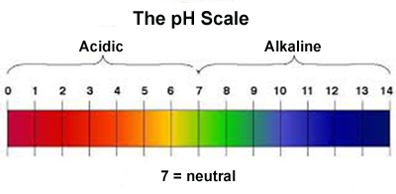
Stronger acids
Stronger alkali

Slide 4
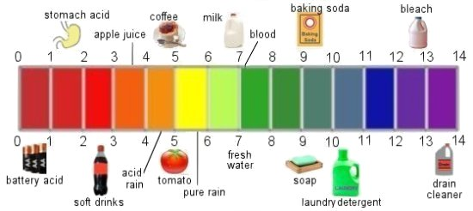

Slide 5
Unit 4: Chemical Changes L1: Acids and Alkalis
Learning Objectives:
Understand how to use the pH scale.
Define acid, alkali, and base.
Write equations for neutralisation.
Define pH scale as it relates to H⁺ concentration.
Explain the difference between dilute and concentrated, strong and weak acids.
Describe the use of universal indicator to measure pH.
Draw a pH curve graph for neutralisation.

Slide 6
Acids and Alkalis
Acid = a substance with a pH less than 7 and produces H⁺ (hydrogen) ions in water.
Examples: HCl, HNO₃, H₂SO₄
Alkali = a substance with a pH greater than 7 and produces OH⁻ (hydroxide) ions in water.
Examples: NaOH, KOH

Slide 7
Bases
Base = a substance that reacts with acids in a neutralisation reaction
Examples: NaOH, CaCO₃, CuO
All alkalis are bases, as they are soluble substances that react with acids and neutralise them.
However, not all bases are alkalis. Some are insoluble and do not produce OH- ions but will still react with acids in a neutralisation reaction.
Bases
Alkalis

Slide 8
Unit 4: Chemical Changes L1: Acids and Alkalis
Learning Objectives:
Understand how to use the pH scale.
Define acid, alkali, and base.
Write equations for neutralisation.
Define pH scale as it relates to H⁺ concentration.
Explain the difference between dilute and concentrated, strong and weak acids.
Describe the use of universal indicator to measure pH.
Draw a pH curve graph for neutralisation.

Slide 9
Neutralisation
During neutralisation H⁺ ions (from acid) react with OH⁻ ions (from alkali).
What is the product of this reaction?
H
H
O
H
H
O

Slide 10
Ionic Equation for Neutralisation
The simplest equation for neutralisation is…
H⁺ + OH⁻ → H₂O
This is why the acid and alkali are neutralised. The product is water, which has a neutral pH of 7.

Slide 11
Unit 4: Chemical Changes L1: Acids and Alkalis
Learning Objectives:
Understand how to use the pH scale.
Define acid, alkali, and base.
Write equations for neutralisation.
Define pH scale as it relates to H⁺ concentration.
Explain the difference between dilute and concentrated, strong and weak acids.
Describe the use of universal indicator to measure pH.
Draw a pH curve graph for neutralisation.

Slide 12
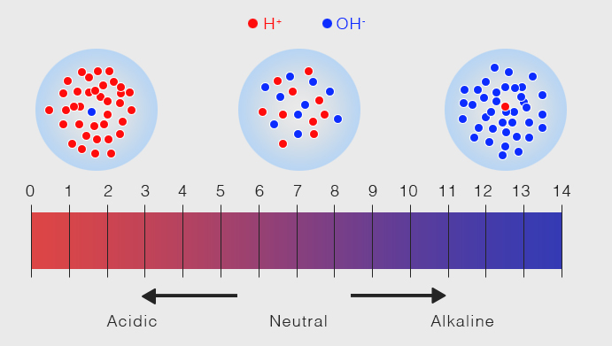
What does the pH number mean?
The value for pH is related to the H⁺ concentration.
The more H⁺, the lower the pH, the more acidic the substance is.
The lower the H⁺, the higher the pH, the more alkaline the substance is.

Slide 13
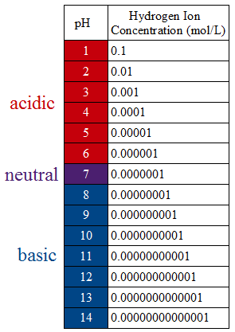
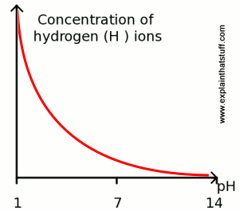
pH – changes by factor of 10 (NOT Linear)
A decrease of 1 unit on the pH scale equals an increase of H⁺ ion concentration x10.
Example:
pH 2 = 0.01 mol/L
pH 1 = 0.10 mol/L

Slide 14
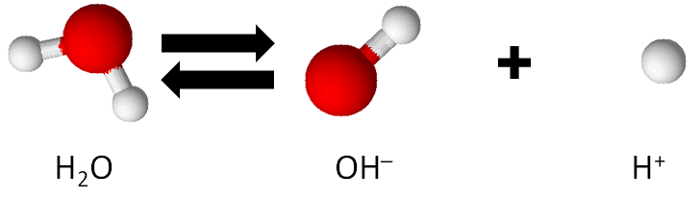
Why is water neutral?
pH of 7 is when there are an equal number of H⁺ and OH⁻ ions.
Water molecules slightly ionise to form both H⁺ and OH⁻, which “cancel out” and is defined as neutral on the pH scale.
These quickly react to form water again so there is only a very small number of ions in water.

Slide 15
Unit 4: Chemical Changes L1: Acids and Alkalis
Learning Objectives:
Understand how to use the pH scale.
Define acid, alkali, and base.
Write equations for neutralisation.
Define pH scale as it relates to H⁺ concentration.
Explain the difference between dilute and concentrated, strong and weak acids.
Describe the use of universal indicator to measure pH.
Draw a pH curve graph for neutralisation.

Slide 16
Strong vs. Weak Acids
turned into ions
dissolved in water
A strong acid is one is completely ionised in aqueous solution.
HCl → H⁺ + Cl⁻
This means ALL HCl molecules turn into H⁺ (and Cl⁻) ions.
A weak acid is only partially ionised in aqueous solution.
CH₃COOH H⁺ + CH₃COO⁻
This means that only SOME of the CH₃COOH molecules turn into H⁺ (and CH₃COO⁻) ions. (the double arrow means it’s a reversible reaction)

Slide 17
Examples you need to know
Strong Acids
Weak Acids
Hydrochloric acid – HCl
Nitric acid – HNO₃
Sulfuric acid – H₂SO₄
Note: sulfuric acid produces two H⁺ ions for every one molecule of acid.
Ethanoic acid – CH₃COOH
Citric acid
Carbonic acid – H₂CO₃

Slide 18
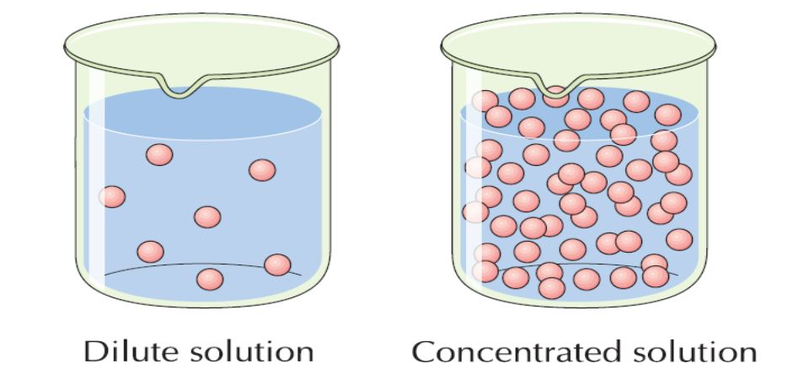
Dilute vs. Concentrated Acids
Amount of space the solution takes up, measured in mL.
Dilute acid – small amount of acid per unit of volume.
Concentrated – large amount of acid per unit of volume.
Does this change the pH of an acid?
NOTE: Strength of acid and concentration of acid are SEPARATE PROPERTIES!
You can have a strong, dilute acid.
You can also have a weak, concentrated acid.
YES!

Slide 19
Both Strength and Concentration will effect the pH of an acid.
The stronger the acid, the lower the pH.
The higher the concentration of the acid, the lower the pH.
Example
Strong acid Weak acid
0.1 M HCl pH = 1 0.1 M ethanoic acid pH = 2.88 4 M HCl pH = -0.3 4 M ethanoic acid pH = 2.08

Slide 20
Unit 4: Chemical Changes L1: Acids and Alkalis
Learning Objectives:
Understand how to use the pH scale.
Define acid, alkali, and base.
Write equations for neutralisation.
Define pH scale as it relates to H⁺ concentration.
Explain the difference between dilute and concentrated, strong and weak acids.
Describe the use of universal indicator to measure pH.
Draw a pH curve graph for neutralisation.

Slide 21
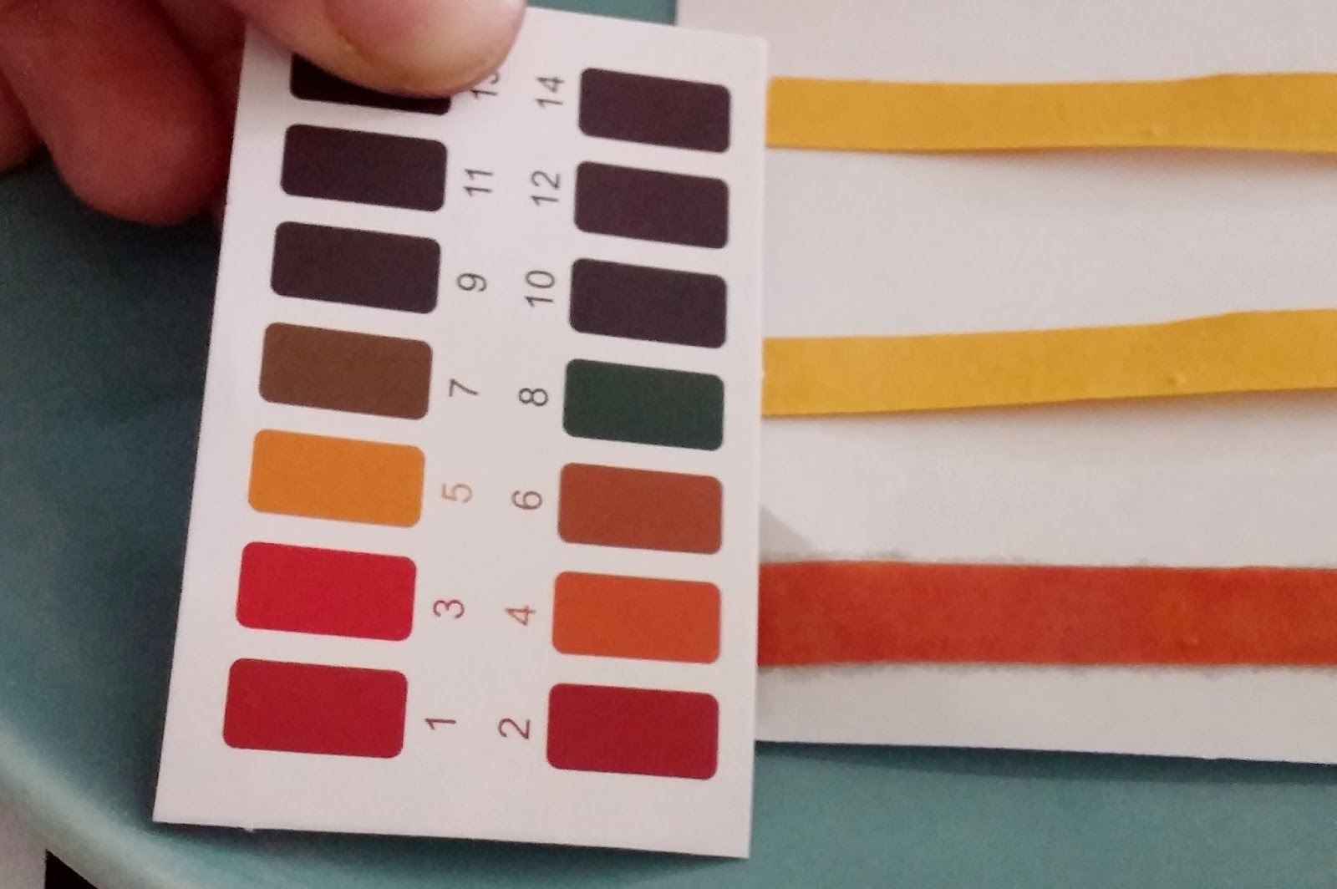
Demo/Practical: Neutralisation (pH change)
We are going to investigate how pH changes during a neutralisation reaction as we add a strong alkali to a strong acid.
We can use universal indicator or pH paper to measure the pH of the solution.
The indicator will change different colours depending on the pH. We use a chart to match the colour to the pH.

Slide 22
Safety Precautions
Dilute acids and alkali are irritants.
Wear goggles at all times.
Stand while doing the experiment.
Have long hair tied back and out of the way.
Measure out chemicals accurately and carefully.
If you spill on yourself, wash the affected area with soap and water.
Wipe up any spills with a paper towel straight away.

Slide 23
Method
Read method and draw an appropriate results table.
Measure 10 cm³ of hydrochloric acid into a 100 cm³ beaker.
Measure the starting pH using pH paper and record in results table (0 cm³ alkali added).
Add 1 cm³ of sodium hydroxide and swirl gently to completely mix so the solution fully reacts. Record the pH again.
Continue adding 1 cm³ of alkali and recording the pH until the pH no longer changes.
HOMEWORK: draw a graph of your results

Slide 24
Unit 4: Chemical Changes L1: Acids and Alkalis
Learning Objectives:
Understand how to use the pH scale.
Define acid, alkali, and base.
Write equations for neutralisation.
Define pH scale as it relates to H⁺ concentration.
Explain the difference between dilute and concentrated, strong and weak acids.
Describe the use of universal indicator to measure pH.
Draw a pH curve graph for neutralisation.

