Slide 1
Heat Transfers L1: Heat and Temperature
Learning Objectives:
Describe the difference between heat energy and temperature.
Accurately measure temperature.
Graph a cooling curve.

Slide 2
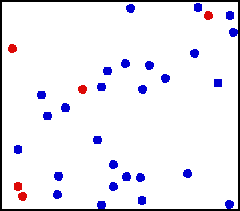
Heat Energy
Heat is a type of energy.
It is also called thermal energy.
All particles contain energy and move around.
Heat energy makes particles move faster.
Heat energy is measured in joules (J).

Slide 3
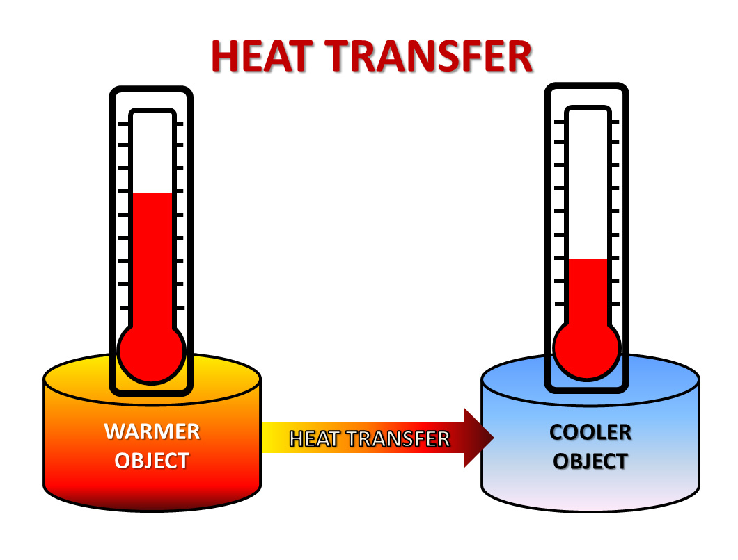
Heat Transfers
Heat moves from hot areas to colder areas.
If heat is added to an object, it becomes hotter.
Heat is transferred in three different ways; conduction, convection, and radiation.

Slide 4
Temperature
Temperature is a measure of how hot or cold something is.
It is also a measure of how fast the particles are moving.
Temperatures is measured in degrees Celsius (ºC).
A thermometer is used to measure temperature.

Slide 5
Heat Transfers
There are three different ways to transfer heat.
Conduction
Convection
Radiation
Watch the demonstration and compare the different ways of transferring heat.

Slide 6
 | Conduction | Convection | Radiation
How it works
Does it pass heat through solids?
Does it pass heat through liquids and gases?
Does it pass heat through a vacuum (empty space)?
Particles bump into each other and pass heat energy
Hot fluids rise and cold fluids sink and transfer heat energy
Infrared radiation is given off by all hot objects as a light wave
quickly
NO
slowly
slowly
YES
YES
NO
NO
quickly

Slide 7
Cooling Curve Experiment
We are going to graph a cooling curve for water and investigated what happens to the temperature of hot water over time.
Measure the starting temperature of the water.
Record the temperature every 30 seconds for 5 minutes.

Slide 8
Time (s) | Temperature (ºC)
0:00
0:30
1:00
1:30
2:00
2:30
3:00
3:30
4:00
4:30
5:00

Slide 9
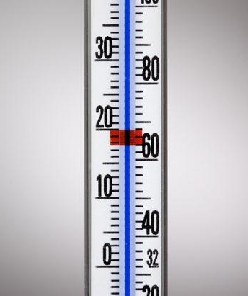
How to use a thermometer accurately
Make sure to read the thermometer at eye level.
Make sure the bulb (round bit at the bottom) is fully immersed in the liquid you are measure.
Understand the scale of the thermometer (for example the scale on the left every marking is 1º, on the scale on the right every marking is 2º)

Slide 10
Analysing Results
Draw a graph of your results.
Graph should include:
Title
X-axis labelled (independent variable) including units
Y-axis labelled (dependent variable) including units
Appropriate scale (should take up at least half the page)
Line of best fit (could be a curve)
Points plotted correctly

Slide 11
Analysing Results
Describe the pattern shown in the results.
What was the independent variable (what we changed)?
What was the dependent variable (what we measured)?
Was this a fair test? Why or why not?
Are the results reliable? Why or why not?
What would you do differently if you were to repeat the experiment?

