Slide 1
Starter Quiz
What ions are produced by acids and alkalis?
Write the ionic equation for neutralisation.
Why is water neutral?
What is the difference between a strong acid and a weak acid?
What is the effect of concentration on pH?
If a 0.1 M HCl acid solution has a pH of 1, what is the concentration of a HCl acid solution with a pH of 2?

Slide 2
Practical: Changes in pH
What was the shape of your pH graph?
Does your graph include:
Labelled axes
Units
Appropriate scale
Title
Smooth curve of best fit

Slide 3
L2: Neutralisation Reactions
Learning Objectives:
Write word equations for neutralisation reactions.
Predict the products of neutralisation reactions.
Describe how to produce a pure, dry sample of a soluble salt.
Required Practical 8: Prepare a pure, dry sample of a soluble salt
Write formulae of salts produced.
Write balanced equations for neutralisation reactions.

Slide 4
Neutralisation Reactions
Ionic equation for neutralisation:
H⁺ comes from the acid.
OH⁻ comes from the alkali.
This is called neutralisation because the product is neutral water, the H⁺ and OH⁻ ions (which determine pH) are removed.
What happens to the other ions in solution?

Slide 5
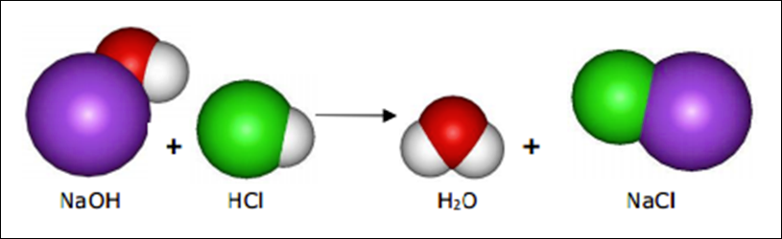
General Equation: Neutralisation Reactions
Acid + Alkali → Salt + Water
Example:
HCl + NaOH → NaCl + H₂O

Slide 6
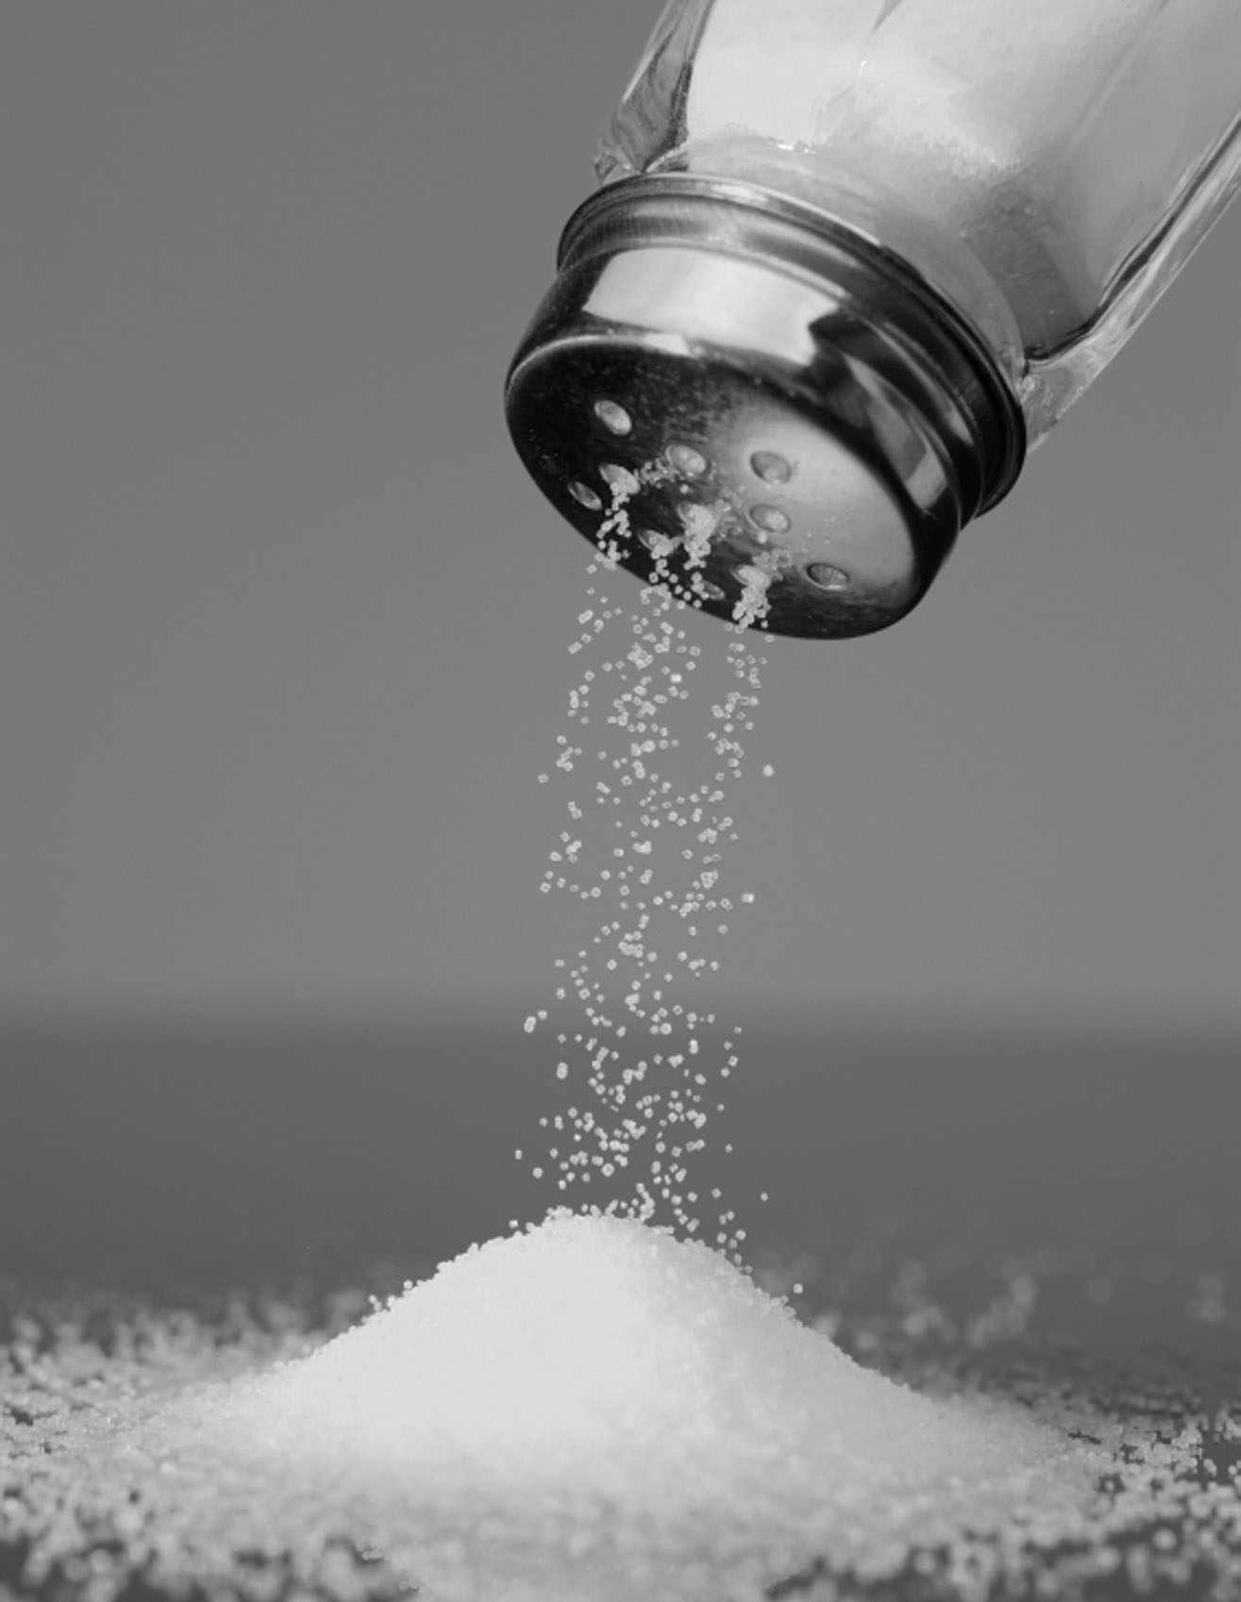
Salts
Salts are ionic compounds made from a positive metal ion and a negative non-metal ion.
They are pH neutral.
Examples:
Sodium chloride (NaCl) – table salt
NOTE: the salt that we eat is only one salt out of a large group of compounds with this name.

Slide 7
Salts Produced
NOTE: We will learn how to write these formulas in just a bit.
Acid Reacted | Salt Produced
Hydrochloric Acid – HCl
Metal Chloride – M_{x}Cl_{x}
Nitric Acid – HNO₃
Metal Nitrate – M_{x}(NO₃)_{x}
Sulfuric Acid – H₂SO₄
Metal Sulfate – M_{x}(SO₄)_{x}

Slide 8
Other Bases Also Neutralise Acids
Alkalis are soluble substances that produce OH⁻ ions.
Example: soluble metal hydroxides (sodium hydroxide, NaOH).
Bases are any substances that reacts with acids, they can be insoluble.
Reactions of Other Bases with Acids
Acid + Metal Hydroxide → Salt + Water
Acid + Metal Oxide → Salt + Water
Acid + Metal Carbonate → Salt + Water + Carbon Dioxide
NOTE: insoluble hydroxides react the same way as soluble ones!

Slide 9
Practice
Complete question 7 on your worksheet.

Slide 10
Answers
Hydrochloric acid + magnesium hydroxide → magnesium chloride + water
Sulfuric acid + potassium oxide → potassium sulfate + water
Hydrochloric acid + sodium carbonate → sodium chloride + water + carbon dioxide.
Sulfuric acid + barium oxide (or barium hydroxide) → barium sulfate + water
Nitric acid + lithium carbonate → lithium nitrate + water + carbon dioxide

Slide 11

L2: Neutralisation Reactions
Learning Objectives:
Write word equations for neutralisation reactions.
Predict the products of neutralisation reactions.
Describe how to produce a pure, dry sample of a soluble salt.
Required Practical 8: Prepare a pure, dry sample of a soluble salt
Write formulae of salts produced.
Write balanced equations for neutralisation reactions.

Slide 12
Experimental Technique:
Producing a pure, dry sample of a soluble salt
Step 1: Neutralisation reaction
React an acid with an insoluble base (solid) until no more reacts to produce desired salt
Step 2: Filtration
Filter out the excess solid to produce a solution of the soluble salt.
Step 3: Crystallisation
Evaporate off the water to crystallise the salt and produce a solid salt sample.

Slide 13
Required Practical 8:
Producing a pure, dry sample of a soluble salt
We will be preparing a sample of copper sulfate.
Read the method and follow it EXACTLY.
Safety:
1.0M dilute sulfuric acid (IRRITANT)
copper(II) oxide (HARMFUL)
copper(II) sulfate (HARMFUL)
Bunsen burners (FIRE HAZARD)

Slide 14
L2: Neutralisation Reactions
Learning Objectives:
Write word equations for neutralisation reactions.
Predict the products of neutralisation reactions.
Describe how to produce a pure, dry sample of a soluble salt.
Required Practical 8: Prepare a pure, dry sample of a soluble salt
Write formulae of salts produced.
Write balanced equations for neutralisation reactions.

Slide 15
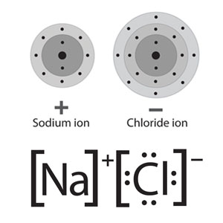
Writing Ionic Formulae
Remember that charges need to balance out for ionic compounds.
Na = +1
Cl = -1
(+1) + (-1) = 0 = balanced
Formula = NaCl

Slide 16
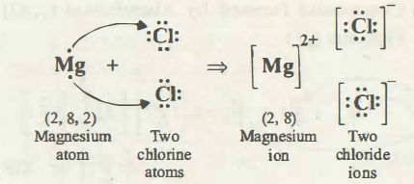
Writing Ionic Formulae
Mg = +2
Cl = -1
(+2) + (-1) = +1 = unbalanced
Use 2Cl = -2
(+2) + 2(-1) = 0 = balanced
Formula = MgCl₂

Slide 17
Writing Ionic Formulae
Mg = +2
NO₃ = -1
(+2) + (-1) = +1 = unbalanced
Use 2 NO₃ = -2
(+2) + 2(-1) = 0 = balanced
Formula = Mg(NO₃)₂
[NO₃]⁻
[Mg]²⁺
[NO₃]⁻

Slide 18
Ion Charges You Need to Know
Hydrogen = +1 H⁺
Chloride = -1 Cl⁻
Nitrate = -1 NO₃⁻
Sulfate = -2 SO₄²⁻
Hydroxide = -1 OH⁻
Carbonate = -2 CO₃⁻²
NOTE: remember that the charge on a monatomic ion corresponds to the group on the periodic table!

Slide 19
Practice
Complete question 11 on your worksheet.

Slide 20
Answers
Potassium nitrate KNO₃ (salt)
Magnesium sulfate MgSO₄ (salt)
Nitric acid HNO₃ (acid)
Calcium carbonate CaCO₃ (base)
Potassium sulfate K₂SO₄ (salt)
calcium nitrate Ca(NO₃)₂ (salt)
Aluminium oxide Al₂O₃ (base)

Slide 21
L2: Neutralisation Reactions
Learning Objectives:
Write word equations for neutralisation reactions.
Predict the products of neutralisation reactions.
Describe how to produce a pure, dry sample of a soluble salt.
Required Practical 8: Prepare a pure, dry sample of a soluble salt
Write formulae of salts produced.
Write balanced equations for neutralisation reactions.

Slide 22
Balanced Neutralisation Equations
Step 1: Write the word equation
Sulfuric acid + lithium hydroxide → lithium sulfate + water
Step 2: Write the correct formulae for all reactants and products
H₂SO₄ + LiOH → Li₂SO₄ + H₂O
Step 3: Balance the equation
H₂SO₄ + 2LiOH → Li₂SO₄ + H₂O

Slide 23
Practice
Complete question 12 on your worksheet.

Slide 24
Answers
2HCl + Mg(OH)₂ → MgCl₂ + H₂O
H₂SO₄ + K₂O → K₂SO₄ + H₂O
2HCl + Na₂CO₃ → 2NaCl + H₂O + CO₂
H₂SO₄ + BaO → BaSO₄ + H₂O
2HNO₃ + Li₂CO₃ → 2LiNO₃ + H₂O + CO₂

Slide 25
L2: Neutralisation Reactions
Learning Objectives:
Write word equations for neutralisation reactions.
Predict the products of neutralisation reactions.
Describe how to produce a pure, dry sample of a soluble salt.
Required Practical 8: Prepare a pure, dry sample of a soluble salt
Write formulae of salts produced.
Write balanced equations for neutralisation reactions.

Slide 26
Homework
Complete the worksheet on balancing neutralisation equations.

