Slide 1
Starter
Write the balanced equations for the following:
Hydrochloric acid reacts with sodium hydroxide
Hydrochloric acid reacts with magnesium oxide
Sulfuric acid reacts with potassium hydroxide
Nitric acid reacts with calcium oxide
Extension: Sulfuric acid reacts with aluminium carbonate

Slide 2
Starter
Write the balanced equations for the following:
HCl + NaOH → NaCl + H₂O
2HCl + MgO → MgCl₂ + H₂O
H₂SO4 + 2KOH → K₂SO₄ + 2H₂O
2HNO₃ +CaO → Ca(NO₃)₂ + H₂O
Extension: 3H₂SO₄ + Al₂(CO₃)₃ → Al₂(SO₄)₃ + 3H₂O + 3CO₂

Slide 3
L3: Reactivity of Metals
Learning Objectives:
Describe what happens to metals atoms when they react.
Describe what affects the reactivity of a metal.
Explain what the reactivity series is.
Use experimental results to place metals in order of reactivity.
Describe the reactions of metals with water and acids.
Write equations for reactions of metals with water and acids.

Slide 4
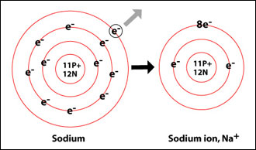
Reactions with Metals
When metal atoms react, they form the most stable electron configuration possible.
What is the most stable?
How do metals become more stable?
Metals lose e⁻ to form positive ions with a full outer shell.

Slide 5
L3: Reactivity of Metals
Learning Objectives:
Describe what happens to metals atoms when they react.
Describe what affects the reactivity of a metal.
Explain what the reactivity series is.
Use experimental results to place metals in order of reactivity.
Describe the reactions of metals with water and acids.
Write equations for reactions of metals with water and acids.

Slide 6
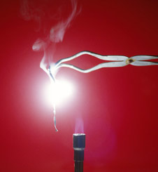
Reactivity = how easy it is for a substance to react
Some metals are more reactive than others.
Can you think of why?
HINT: Which groups of the periodic table are more/less reactive?
How would you know if a metal was more reactive?

Slide 7
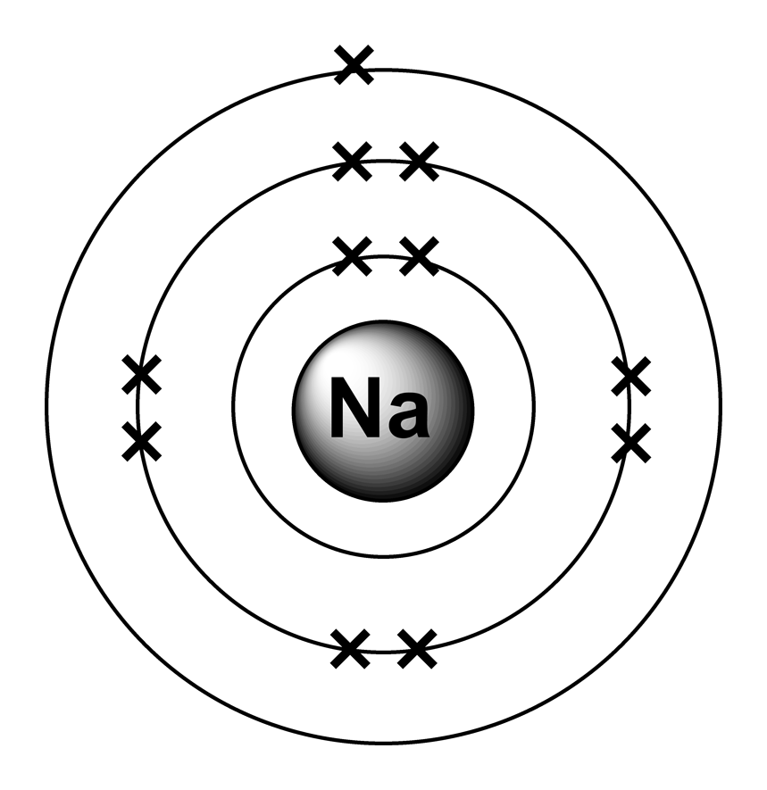
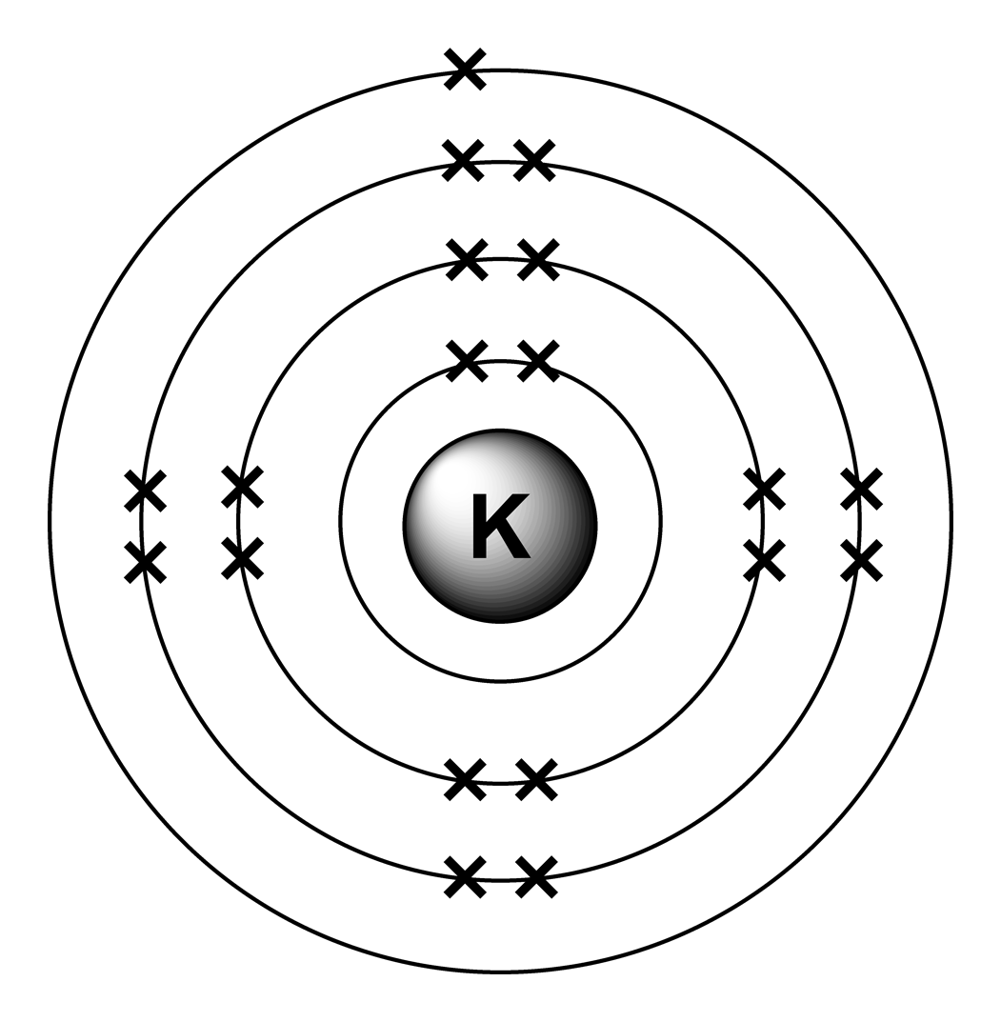
Reactivity
The reactivity of a metal is related to how easily it forms positive ions.
Metals with fewer electrons on the outer shell to lose are more reactive.
Metals with more electron shells are more reactive.
Because outer e⁻ are further from the nucleus and feel a weaker pull from the protons.
more reactive

Slide 8
L3: Reactivity of Metals
Learning Objectives:
Describe what happens to metals atoms when they react.
Describe what affects the reactivity of a metal.
Explain what the reactivity series is.
Use experimental results to place metals in order of reactivity.
Describe the reactions of metals with water and acids.
Write equations for reactions of metals with water and acids.

Slide 9
The Reactivity Series
MOST REACTIVE
The metals can be placed in order of their reactivity in a reactivity series.
We are going to do an investigation to try to place metals in the correct places on the reactivity series.
LEAST REACTIVE

Slide 10
L3: Reactivity of Metals
Learning Objectives:
Describe what happens to metals atoms when they react.
Describe what affects the reactivity of a metal.
Explain what the reactivity series is.
Use experimental results to place metals in order of reactivity.
Describe the reactions of metals with water and acids.
Write equations for reactions of metals with water and acids.

Slide 11
Practical: Metal Reactions with Water and Acid
Reaction with Water
Metal + Water → Metal Hydroxide + Hydrogen
Example: 2Na _{(s)} + 2H₂O _{(l)} → 2NaOH _{(aq)} + H₂ _{(g)}
Reaction with Acid
Metal + Acid → Salt + Hydrogen
Example: 2Na _{(s)} + 2HCl _{(aq)} → 2NaCl _{(aq)} + H_{2 (g)}
What do you notice about both equations?
What should you observe during the reaction?
How will you place the metals in order of reactivity using your observations?

Slide 12
Practical
We are going to react different metals with water and acid and place the metals in order of reactivity to form a reactivity series.
Safety
Follow the instructions carefully.
Dilute hydrochloric acid (IRRITANT), goggles must be worn at all times.
Bunsen burner/lit splints (BURN HAZARD), hair must be tied back.

Slide 13
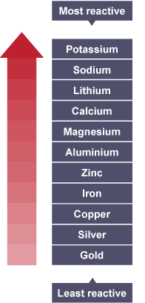
Reactivity Series
How does your reactivity series compare with the actual one?
Do you remember the observations when the group 1 metals are placed in water (Unit 1)?
NOTE: You will be expected to be able to describe the reactions of potassium, sodium, lithium, calcium, magnesium, zinc, iron and copper with water or dilute acids

Slide 14
Group 1 Metals, Reactions With Water
https://www.youtube.com/watch?v=uixxJtJPVXk
Watch video, 1:00 – 2:00
Record the observations for lithium, sodium, and potassium reacting with water.
What do you think would be the reactions with acid?

Slide 15
L3: Reactivity of Metals
Learning Objectives:
Describe what happens to metals atoms when they react.
Describe what affects the reactivity of a metal.
Explain what the reactivity series is.
Use experimental results to place metals in order of reactivity.
Describe the reactions of metals with water and acids.
Write equations for reactions of metals with water and acids.

Slide 16
Homework
Complete the worksheet on the equations for the reactions we studied today.

