Slide 1
Starter
Write the word equation for the following reactions.
Iron reacts with sulfuric acid
Potassium reacts with hydrochloric acid
Write the balanced equations for the following reactions.
Lithium reacts with hydrochloric acid
Magnesium reacts with hydrochloric acid
Sodium reacts with sulfuric acid

Slide 2
Starter
Write the word equation for the following reactions.
Iron + sulfuric acid → iron sulfate + hydrogen
Potassium + hydrochloric acid → potassium chloride + hydrogen
Write the balanced equations for the following reactions.
2Li _{(s)} + 2HCl _{(aq)} → 2LiCl _{(aq)} + H_{2 (g)}
Mg _{(s)} + 2HCl _{(aq)} → MgCl_{2 (aq)} + H_{2 (g)}
2Na _{(s)} + H₂SO_{4 (aq)} → Na₂SO_{4 (aq)} + H_{2 (g)}

Slide 3
L4: Redox
Learning Objectives:
Define the terms oxidation and reduction in terms of oxygen.
Recall that metal oxide formation is oxidation.
Describe how metals can be extracted using reduction with carbon.
Describe what a displacement reaction is.
Use the reactivity series to predict the products of displacement.
Write ionic equations for displacement reactions.
Define oxidation, reduction, and redox in terms of electrons.
Identify what is being oxidised and reduced using half equation for redox reactions.

Slide 4
Simple Definitions
Oxidation
  The gain of oxygen
Reduction
  The loss of oxygen

Slide 5

L4: Redox
Learning Objectives:
Define the terms oxidation and reduction in terms of oxygen.
Recall that metal oxide formation is oxidation.
Describe how metals can be extracted using reduction with carbon.
Describe what a displacement reaction is.
Use the reactivity series to predict the products of displacement.
Write ionic equations for displacement reactions.
Define oxidation, reduction, and redox in terms of electrons.
Identify what is being oxidised and reduced using half equation for redox reactions.

Slide 6

Metal Oxide Formation is Oxidation
metal + oxygen → metal oxide
Oxygen is being added so it is an oxidation reaction.
The metal is said to be oxidised.
Example:
Metals tarnish when they react with air, this is oxidation.
Copper + oxygen → copper oxide
2Cu + O₂ → 2CuO

Slide 7
L4: Redox
Learning Objectives:
Define the terms oxidation and reduction in terms of oxygen.
Recall that metal oxide formation is oxidation.
Describe how metals can be extracted using reduction with carbon.
Describe what a displacement reaction is.
Use the reactivity series to predict the products of displacement.
Write ionic equations for displacement reactions.
Define oxidation, reduction, and redox in terms of electrons.
Identify what is being oxidised and reduced using half equation for redox reactions.

Slide 8
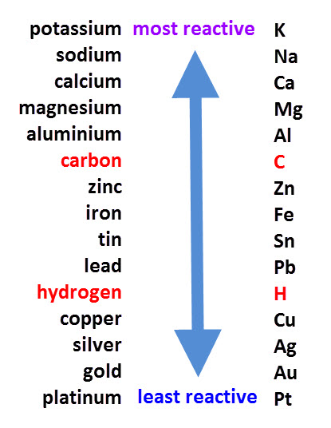
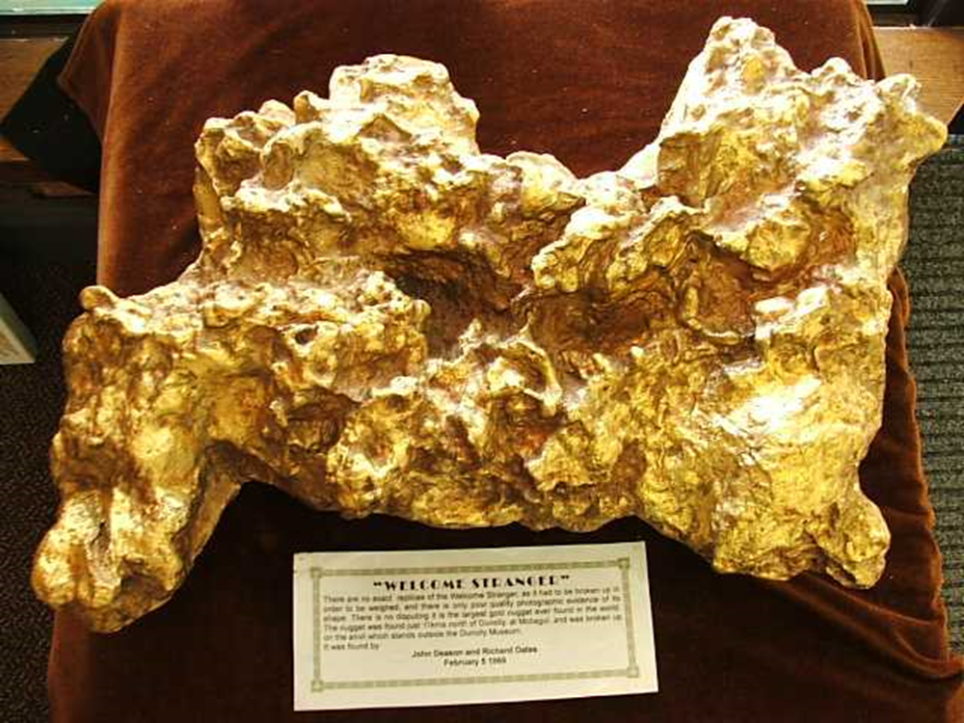
Reactivity Series and Oxidation
Unreactive metals at the bottom of the reactivity series are found as pure metals naturally.
They do NOT oxidise easily.
This is a picture of the largest gold nugget ever found.

Slide 9
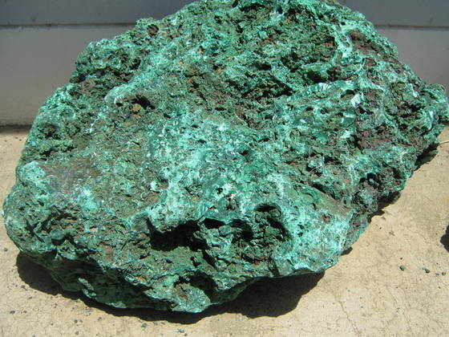
Most Metals Found Naturally as Metal Oxides
Note: Reactivity series ranks metals in order of reactivity but the non-metals carbon and hydrogen are added as reference points.
However, most metals have already reacted with air and become oxidised into metal oxide compounds.
Before these metals can be used they have to be extracted by removing the oxygen.
This is a picture of copper ore before extraction (mostly copper oxide).

Slide 10
Extraction:
Reduction With Carbon
metal oxide + carbon → metal + carbon dioxide
The metal is reduced as the oxygen has been removed.
This leaves pure metal that we can use.
This only works for metals that are below carbon on the reactivity series.

Slide 11
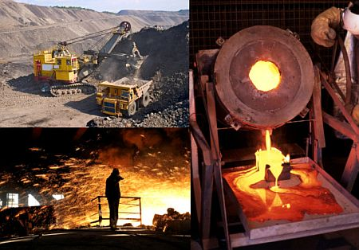
Here is a picture of the process for obtaining usable lead.

Slide 12
L4: Redox
Learning Objectives:
Define the terms oxidation and reduction in terms of oxygen.
Recall that metal oxide formation is oxidation.
Describe how metals can be extracted using reduction with carbon.
Describe what a displacement reaction is.
Use the reactivity series to predict the products of displacement.
Write ionic equations for displacement reactions.
Define oxidation, reduction, and redox in terms of electrons.
Identify what is being oxidised and reduced using half equation for redox reactions.

Slide 13
Extraction:
Displacement Reactions
More reactive metals can be used to extract other metals from their compounds.
Displacement reaction: reaction when a more reactive metal will displace (switch places with) a less reactive metal in a compound.
Ex: scrap iron can be used to extract copper
CuSO_{4 (aq)} + Fe _{(s)} → FeSO_{4 (aq)} + Cu _{(s)}

Slide 14
Demo: Displacement Reactions
Complete question 7 on your worksheet (except for the last column) to predict what will happen when the four combinations of substances are mixed together.
What do you observe?
How do you know if a reaction has taken place?
Does this match with the equation?
Record your observations onto your worksheet.

Slide 15
Practice
Complete question 8 on your worksheet.
Predict whether or not the following reactions will take place.
If you predict the reaction will take place, write out the word equation or balanced symbol equation for the reaction.
NOTE: roman numerals = charge of ion
copper (II) means that it is Cu²⁺

Slide 16
Answers
2Na _{(s)} + CaCl_{2 (aq)} → 2NaCl _{(aq)} + Ca _{(s)}
No reaction
Mg _{(s)} + CuSO_{4 (aq)} → MgSO_{4 (aq)} + Cu _{(s)}
No reaction
Na _{(s)} + Fe(NO₃)_{2 (aq)} → NaNO_{3 (aq)} + Fe _{(s)}

Slide 17
L4: Redox
Learning Objectives:
Define the terms oxidation and reduction in terms of oxygen.
Recall that metal oxide formation is oxidation.
Describe how metals can be extracted using reduction with carbon.
Describe what a displacement reaction is.
Use the reactivity series to predict the products of displacement.
Write ionic equations for displacement reactions.
Define oxidation, reduction, and redox in terms of electrons.
Identify what is being oxidised and reduced using half equation for redox reactions.

Slide 18
Ionic Equations
Displacement reactions can be represented using ionic equations.
This shows all the ions participating in the chemical reaction.
Spectator ions (those that stay the same) are removed.
Equation: CuSO_{4 (aq)} + Mg _{(s)} → MgSO_{4 (aq)} + Cu _{(s)}
Ionic Equation: Cu²⁺ _{(aq)} + Mg _{(s)} → Mg²⁺ _{(aq)} + Cu _{(s)}

Slide 19
Step 1: Balanced Equation
CuSO_{4 (aq)} + Mg _{(s)} → MgSO_{4 (aq)} + Cu _{(s)}
Step 2: Write out all ions and atoms
Cu²⁺ _{(aq)} + SO₄²⁻ _{(aq)} + Mg _{(s)} → Mg²⁺ _{(aq)} + SO₄²⁻ _{(aq)} + Cu _{(s)}
Step 3: Cross out all spectator ions
Cu²⁺ _{(aq)} + SO₄²⁻ _{(aq)} + Mg _{(s)} → Mg²⁺ _{(aq)} + SO₄²⁻ _{(aq)} + Cu _{(s)}
Step 4: Write the ionic equation with what is left
Cu²⁺ _{(aq)} + Mg _{(s)} → Mg²⁺ _{(aq)} + Cu _{(s)}

Slide 20
Practice
Complete question 11 on your worksheet.

Slide 21
Answers
2K _{(s)} + Ca²⁺ _{(aq)} → 2K⁺ _{(aq)} + Ca _{(s)}
Mg _{(s)} + Cu²⁺ _{(aq)} → Mg²⁺ _{(aq)} + Cu _{(s)}
2Na _{(s)} + Mg²⁺ _{(aq)} → 2Na⁺ _{(aq)} + Mg _{(s)}
Ca _{(s)} + Fe²⁺ _{(aq)} → Ca²⁺ _{(aq)} + Fe _{(s)}

Slide 22
L4: Redox
Learning Objectives:
Define the terms oxidation and reduction in terms of oxygen.
Recall that metal oxide formation is oxidation.
Describe how metals can be extracted using reduction with carbon.
Describe what a displacement reaction is.
Use the reactivity series to predict the products of displacement.
Write ionic equations for displacement reactions.
Define oxidation, reduction, and redox in terms of electrons.
Identify what is being oxidised and reduced using half equation for redox reactions.

Slide 23
Harder Definitions (HIGHER TIER)
Oxidation = loss of electrons
Reduction = gain of electrons
Redox reaction = a chemical reaction where both oxidation and reduction take place

Slide 24
L4: Redox
Learning Objectives:
Define the terms oxidation and reduction in terms of oxygen.
Recall that metal oxide formation is oxidation.
Describe how metals can be extracted using reduction with carbon.
Describe what a displacement reaction is.
Use the reactivity series to predict the products of displacement.
Write ionic equations for displacement reactions.
Define oxidation, reduction, and redox in terms of electrons.
Identify what is being oxidised and reduced using half equation for redox reactions.

Slide 25
Redox Reactions and Half Equations
In a redox reaction:
  One substance is oxidised
  One substance is reduced
Two half-equations are used represent both of these processes.
Half equations show what is happening with the electrons.
  Oxidation (loss of electron) M → M⁺ + e-
  Reduction (gain of electron) M⁺ + e⁻ → M

Slide 26
Redox Reactions
You need to be able to identify the substances being oxidised or reduced.
Here are the redox reactions you need to know:
  Displacement reactions
  Reaction of metal with acid
NOTE: oxidation of metals (forming metal oxides) and reduction of metals (with carbon) are also technically redox reactions, but you only need to know those in terms of loss or gain of oxygen.

Slide 27
Displacement Reactions are Redox Reactions
Ionic Equation for Displacement Reaction
Cu²⁺ _{(aq)} + Mg _{(s)} → Mg²⁺ _{(aq)} + Cu _{(s)}
Half-Equations
Oxidation (loss of electron) Mg → Mg²⁺ + 2e-
Reduction (gain of electron) Cu²⁺ + 2e⁻ → Cu
The magnesium atom is being oxidised.
The copper ion is being reduced.

Slide 28
Practice
Complete question 15 on your worksheet.

Slide 29
Answers
A Oxidised 2 K _{(s)} → 2K⁺ _{(aq)} + 2e⁻
Reduced Ca²⁺ _{(aq)} + 2e⁻ → Ca _{(s)}
B Oxidised Mg _{(s)} → Mg²⁺ _{(aq)} + 2e⁻
Reduced Cu²⁺ _{(aq)} + 2e⁻ → Cu _{(s)}
C Oxidised 2Na _{(s)} → 2Na⁺ _{(aq)} + 2e⁻
Reduced Mg²⁺ _{(aq)} + 2e⁻ → Mg _{(s)}
D Oxidised Ca _{(s)} → Ca²⁺ _{(aq)} + 2e⁻
Reduced Fe²⁺ _{(aq)} + 2e⁻ → Fe _{(s)}

Slide 30
Redox Reaction: Metals Reacting with Acids
Mg _{(s)} + 2HCl _{(aq)} → MgCl_{2 (aq)} + H_{2 (g)}
Which is being oxidised? Which is being reduced?
Write the ionic equation and the half-equations for the reaction to help you.

Slide 31
Redox Reaction: Metals Reacting with Acids
Mg _{(s)} + 2HCl _{(aq)} → MgCl_{2 (aq)} + H_{2 (g)}
Ionic Equation
Mg _{(s)} + 2H⁺ _{(aq)} + 2Cl⁻ _{(aq)} → Mg²⁺ _{(aq)} + 2Cl⁻ _{(aq)} + H_{2 (g)}
Mg _{(s)} + 2H⁺ _{(aq)} → Mg²⁺ _{(aq)} + H_{2 (g)}
Half Equations
Mg → Mg²⁺ + 2e⁻
2H⁺ + 2e⁻ → H₂
Oxidation – loss of electrons
Reduction – gain of electrons

Slide 32
Metals Reactions with Acids
Half Equations (Generic)
2M → 2M⁺ + 2e⁻
2H⁺ + 2e⁻ → H₂
When metals react with acids…
…the metal is always oxidised.
…the hydrogen is always reduced.

Slide 33
L4: Redox
Learning Objectives:
Define the terms oxidation and reduction in terms of oxygen.
Recall that metal oxide formation is oxidation.
Describe how metals can be extracted using reduction with carbon.
Describe what a displacement reaction is.
Use the reactivity series to predict the products of displacement.
Write ionic equations for displacement reactions.
Define oxidation, reduction, and redox in terms of electrons.
Identify what is being oxidised and reduced using half equation for redox reactions.

Slide 34
Homework
Pg. 140 from your textbook answer all practice questions (fast recall and application).

