Slide 1
Starter
Write out the balanced equation for the electrolysis of lead bromide.
Write two half equations to represent the reactions at both electrodes.
Label the half equations with:
The electrode where the reaction took place
Oxidation or reduction?

Slide 2
L6: Electrolysis of Aqueous Solutions
Learning Objectives:
Required Practical 9: investigate what happens when aqueous solutions are electrolysed using inert electrodes.
Predict what products are formed during the electrolysis of aqueous solutions.
Write half equations for the reactions at each electrode and identify them as oxidation or reduction.

Slide 3
What is different about the electrolysis of molten ionic compounds and aqueous solutions?
With molten ionic compounds, the only substances in the liquid are the two ions from the ionic compound.
Aqueous solutions are a mixture containing:
+ and - Ions from ionic compound
Water
H⁺ ions (from decomposition of water)
OH⁻ ions (from decomposition of water)

Slide 4
Electrolysis Reactions
For each of the following substances in the aqueous solution, predict a) what kind of electrolysis reaction would occur (or not), b) at which electrode, and c) what product is formed?
Positive metal ion (ionic compound)
Negative non-metal ion (ionic compound)
Water
H⁺ ions (from decomposition of water)
OH⁻ ions (from decomposition of water)

Slide 5
Possible Products of Electrolysis of Aqueous Solutions
Substance | Cathode (Reduction) | Anode (Oxidation)
Positive metal ion | Elemental metal atoms (solid)
Negative ions |  | Elemental non-metal (usually a gas)
Water
H⁺ ions | Hydrogen gas
OH⁻ ions |  | Oxygen gas and water

Slide 6
Which reactions will happen?
Not all of the possible reactions will happen.
Only one electrolysis reaction will happen at each electrode.
We are going to investigate what reactions occur for different aqueous solutions.

Slide 7
Identifying Elements
These are the products we are going to be looking for and how to identify them.
Substance | How to identify
metal | Solid being formed
Chlorine gas (pale green gas) | Will turn damp blue litmus red
Hydrogen gas | Bubbles formed at cathode (usually too small amt. to test with squeaky pop)
Oxygen gas | Bubbles formed at anode which does NOT change damp blue litmus (relights glowing splint but usually not enough to test)

Slide 8
Required Practical 9
For this investigation you will be developing a hypothesis that you will test.
Your hypothesis does not have to be correct!
Be as specific as possible in your hypothesis.
Safety
Follow instructions exactly as written.
Wear goggles at all times.
Handle electrical equipment safely to prevent electric shock.

Slide 9
L6: Electrolysis of Aqueous Solutions
Learning Objectives:
Required Practical 9: investigate what happens when aqueous solutions are electrolysed using inert electrodes.
Predict what products are formed during the electrolysis of aqueous solutions.
Write half equations for the reactions at each electrode and identify them as oxidation or reduction.

Slide 10
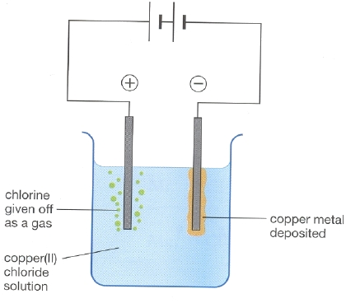
Preferential Discharge of Ions
Only one ion can be discharged (removed from the solution by electrolysis reaction) at each electrode.
Which ion is discharged depends on the reactivity of the substances.

Slide 11
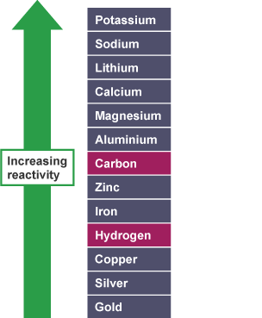
Rules for Predicting Which Ions Discharged
Cathode (-)
If the metal is more reactive than hydrogen in the reactivity series, than hydrogen ions are discharged forming hydrogen gas.
If the metal is less reactive than hydrogen, then the metal ions are discharged forming metal atoms (solid).

Slide 12
Rules for Predicting Which Ions Discharged
Anode (+)
If there are halide ions present (group 7), than the halide ions are discharged to form halogens.
If there are NO halide ions present, than hydroxide ions are discharged forming oxygen gas and water.
F₂ - gas
Cl₂ – gas
Br₂ – gas

Slide 13
L6: Electrolysis of Aqueous Solutions
Learning Objectives:
Required Practical 9: investigate what happens when aqueous solutions are electrolysed using inert electrodes.
Predict what products are formed during the electrolysis of aqueous solutions.
Write half equations for the reactions at each electrode and identify them as oxidation or reduction.

Slide 14
Half-Equations
What is the half equation for the discharge of hydrogen ions?
Where does this happen?
Is it oxidation or reduction?
2H⁺ _{(aq)} + 2e⁻ → H_{2 (g)}
cathode – reduction

Slide 15
Half-Equations
What is the half equation for the discharge of hydroxide ions?
Where does this happen?
Is it oxidation or reduction?
4OH⁻ _{(aq)} → O_{2 (g)} + 2H₂O _{(l)} + 4e⁻
anode – oxidation

Slide 16
Practice
Complete question 8 on your worksheet.

Slide 17
Answers
2H⁺ _{(aq)} + 2e⁻ → H_{2 (g)} 2Cl⁻ _{(aq)} → Cl_{2 (g)} + 2e⁻
Cu²⁺ _{(aq)} + 2e⁻ → Cu _{(s)} 2Br⁻ _{(aq)} → Br_{2 (g)} + 2e⁻
4H⁺ _{(aq)} + 4e⁻ → 2H_{2 (g)} 4OH⁻ _{(aq)} → O_{2 (g)} + 2H₂O _{(l)} + 4e⁻
2Cu²⁺ _{(aq)} + 4e⁻ → 2Cu _{(s)} 4OH⁻ _{(aq)} → O_{2 (g)} + 2H₂O _{(l)} + 4e⁻

Slide 18
L6: Electrolysis of Aqueous Solutions
Learning Objectives:
Required Practical 9: investigate what happens when aqueous solutions are electrolysed using inert electrodes.
Predict what products are formed during the electrolysis of aqueous solutions.
Write half equations for the reactions at each electrode and identify them as oxidation or reduction.

Slide 19
Homework
Revise the chapter.
Complete exam style questions on pg. 150-151.

