Slide 1
Chemical Bonds and Changes of State
Learning Objectives:
Recall the three different types of bonding.
Explain why chemical bonds form.
Use kinetic theory to describe the motion of particles for the different states of matter.
Explain changes of state in terms of motion of particles, energy transfers and bond strength.

Slide 2
Review: Draw the structure of a neon atom
What group does neon belong to?
What special property gives this group their name?
Considering their atomic structure, why do these elements have this property?
Noble Gases
They are very unreactive.
Ne
They have full electron shells. This makes them very stable.

Slide 3
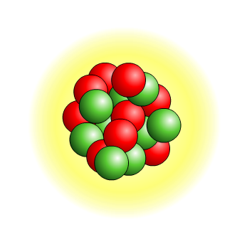
Why do atoms form bonds?
Filled electron shells are very stable.
1st shell holds a maximum of 2 electrons
2nd shell holds a maximum of 8 electrons
3rd shell holds a maximum of 8 electrons
Atoms forms bonds to obtain full electron shells and become stable.
Notes:
Bonds involve the electrons in the outer shells of atoms.
Each shell has a maximum number of electrons that it can hold. Electrons fill the shells nearest the nucleus first.

Slide 4
Why do atoms participate in chemical reactions?
Elements with incomplete outer electron shells are unstable so will form chemical bonds.
What are the three things that can happen to an atom so that it can obtain a full outer electron shell and become stable?
Give electrons
Take electrons
Share electrons
This is what happens in a chemical reaction. Reactive elements are more likely to chemically react.

Slide 5
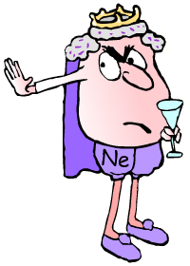
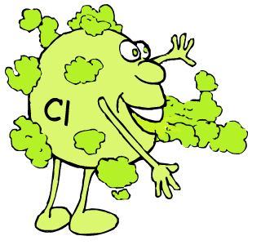
What makes some elements more reactive than others?
The atoms of noble gases have completely full outer shells and so are stable.
This makes the noble gases very unreactive and so they do not usually form bonds.
The atoms of other elements have incomplete outer electron shells and so are unstable.
By forming bonds, the atoms of these elements are able to have filled outer shells and become stable.
Elements who only need to gain or lose a few electrons are very reactive.

Slide 6
What are the types of bonding?
Different types of bonds are formed depending on the types of atoms involved:
give/take e⁻
ionic bonding
– occurs between metal and non-metal atoms.
covalent bonding
– occurs between non-metals atoms only.
share e⁻
metallic bonding
– occurs between metal atoms only.
share e⁻
All bonds involve electrons and all bonding involve changes to the number of electrons in the outer shells of atoms.
Notes:
Teacher notes
See the GCSE Science chemistry ‘Metals and Alloys’ presentation for more information on metallic bonding.
See the GCSE Additional Science chemistry ‘Covalent Bonding’ presentation for more information about covalent bonding.

Slide 7
How does bonding relate to changes of state?

Slide 8
State of Matter | Solid | Liquid | Gas
Particle Model Diagram
Energy of Particles
Motion of Particles
Speed of Particles
Strength of Bonds Between Particles
Low
Medium
High
Vibrate in fixed position
Slide over each other
Move freely in all directions
Slow
Medium
Fast
Strong
Medium
Weak

Slide 9
The stronger the bonds between particles, the more difficult it is for the particles to move apart.
Using ideas about particles, bonds, and energy describe what happens when a substance:
Melts
Evaporates
Condenses
Freezes

Slide 10
Changes of State
Melting: When a solid is heated, the particles gain energy and move faster. If they move fast enough they break the bonds holding them together and slide past each other as liquid particles.
Evaporating: If the liquid particles gain even more energy they completely break their bonds and are able to move in all directions as a gas.
Condensing: If gas particles cool down and lose energy, they move more slowly and come closer together. Bonds reform and they become a liquid.
Freezing: If the particles cool down even more, the move so slowly and reform strong bonds. Now they can only vibrate in place as a solid.

Slide 11
Melting Point and Boiling Point
The melting point is the temperature at which a substance…
…melts or freezes.
Why is it both?
Depends if you are heating up or cooling down.
The boiling point is the temperatures at which a substance…
…evaporates or condenses

Slide 12
Which physical state?
A substance is solid if the temperature is below the melting point.
A substance is liquid if it is between the melting point and boiling point.
A substance must be a gas if it is above the boiling point.
Note:
Evaporation can happen at temperatures below the boiling point, but only occurs at the surface if the particles are moving in the correct direction with enough energy to break the surface. Boiling happens through the liquid and is a rapid process.

Slide 13
Sample Question
Which substance is a liquid at -260 degrees C?
Which substance is a liquid over the largest temperature range?
Which substances are gases at -200 degrees C?
Which substance is a solid at -100 degrees C?

Slide 14
Sample Question
Which substance is a liquid at -260 degrees C?
Helium
Which substance is a liquid over the longest temperature range?
Oxygen
Which substances are gases at -200 degrees C?
Helium and Neon
Which substance is a solid at -100 degrees C?
Carbon dioxide

Slide 15
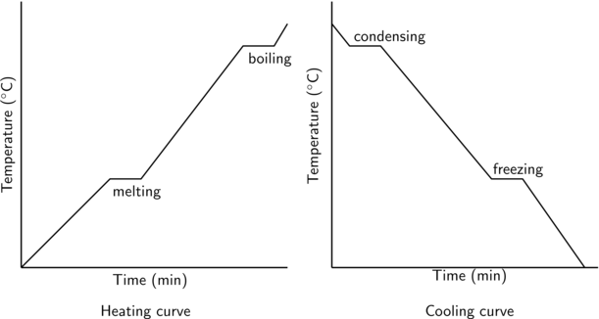
Gas
Boiling Point
Liquid
Melting Point
Solid

