Slide 1
Lesson 2 – Conduction
Learning Objectives:
Recall that conduction happens the most through solids.
Describe heat transfer by conduction using the particle model.
Explain why some materials are conductors and some are insulators.

Slide 2
Review: Particle Model
Draw the particle model for solids, liquids, and gases.
Describe the motion of the particles in each state of matter.
Explain what happens to the particles when energy is added.

Slide 3
Particles only vibrate.
Regular arrangement of closely packed particles.
When energy is added the particles vibrate faster. If they vibrate fast enough they break their bonds and turn into a liquid.
Particles slide past each other.
Random arrangement of packed particles.
When energy is added the particles move faster. If they move fast enough they completely break apart from each other and turn into a gas.
Particles move quickly in all directions.
Random arrangement of particles that are far apart.
When energy is added the particles move even faster.

Slide 5
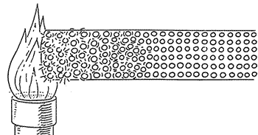
Conduction
When the particles in a solid are heated they vibrate more.
The hot particles then bump into the cold particles and pass on the heat energy.
The hot particles lose some energy when they bumped into the cold particles and cool down.

Slide 6
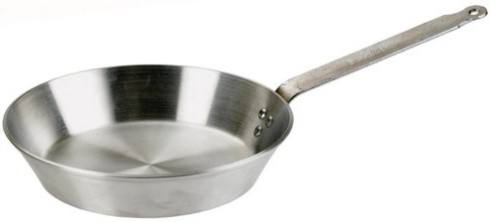
Conductors and Insulators
Conductors = materials that pass heat energy easily (i.e. metals).
Insulators = materials that do not pass heat energy easily (i.e. air).
Thinking about the particle model, explain why metals are good conductors of heat but air is not.

Slide 7
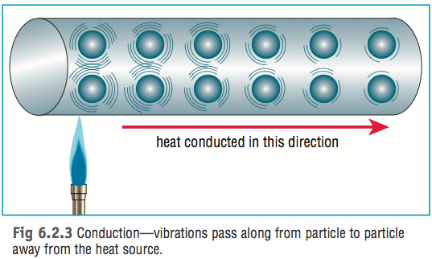
Conductors and Insulators
Solids pass heat energy most easily by conduction because the particles are closely packed together.
Liquids are slightly further apart so moderately conduct heat.
Gases are very far apart so are thermal insulators.

Slide 8
Practical: Conductors and Insulators
Place hot water into two different cups; one made of metal and one made of plastic.
Measure the temperature of both, they should be the same.
Touch the outside of both cups and record your observations.
Repeat the experiment using cold water instead of hot water.

Slide 9
Material | Temperature | Observation
Metal
Glass
Foam
Metal
Glass
Foam

Slide 10
Analysing Results
Which materials are conductors?
Which materials are insulators?
How do you know?

