Slide 1
Lesson 2 – Magnetic Fields
Learning Objectives:
Recall what a magnetic field is.
Recall that the Earth has a magnetic field.
Describe the magnetic field of a bar magnet.
Explain how we can use the magnetic field of the Earth.

Slide 2
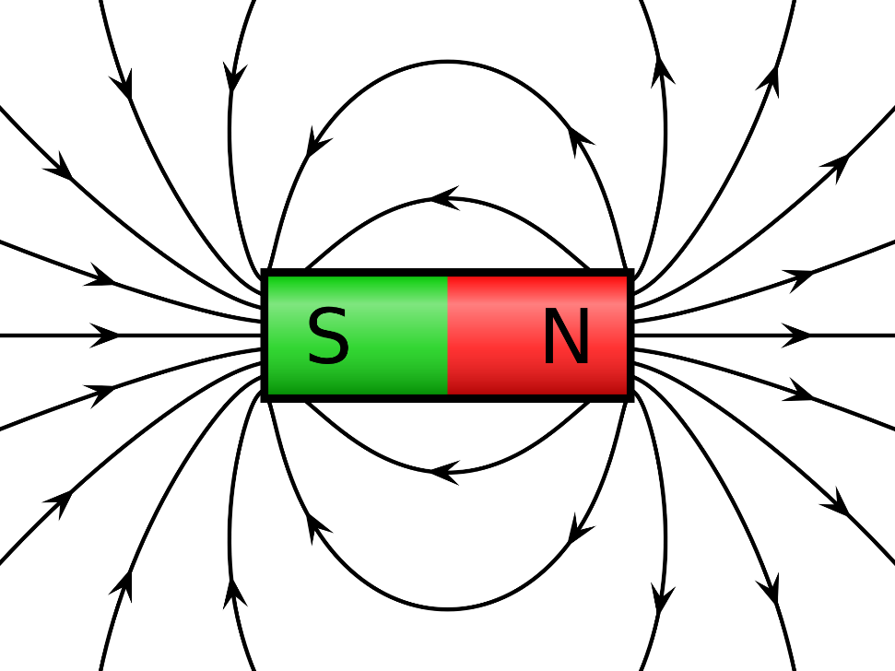
Magnetic Field
Magnetic field = area around a magnet where magnetic materials feel a magnetic force
On the diagram, the lines are called magnetic field lines.
The closer together the lines, the stronger the magnetic field.

Slide 3
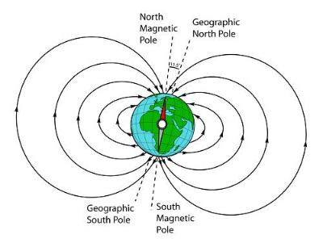
Earth’s Magnetic Field
The core of the Earth is made of iron.
The movement of the iron in the core causes the Earth’s magnetic field.
Interestingly, the magnetic poles do not line up with the geographic poles.

Slide 4
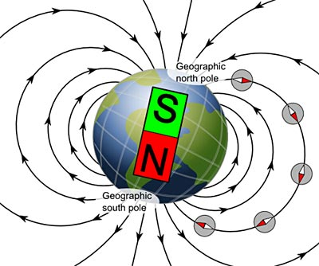
Earth’s Magnetic Field
You can imagine there is a giant bar magnet inside the Earth.
The South end of the magnet would point to the geographic North (because opposites attract).
The North end of the magnet would point to geographic South.

