Slide 1
How does a hot air balloon work?

Slide 2
Lesson 3 – Convection
Learning Objectives:
Recall that convection only happens in fluids (liquids and gases).
Describe how heat is transferred through fluids as convection currents.
Explain how convection happens as fluids become less dense as they are heated and rise while fluids become more dense as they are heated and sink.

Slide 3
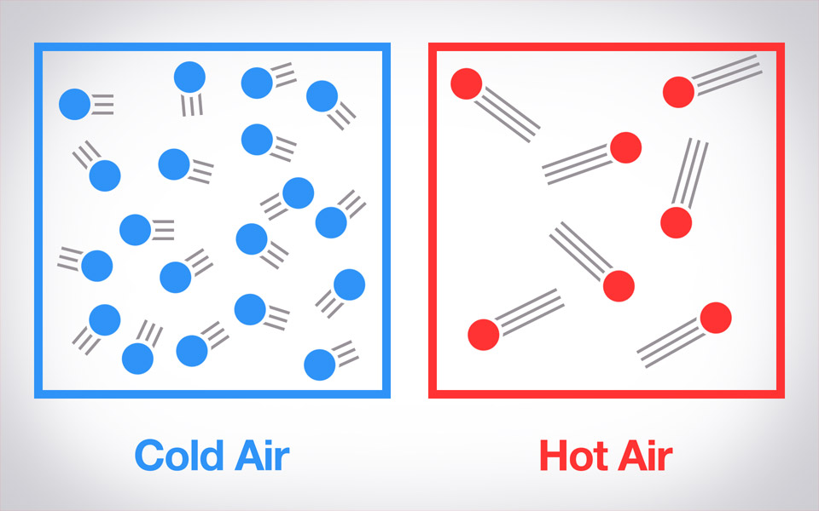
Heat Rises
What happens to the particles in a fluid when they are heated?
When fluids are heated they gain more energy and move around faster.
They move further apart and it becomes less dense.

Slide 4
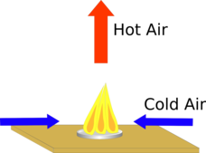
Heat Rises
When the fluid becomes less dense it is lighter.
The lighter fluid rises (floats).
Cold air is more dense and sinks.

Slide 6
Demo: Convection Currents

Slide 7
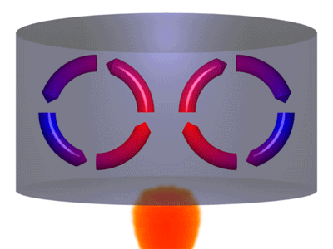
Convection Currents
Air near the heat source heats up and rises.
As the hot air rises, it pushes cold air out of the way and cools down as it is away from the heat source.
The cold air sinks towards the heat source.
This creates a convection current.

Slide 8
Convection Only Happens in Fluids
Fluids = materials that flow, liquids and gases.
Why is it that convection CANNOT happen in solids?
Solid particles are in a fixed arrangement and cannot move around so cannot cause convection currents.

