Slide 1
Lesson 3 Properties of Ionic Compounds
Learning Objectives:
Recall the properties of ionic compounds.
Describe the lattice structure of ionic compounds.
Explain how electrostatic forces between ions affect the melting and boiling points of ionic compounds.
Explain why ionic compounds conduct electricity when dissolved or molten but not when solid.

Slide 2
Demo: Properties of Ionic Compounds
We are going to investigate the following properties:
Melting point
Electrical conductivity
Malleability
Notes:
Melting point: heat sugar and salt with Bunsen burner
Electrical conductivity: salt and sugar when solid, salt and sugar when dissolved in water
Malleability: rock candy vs metal wire

Slide 3
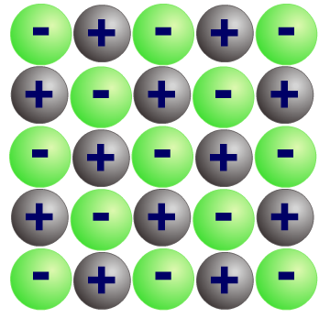
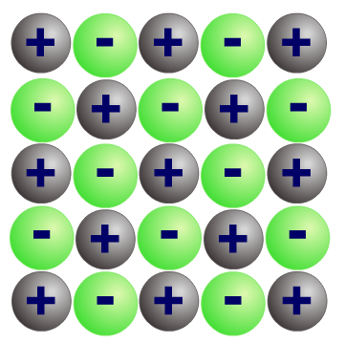
1. What is an ionic lattice?
In an ionic compound, millions and millions of ions are packed together in a regular cubic arrangement, joined by ionic bonds.
This forms a giant 3D structure called an ionic lattice.
The ionic lattice will continue to build in this way until there are no more ions left to add.
The structure of the ionic lattice affects the properties of the ionic compound.

Slide 4
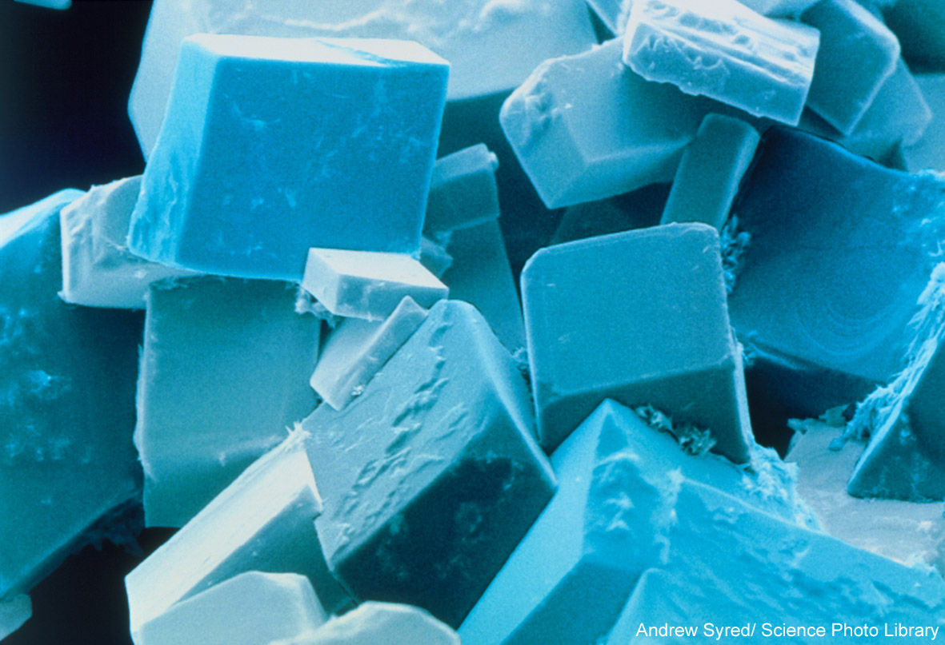
2. Why do ionic compounds form crystals?
Ionic compounds such as sodium chloride, form crystals, with a cubic shape. This is due to the structure of the ionic lattice.
All ionic compounds form lattices and crystals when solid.
Notes:
Teacher notes
Photo credit: Andrew Syred/Science Photo Library.
The image is a coloured scanning electron micrograph (SEM) of common salt, sodium chloride, recrystallised from distilled water. The salt crystal is built up from a cubic lattice of sodium and chloride ions. In the absence of impurities the exact cubic crystal form is produced. This micrograph shows that in practice this basic cube is usually disrupted by dislocations; these give rise to crystals with a variety of shapes, although they all retain the basic cubic symmetry. Magnification: x280 at 5x7cm size. x975 at 10x8‘.

Slide 5
3a) Heating ionic compounds
Why are ionic compounds solid at room temperature and have high melting points and boiling points?
Ion charges
Melting point (ºC)
Boiling point (ºC)
Compound
sodium chloride
1⁺ and 1⁻
801
1,413
magnesium oxide
2⁺ and 2⁻
2,852
3,600
strong ionic bonds hold ions together
Ionic bonds are strong and a lot of heat is needed to break them.
Larger ionic charges produce stronger ionic bonds and so much more heat is required to break the ionic bonds in magnesium oxide than in sodium chloride.

Slide 6
3b) Do ionic compounds conduct electricity?
Notes:
Teacher notes
This virtual experiment illustrates which substances, and in what state conduct electricity and why. It could be used as a precursor to running the practical in the lab, or as a revision exercise.
See also the GCSE Science chemistry ‘Metals and Alloys’ presentation for more information on metallic bonding.
See the GCSE Additional Science chemistry ‘Covalent Bonding’ presentation for more information about covalent bonding.

Slide 7
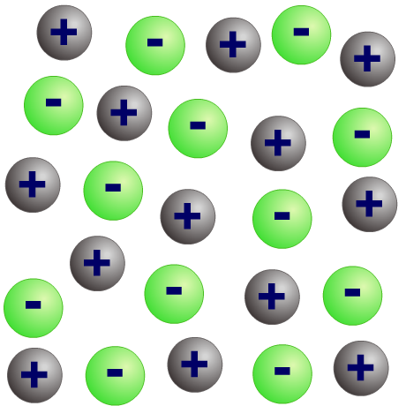
3b) How can ionic compounds conduct electricity?
As solids, ionic compounds cannot conduct electricity because their ions are
bonded together in the lattice.
ions in solid state cannot move
When liquid (molten), the ions can break free of the lattice and are able to move. The ions are charged particles and so can carry an electric current.
ions in
molten state can move
and conduct electricity
Ionic compounds are usually soluble in water because water molecules have a slight electrical charge and so can attract the ions away from the lattice. When dissolved, the ions are free to move and can carry an electric current.

Slide 8
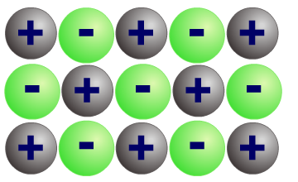
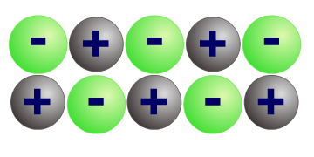
3c) Why are ionic compounds brittle?
Ionic compounds are brittle – they shatter when they are hit.
Ionic bonds are strong, so why does this happen?
force
repulsion
When the lattice is hit, a layer of ions is shifted so that ions with the same charges are lined up together.
These like charges repel each other and so split the ionic lattice causing it to shatter.

Slide 9
True or false?
Notes:
Teacher notes
This true-or-false activity could be used as a plenary or revision exercise on the properties of ionic compounds, or at the start of the lesson to gauge students’ existing knowledge of the subject matter. Coloured traffic light cards (red = false, yellow = don’t know, green = true) could be used to make this a whole-class exercise.

