Slide 1
Metallic Bonding
Learning Objectives:
Recall what an alloy is.
Describe metallic bonding.
Explain the role of delocalised electrons in metallic bonding.
Use the structure of metals to explain the properties of metals including melting and boiling point, physical state, and electrical conductivity.
Compare the structure and property of alloys and pure metals.

Slide 2
Starter: Properties of Metals
Write down as many properties of metals as you can think of.

Slide 3
Review: Ion formation
Why do elements form ions?
What type of ions do metals form?
Why?
Predict the charges on the following metals:
Sodium
Magnesium
Aluminium

Slide 4
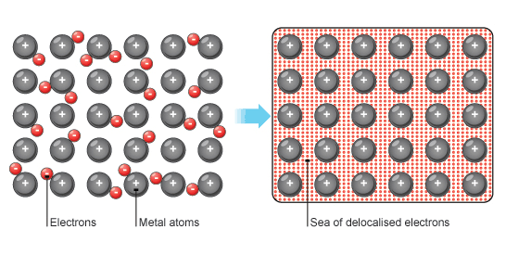
Metallic Bonding
Metals have giant structures made of positive ions in layers in a “sea” delocalised electrons that are free to move between them.
The positive metal ions are attracted to the negatively charged delocalised electrons which are shared.
This attractive force is what makes of the metallic bond.

Slide 5
Demo: Properties of Metals
Notes:
Conducts electricity
High melting/boiling point
Malleable

Slide 6
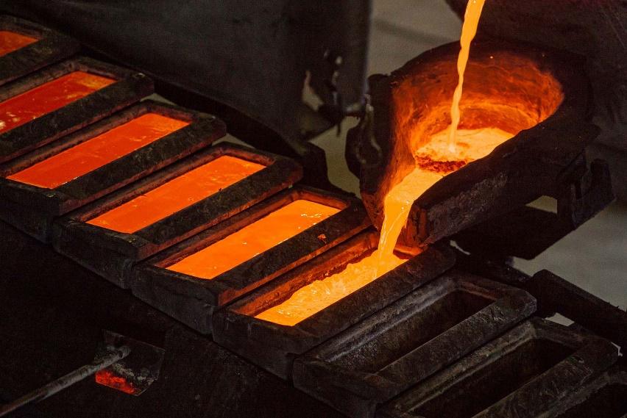
What happens when substances melt?
Heat energy causes particles to move faster. If they gain enough energy they will break the bonds/forces holding them together and move freely.
Why do metals have high melting and boiling points?
Metallic bonds are quite strong because of the electrostatic forces between positive metal ions and the sea of delocalised electrons. These bonds require a lot of energy (heat) before they break and the substance melts.

Slide 7
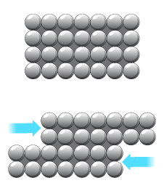
Metals are malleable, can be bent into different shapes without breaking.
This is because the layers in the metal structure can slide over each other and still be held together by the sea of delocalised electrons.

Slide 8
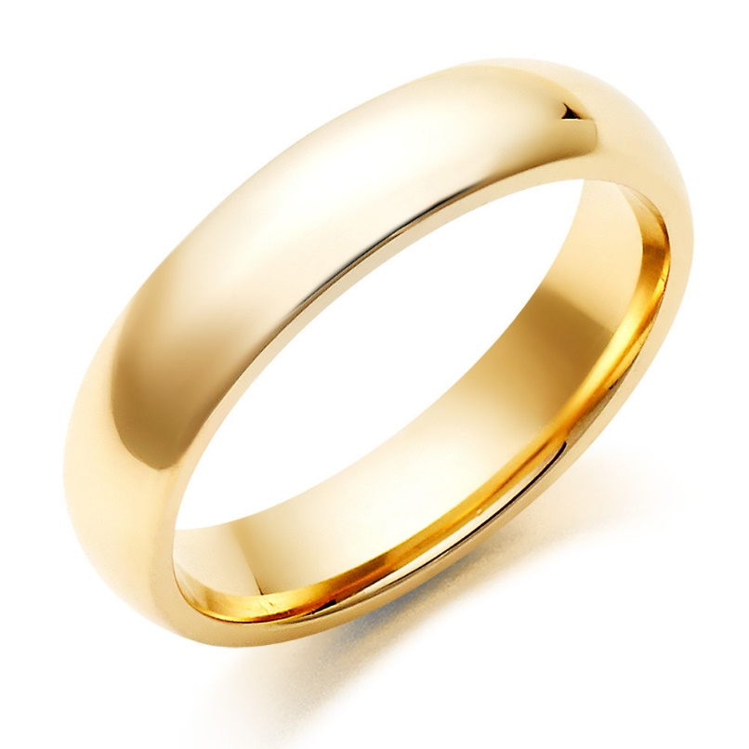
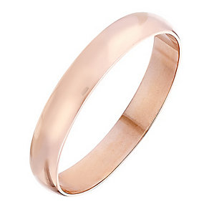
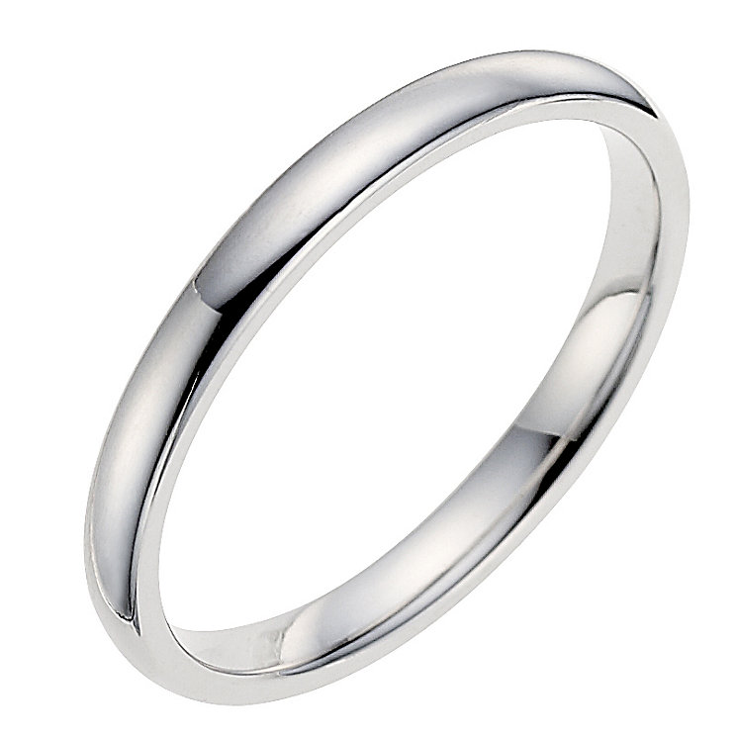
What are these rings made of?
What makes them different?
Why would this be useful?

Slide 9

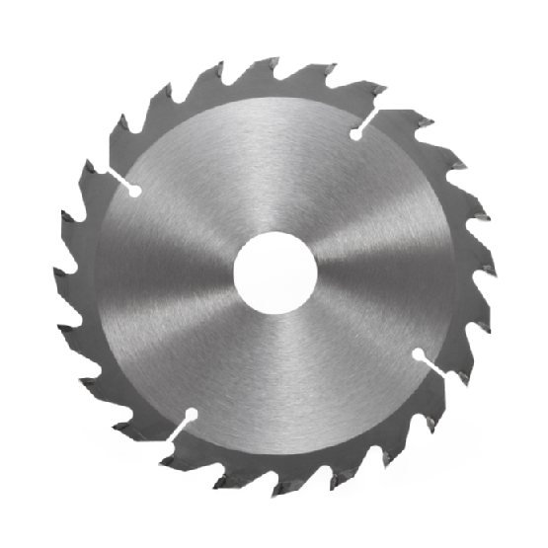
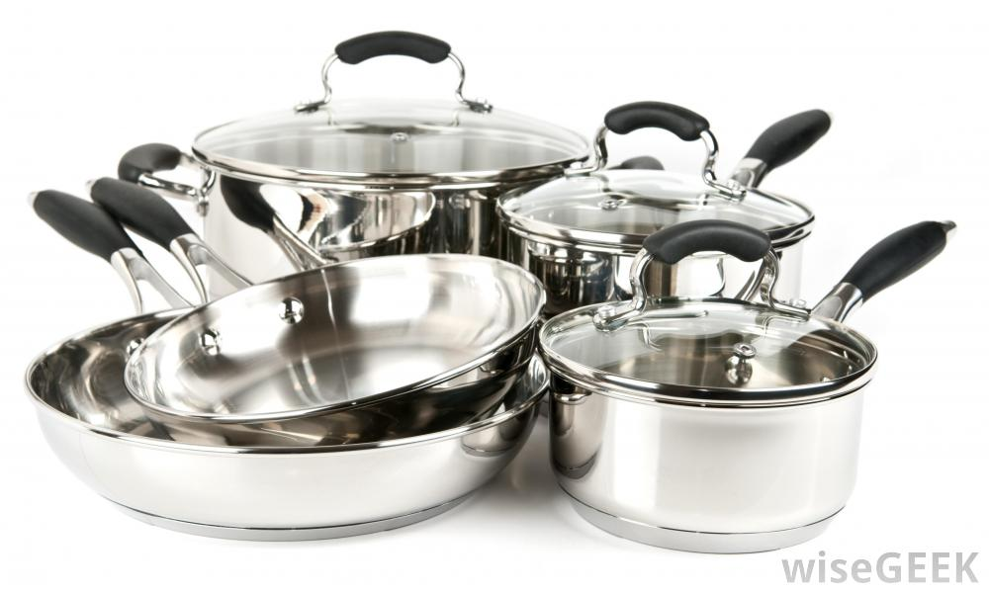
Alloys = mixture of metals or metals with carbon
Alloys have different properties to the pure metals they are made from.
Example
Iron can be made into:
Low carbon steel
High carbon steel
Stainless steel
Notes:
Low carbon steel – easy to mold, car parts
High carbon steel – very strong, cutting tools
Stainless steel – resists corrosion, cutlery/cooking

Slide 10

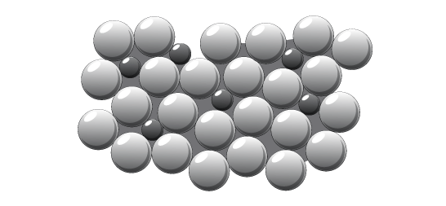
Why are alloys useful?
Alloys are much stronger than pure metal.
Gold, iron, and aluminium are too soft for many uses so are mixed with other metals (or carbon) to make alloys.
Pure metal has atoms of all the same size and arranged in layers.
These layers slide easily.
Alloys have different sized atoms so do NOT form layers.
This makes it difficult for the atoms to slide and makes alloys very strong.

Slide 11
Demo: properties of alloys
Notes:
Bending copper vs bronze

