Slide 1
Term 2 Revision Quiz
Topics
Microbes and Disease
Heat Transfers
Magnets
Ecology

Slide 2
Microbes and Disease

Slide 3
What is a micro-organism?
A microscopic (tiny) living thing.

Slide 4
What are the different types of microbes?
Bacteria, viruses, fungi

Slide 5
Name three USES for microbes (name the microbe)
Fungi (Yeast) – bread
Fungi (Yeast) – alcohol
Bacteria – cheese
Bacteria – yoghurt

Slide 6
Put the microbes in order from smallest to largest
Virus → bacteria → fungi

Slide 7
What is a pathogen?
A microbe that causes disease.

Slide 8
How do bacteria cause disease?
Produce toxins which can harm cells

Slide 9
How do viruses cause disease?
Infect and take over normal cells (to reproduce)

Slide 10
Describe five ways that the body stops pathogens entering
Chemicals in tears kill bacteria
Skin is a barrier
Blood clots to prevent entry
Mucus traps pathogens and cilia sweep it away (airways)
Acid in stomach kills bacteria

Slide 11
What is the function of the immune system?
Get rid of pathogens that have infected the body.

Slide 12
What is the main cell of the immune system?
White blood cell

Slide 13
What are the three ways that white blood cells deal with pathogens?
Engulf pathogens
Produce antitoxins
Produce antibodies

Slide 14
How do antibodies help deal with pathogens? (3 marks)
Recognise and attach to pathogens (tag)
Cause pathogens to stick together (disable)
This alerts white blood cells to ingest the pathogen.

Slide 15
What causes you to be immune to a disease?
When the immune system fights off infection some of the white blood cells and antibodies that recognise that pathogen remain in the blood.
They recognise the pathogen and get rid of it quickly if it enters again so you do not become ill.

Slide 16
What is in a vaccine?
Dead or weakened form of a pathogen

Slide 17
How does immunisation work?
The immune system responds to the dead or weakened pathogen as if it was the actual pathogen.
Produces white blood cells and antibodies that will recognise the pathogen if it enters.

Slide 18
Name two diseases caused by bacteria
Food poisoning (e.coli, salmonella)
Cholera
Tuberculosis

Slide 19
Name two diseases caused by viruses
Cold
Influenza (flu)
Chicken pox
Measles
AIDS

Slide 20
Name a disease caused by a fungus
Athlete’s foot

Slide 21
What is an epidemic?
A widespread occurrence of an infectious disease.

Slide 22
Name six ways that diseases can spread
Direct contact
Air
Water
Food
Animals
Bodily fluids (example: blood, saliva)

Slide 23
What do antibiotics do? What do they not work on?
Antibiotics are medicines that kill bacteria.
They do not treat viral or fungal infections.

Slide 24
Heat Transfers

Slide 25
What is another name for heat energy?
Thermal energy

Slide 26
What is the unit for energy?
Joule (or kilojoule)

Slide 27
What direction does heat always travel during heat transfers?
From hot to cold.

Slide 28
What is the difference between heat and temperature?
Heat is a form of energy
Temperature is a measure of how hot or cold something is (and how fast the particles are moving)

Slide 29
What is used to measure temperature?
thermometer

Slide 30
What is the unit for temperature that we use in science?
Degrees Celsius (ºC)

Slide 31
Name the three different types of heat transfer
Conduction
Convection
Radiation

Slide 32
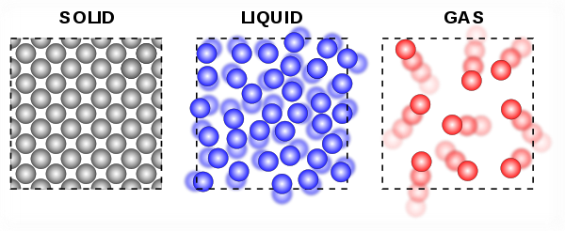
Draw the particle model for solids, liquids, and gases.

Slide 33
Describe how heat is transferred by conduction
Hot particles move faster (vibrate more)
They bump into colder particles and cause them to vibrate more.

Slide 34
What do you call a material that heat passes through easily? Give an example
Conductor
Metal

Slide 35
What do you call a material that does NOT allow heat through easily? Give an example.
Insulator
Air, foam, wood

Slide 36
Why does conduction happen slowest through gases?
The particles are further apart.
So they do not collide as frequently.

Slide 37
Describe convection (4 marks)
Heated fluid particles gain energy, move faster, and spread out.
The hot fluid (NOT THE PARTICLES) becomes less dense.
The hot fluid rises and pushes cold fluid out of the way.
Cold fluid sinks as it is more dense.

Slide 38
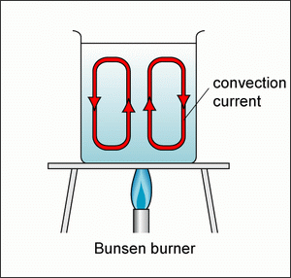
Draw a convection current for the following example.

Slide 39
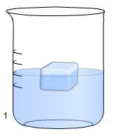
Draw the convection current for the following example.

Slide 40
Explain why convection only happens in fluids and not solids.
The particles in a solid are fixed in place, they cannot move far enough apart to become less dense enough to rise.

Slide 41
What type of heat transfer can happen in a vacuum?
radiation

Slide 42
What is another name for radiation?
Infrared radiation

Slide 43
Why type of material reflect infrared radiation and what type absorbs?
Reflect: Light coloured, shiny
Absorb: dark coloured, matt (dull)

Slide 44
Why does a metal railing feel colder than a wooden door on a cold day?
The metal is a conductor so quickly transfers heat away from your hand. You feel this loss of heat as coldness.
The wood is an insulator and does not quickly transfer heat so does not feel as cold.

Slide 45
Magnets

Slide 46
What is a magnet?
An object that attracts and repels other magnets and attracts magnetic materials.

Slide 47
Where is the magnetic force strongest on a magnet?
At the poles (where the magnetic field lines are closest together)

Slide 48
Describe what happens when…
attract

Slide 49
Draw magnets that repel.
N – N
S – S

Slide 50
What is a magnetic material? Name a magnetic material.
A material that is attracted to a magnet.
Iron, steel, cobalt, nickel

Slide 51
Describe how to make a temporary magnet
Stroke a magnet slowly, in one direction against a magnet material

Slide 52
Is magnetism a contact or non-contact force? Explain what this means.
Non-contact force
Because it acts at a distance (does not have to be touching to exert a force)

Slide 53
What is a magnetic field?
The area around a magnet where a magnetic force can be felt by magnetic materials and other magnets.

Slide 54
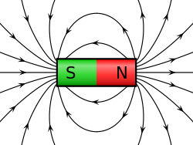
Draw the shape of a magnetic field around a bar magnet.

Slide 55
What is a compass?
Piece of equipment containing a small magnet inside that points North because of the Earth’s magnetic field.

Slide 56
Which end of a bar magnet will a compass needle point towards?
South pole

Slide 57
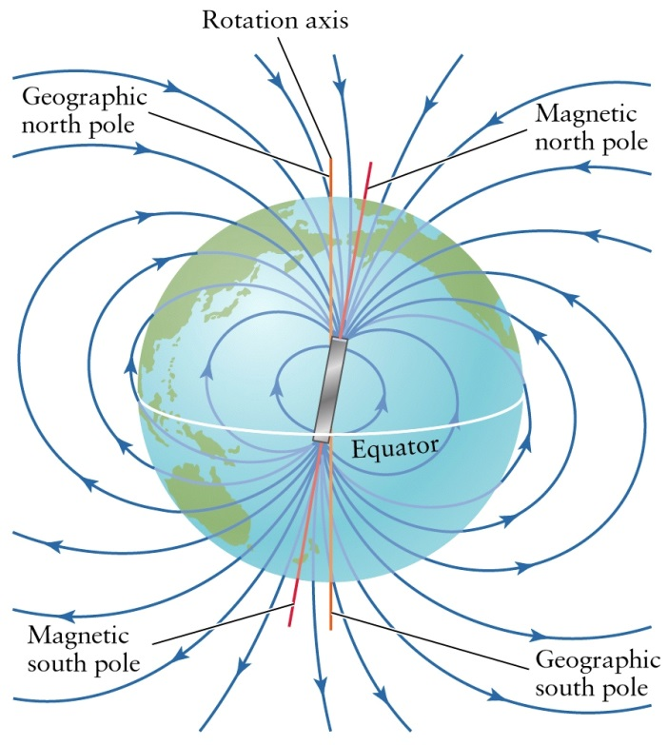
The Earth has a magnetic field. The shape is the same as if there was a giant bar magnet inside the Earth. Label the poles on this imaginary magnet.

Slide 58
Describe how to make an electromagnet. (3 marks)
Wrap a coil of wire
Around a core
And run an electric current through the wire

Slide 59
Name three ways to increase the strength of the electromagnet
Increase number of coils
Increase the current (by increasing the voltage)
Using a magnetic core

Slide 60
What is an advantage of an electromagnet?
Able to change the strength of the magnet
Able to switch on and off

Slide 61
Ecology

Slide 62
What does the word “ecology” mean?
The study of organisms and their environment.

Slide 63
What is a habitat?
Where an organism lives.

Slide 64
What is a producer? Give an example.
A producer is an organism that makes its own food (by photosynthesis)
Plants are producers

Slide 65
What do you call animals that have to eat to survive?
consumers

Slide 66
Define the terms predator and prey.
Predator – hunts other animals
Prey – is hunted by other animals

Slide 67
Define carnivore, omnivore, and herbivore
Carnivore – eats animals only
Omnivore – eats plants and animals
Herbivore – eats plants only

Slide 68
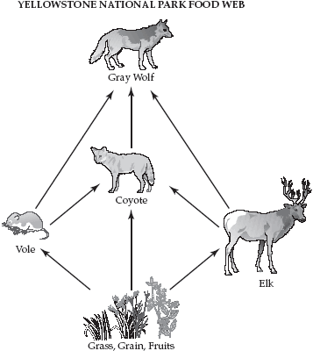
What two species for the same food resource in this food web?
Coyote
Gray wolf

Slide 69
Draw a food chain with humans in it with three trophic levels.
Example:
Grass → Cow → Human

Slide 70
Draw a pyramid of biomass from the food chain. GRASS → COW → HUMAN
HUMAN
COW
GRASS

Slide 71
Explain why this pyramid of numbers is not the same shape as the pyramid of biomass.
Because the oak tree is very large (large biomass → large amount of energy) and can feed many beetles.
BIRD
BEETLE
OAK TREE

Slide 72
Why does the pyramid get smaller as you go up the food chain?
Energy is lost between the trophic levels.

Slide 73
Name three ways that energy is lost as you go up the food chain.
Not all organisms are eaten.
Some energy/biomass is passed out as waste (not digested)
Organisms use up energy from respiration by…
Moving
Keeping warm

Slide 74
What type of energy use DOES move up the food chain?
Energy used for growth.

Slide 75
What is a quadrat used for?
It is used to estimate the number of organisms in an area (when it is too many to count)

Slide 76
What is the largest classification group? Name two examples.
Kingdom
Plant kingdom and animal kingdom

Slide 77
What are the two main groups in the animal kingdom?
Vertebrate (with backbone)
Invertebrate (without backbone)

Slide 78
Name the five vertebrate groups.
Mammals
Birds
Reptiles
Amphibians
Fish

Slide 79
What features do mammals have?
Hair or fur
Lungs
Give birth to live young

Slide 80
What features do birds have?
Feathers
Lay eggs
lungs

Slide 81
What features do reptiles have?
Dry scales
Lungs
Lay eggs

Slide 82
What features do amphibians have?
Moist skin
Lay eggs
Lungs
Live both in and out of water

Slide 83
What features do fish have?
Scales
Gills
Lay eggs
Live only in water

Slide 84
What are the three types of vascular plants?
Ferns
Conifers
Flowering plants

Slide 85
Non-vascular plants do not produce seeds, they produce…
spores

Slide 86
Give an example of a non-vascular plant.
Algae
Moss
Liverwort

Slide 87
Name the three types of symbiotic relationships and describe them.
Commensalism – one benefits, other not harmed
Mutualism – both benefit
Parasitism – one benefits, the other is harmed

