Slide 1
Radiation
Learning Objectives:
Recall that all hot objects give off infrared radiation.
Recall that infrared radiation is a type of electromagnetic wave (form of light).
Describe materials that are good reflectors, absorbers, and emitters of radiation.
Explain why radiation is the only form of heat transfer that can happen through a vacuum.

Slide 2
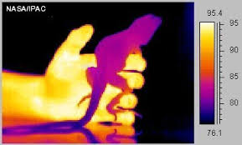
Infrared Radiation
All hot objects transfer thermal energy by infrared radiation (IR).
The hotter an object is, the more infrared radiation it gives off.
Infrared radiation is often shortened to radiation.

Slide 3
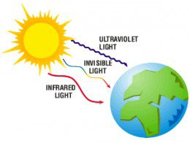
Radiation Can Travel In Space
Radiation is the only form of heat transfer that can happen in a vacuum (area with no particles) such as in space.
This is why the Sun’s infrared radiation can reach us on Earth.
Conduction and convection both involve the movement of particles and there are no particles in space!

Slide 4
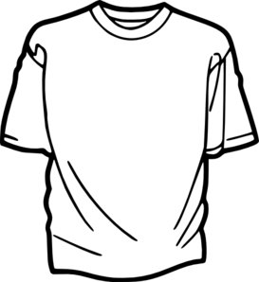
Which shirt will make you feel hotter on a sunny day? Why?

Slide 5
Radiation can be Reflected or Absorbed
What kind of material reflect radiation?
Light coloured
Shiny
What kind of materials absorb radiation?
Dark coloured
Matte (not shiny)

Slide 6
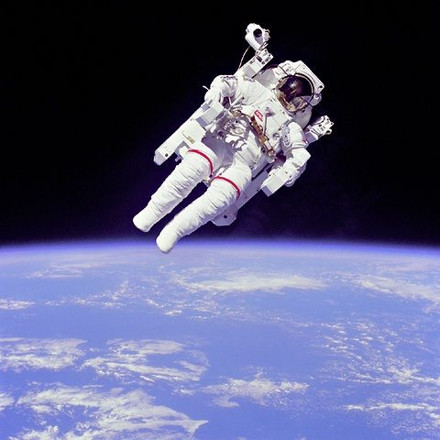
Why is the astronaut’s suit white?

Slide 7
 | Conduction | Convection | Radiation
How it works
Does it pass heat through solids?
Does it pass heat through liquids and gases?
Does it pass heat through a vacuum (empty space)?
Hot fluids rise and cold fluids sink and transfer heat energy
Infrared radiation is given off by all hot objects as a light wave
Particles bump into each other and pass heat energy
quickly
NO
YES
slowly
YES
YES
NO
NO
YES

Slide 8
comparison
http://www.bbc.co.uk/education/clips/zsqb9j6

Slide 9
Vacuum Flask Thermos

Slide 10
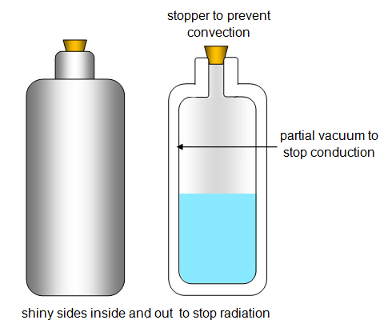
Vacuum Flask Thermos

