Slide 1
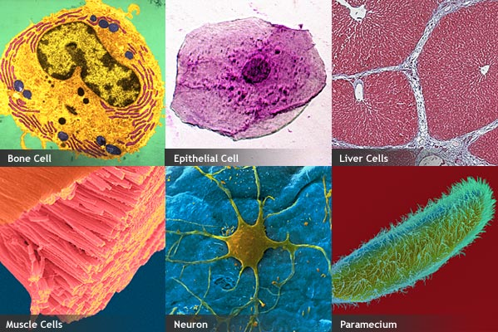
Starter: Match the cells with the correct picture. - Bone - Neuron - Liver - Muscle - Paramecium - Epithelial
1. ?
2. ?
3. ?
4. ?
5. ?
6. ?
Notes:
Animation removes boxes to reveal the answers

Slide 2
L4: Specialised Cells
Learning Objectives:
Describe how some cells may be specialised to carry out a particular function.
Sperm cells, nerve cells, and muscle cells in animals.
Root hair cells, xylem, and phloem in plants.
Explain how the structure of different types of cells relate to their function in a tissue, an organ, an organ system, or the whole organism.
Compare and contrast differentiation to become specialised cells between animal cells and plant cells.

Slide 3
Video: Cell Differentiation
Watch the video and answer the following questions:
What is cell differentiation?
Why do you think it is important?
Notes:
Video: 1.2 Cell Differentiation

Slide 4
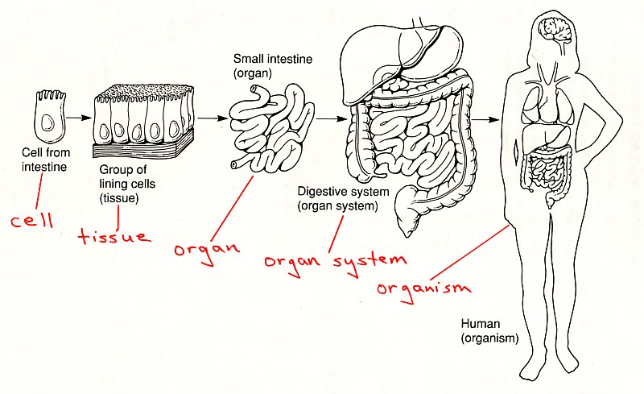
All living things are made of cells
Cell
Tissue – group of the same type of cells working together
Organ – different types of tissues working together
Organ system – different organs working together
Organism – whole living thing made of all the organ systems

Slide 5
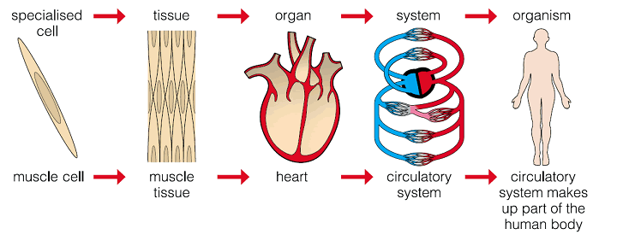
Cellular Organisation

Slide 6
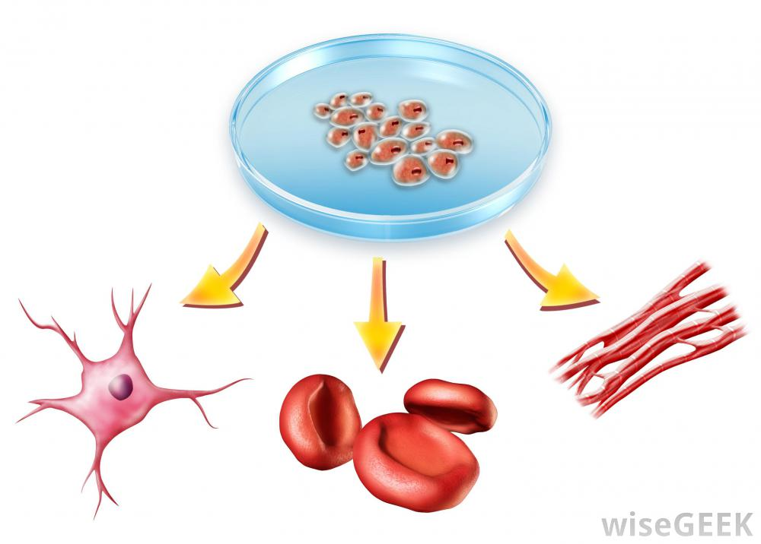
Cell Differentiation
As an organism develops, cells differentiate to form different types.
Most animal cells differentiate at an early stage, develop special features, and become specialised.
Many plant cells, however, retain the ability to differentiate throughout life.

Slide 7
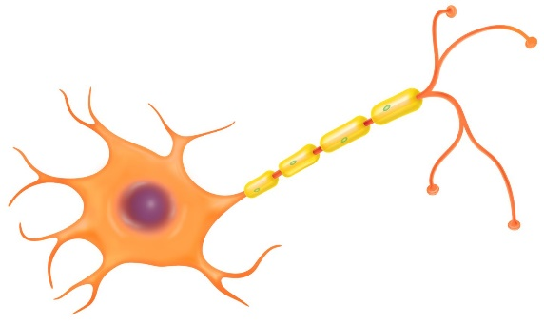
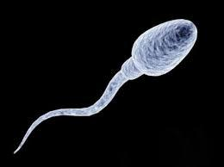
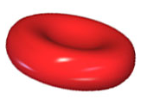
Specialised Animal Cells
Discuss with your partner:
What are these cells?
What are their functions?
How are they adapted to perform their function?
Notes:
(clockwise from top left) Sperm cell, nerve cell (neuron), muscle cell, epithelial cell, red blood cell
Short discussion, student will make notes later on

Slide 8
Specialised Cells: Plant and Animal
You are going to learn about nine different specialised cells.
Fill in the worksheet as you go along. Practice writing concise notes!
Animal Cells
Sperm Cell
Nerve Cell
Red Blood Cell
Muscle Cell
Epithelial Cell
Plant Cells
6. Root hair cell
7. Xylem cell
8. Phloem cell
9. Leaf cell
Notes:
Can be done as a jigsaw with groups of three, each student learns about three different cells and shares with the rest of group.
Or, students rotate to different stations or posters passed around the room.
Encourage students to summarise as they will try to write everything, give a suitable time limit.

